Slide 1
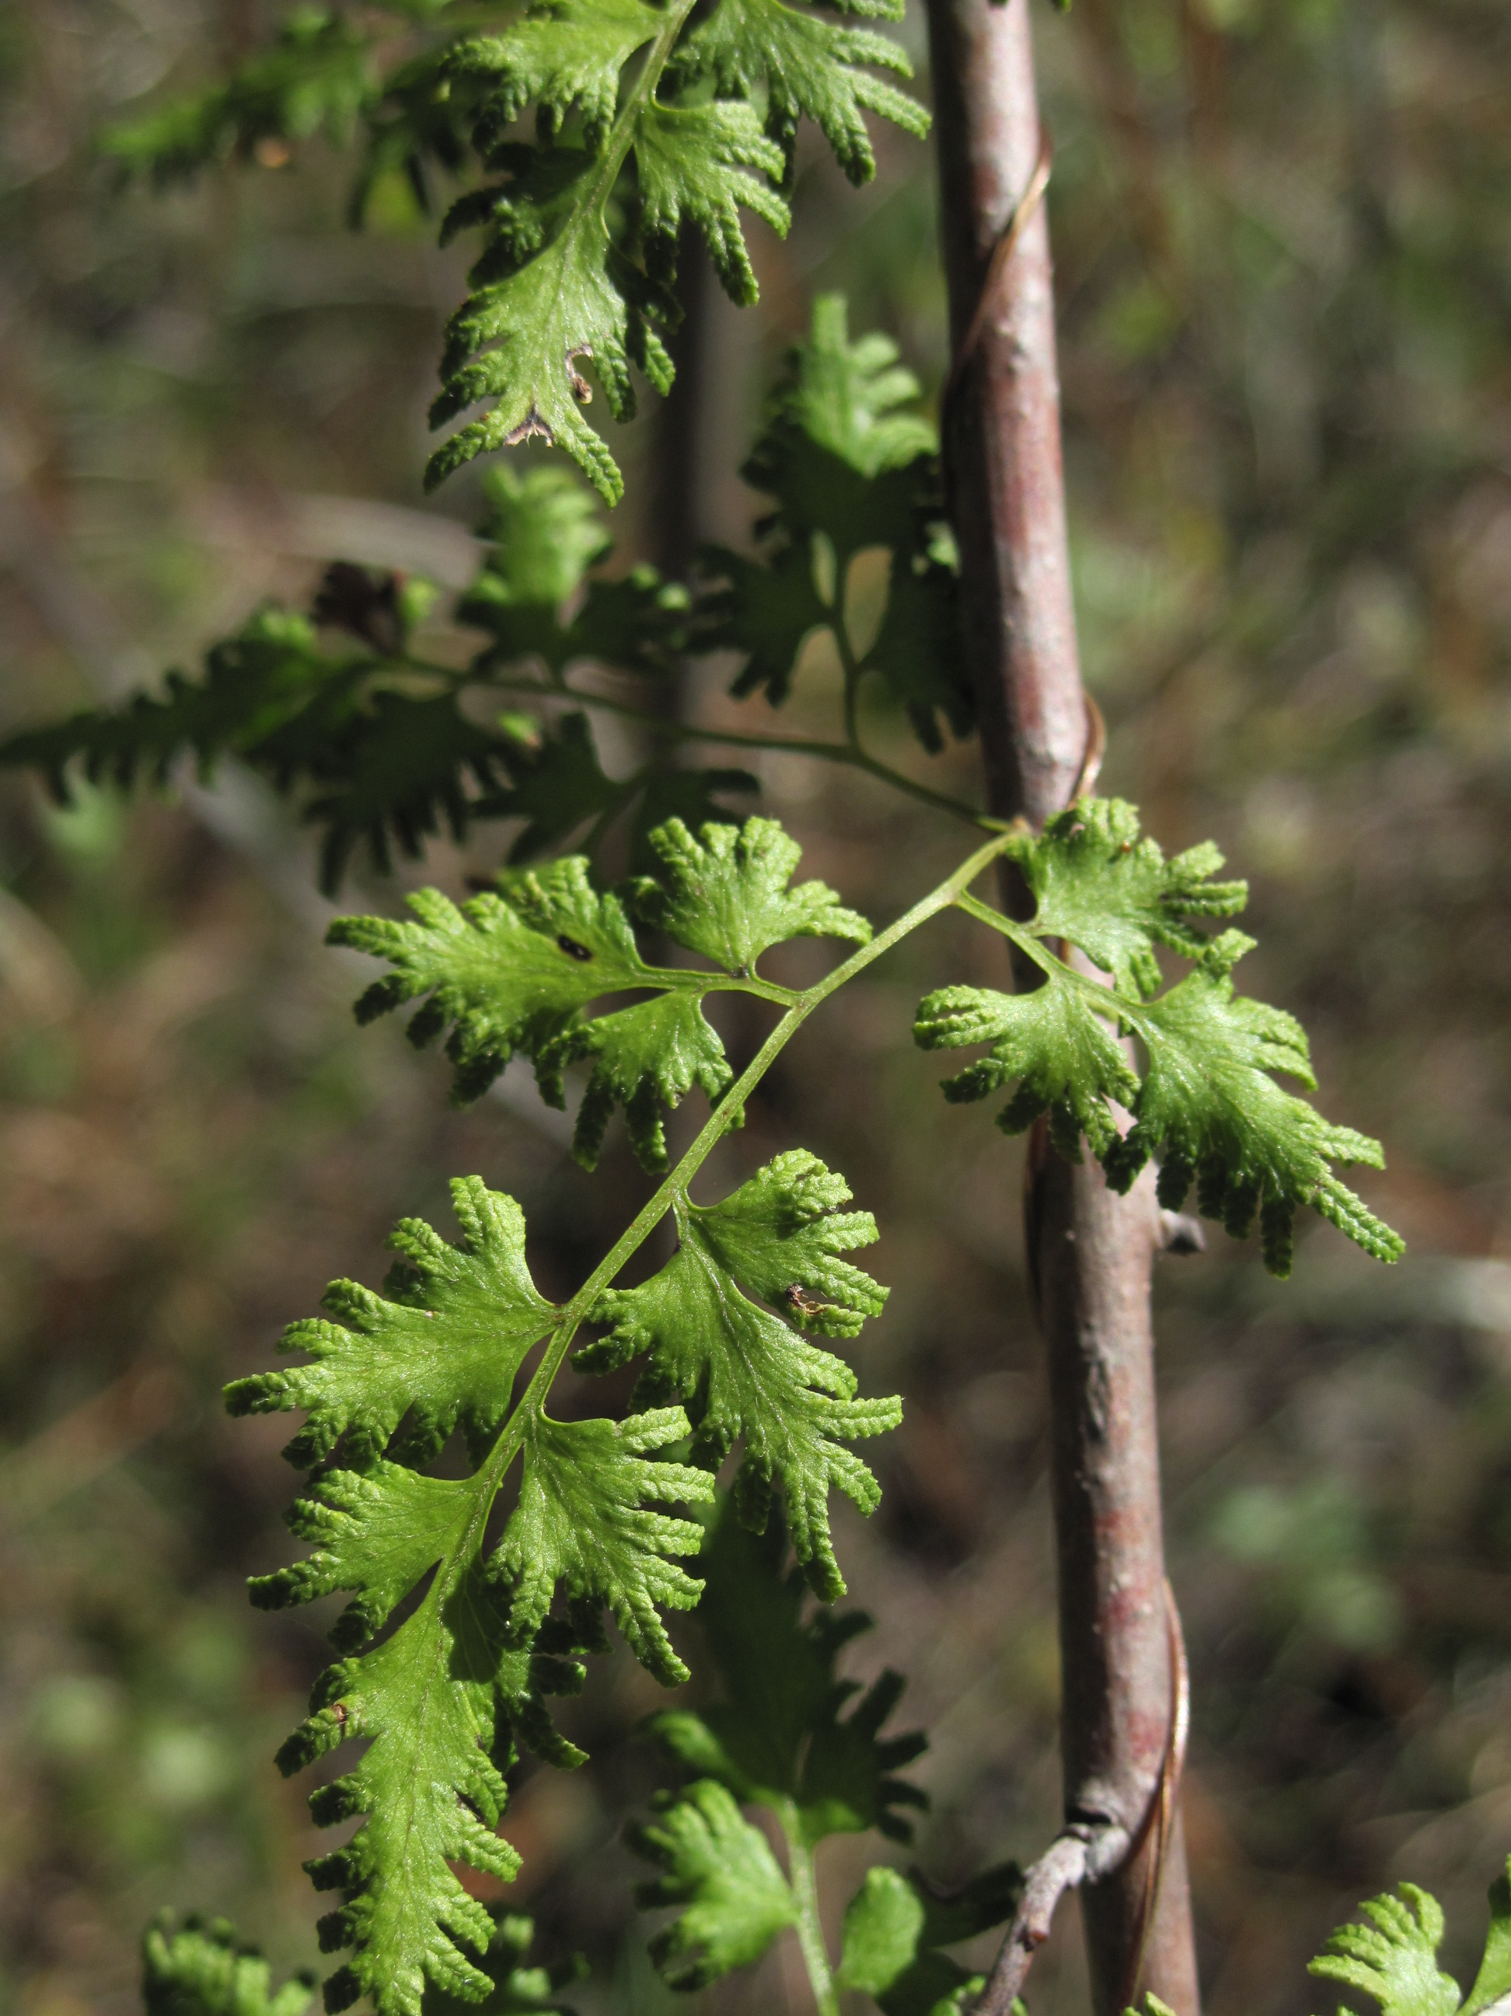
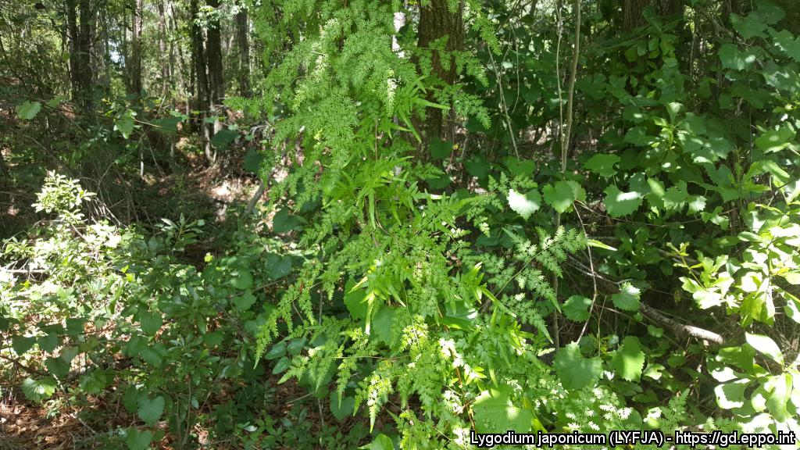
BE AWARE!
Lygodium japonicum
A threat to the EPPO region
How to recognize it? Can you help us?
L. japonicum is a rhizomatous vine, with a twining rachis climbing to 30 m. Below-ground rhizomes are creeping, with black to reddish-brown hairs. Stipes are spaced to 1 cm apart on rhizome. Stems remain underground, but send up long vine-like indeterminate fronds that have numerous compound pinnae. Pinnae on frondlets are triangular to deltoid-shaped, with short stalks, about 3-5 cm long. The mid-ribs (costae) have scattered hairs, and veins and pinnae surfaces are typically glabrous. Each pinnule on the pinnae is pinnate to lobed and stalked often with dissected terminal lobes. Pinnules are pubescent below and margins are variously dentate.
Because Lygodium japonicum has the potential to impact the habitats it invades, including native plant species and important ecosystem services, it is important to report any sightings to plant protection authorities. Early detection will allow a rapid implementation of appropriate measures against Lygodium japonicum.
If you see Lygodium japonicum:
Check the identification of the species with other vine like species.
Whenever possible, take a picture of the plant, record exact location, date and habitat where it was observed.
Contact us.
Contact us
Image: Kimberly Bohn, EPPO Global Database
Your contact details
Your institution name
Logo
Image: Steve Miller, EPPO Global Database
This leaflet has been prepared within the LIFE funded project LIFE15 PRE FR 001 in collaboration with the NERC Centre for Ecology and Hydrology
Prepared in collaboration with EPPO – www.eppo.int

Slide 2
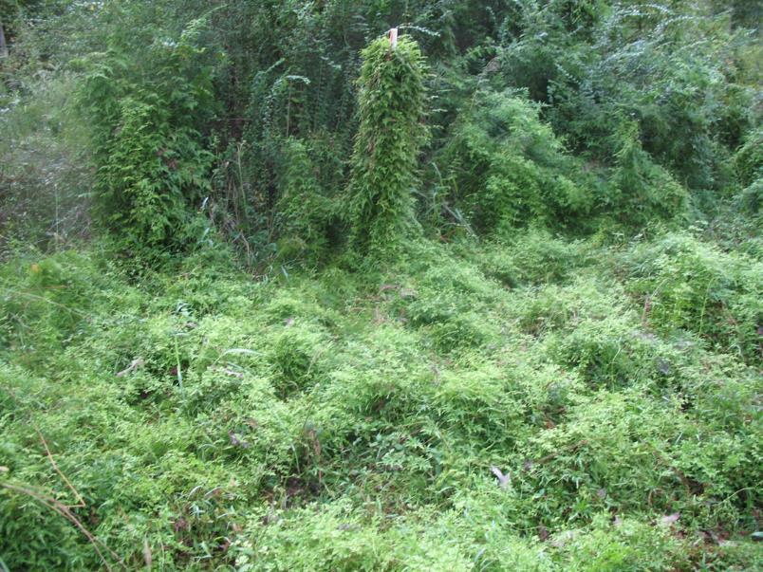
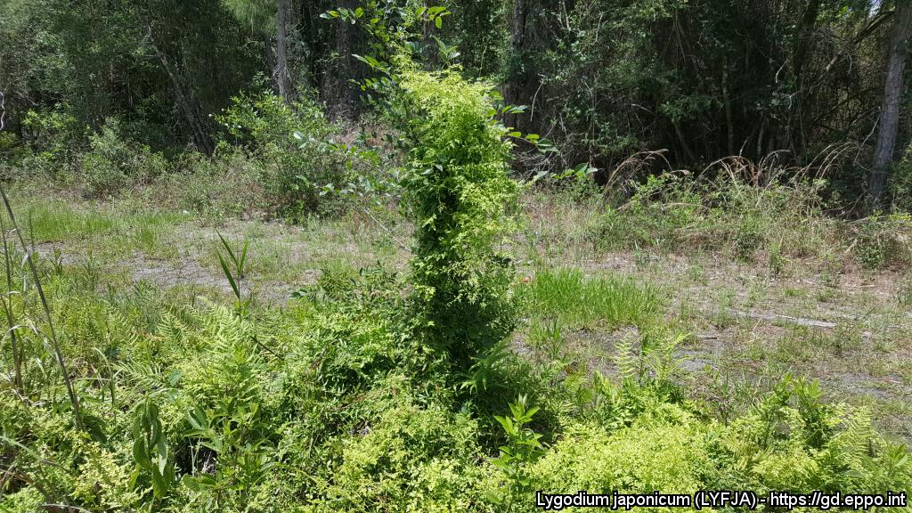
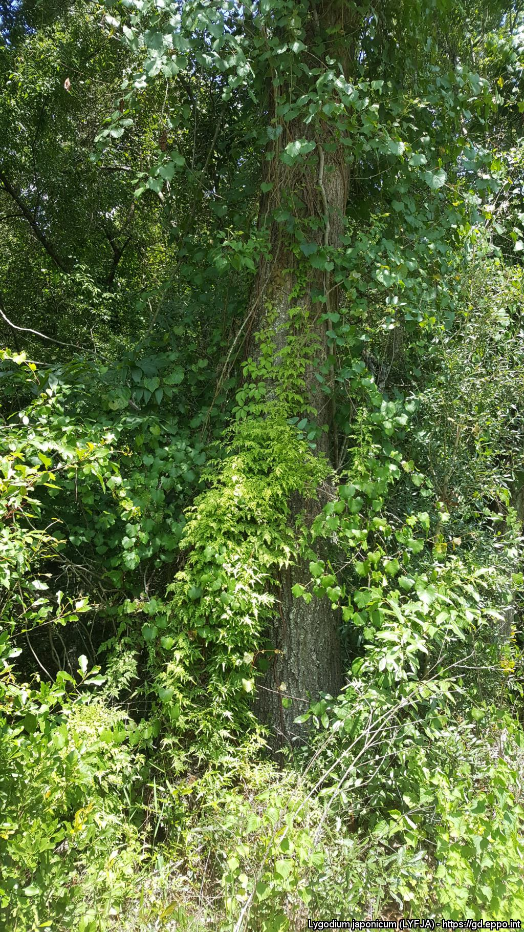
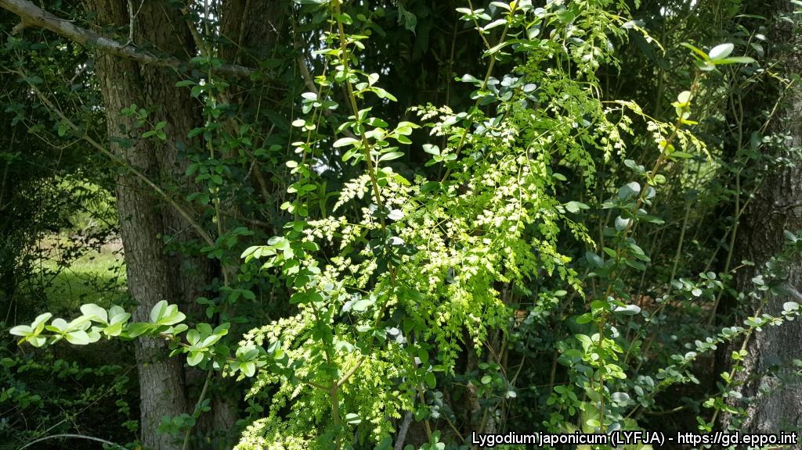
What is L. japonicum? What is the problem? Where is it found?
Lygodium japonicum is a broadleaved, herbaceous perennial climbing fern native to Asia. Lygodium japonicum is a true fern that reproduces by spores (homosporous fern), which then germinate and develop through gametophyte and sporophyte stages.
As Lygodium japonicum is considered to be a threat to native biodiversity, its appearance in new areas should be reported immediately to us.
The pathway plants for planting is considered the main entry pathway into the EPPO region.
In North America, L. japonicum was introduced as an ornamental plant. In the Netherlands gametophytes have been detected in growing media of bonsai plants imported from China. L. japonicum can grow in sun or shade, damp, disturbed or undisturbed areas in the US. It can grow so dense that it forms a living ‘wall’, leading to the elimination of seedlings and other native vegetation.
The species has been shown to reduce native plant species richness and diversity.
The species is currently absent from the natural environment in the EPPO region.
In its invasive range, in particular in North America, it invades a diverse range of habitats including habitats floodplain forests, swamps, marshes, river and stream banks and upland woodlands.
Image: Kimberly Bohn, EPPO Global Database
Above-ground foliage of L. japonicum dies back after frost and temperatures at or near 0° C however belowground root and rhizomes will remain dormant through winter and resprout when temperatures reach at least 18 °C.
In North Florida, spore development begins around late June to July, become mature in late August, and disperse throughout mid-September through late October.
Image: Steve Miller, EPPO Global Database
Image: Steve Miller, EPPO Global Database

