Slide 1

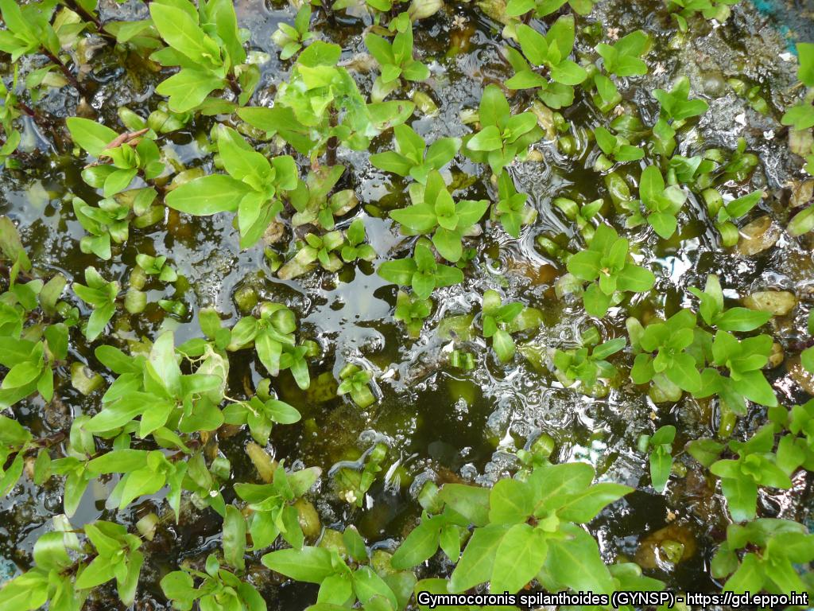
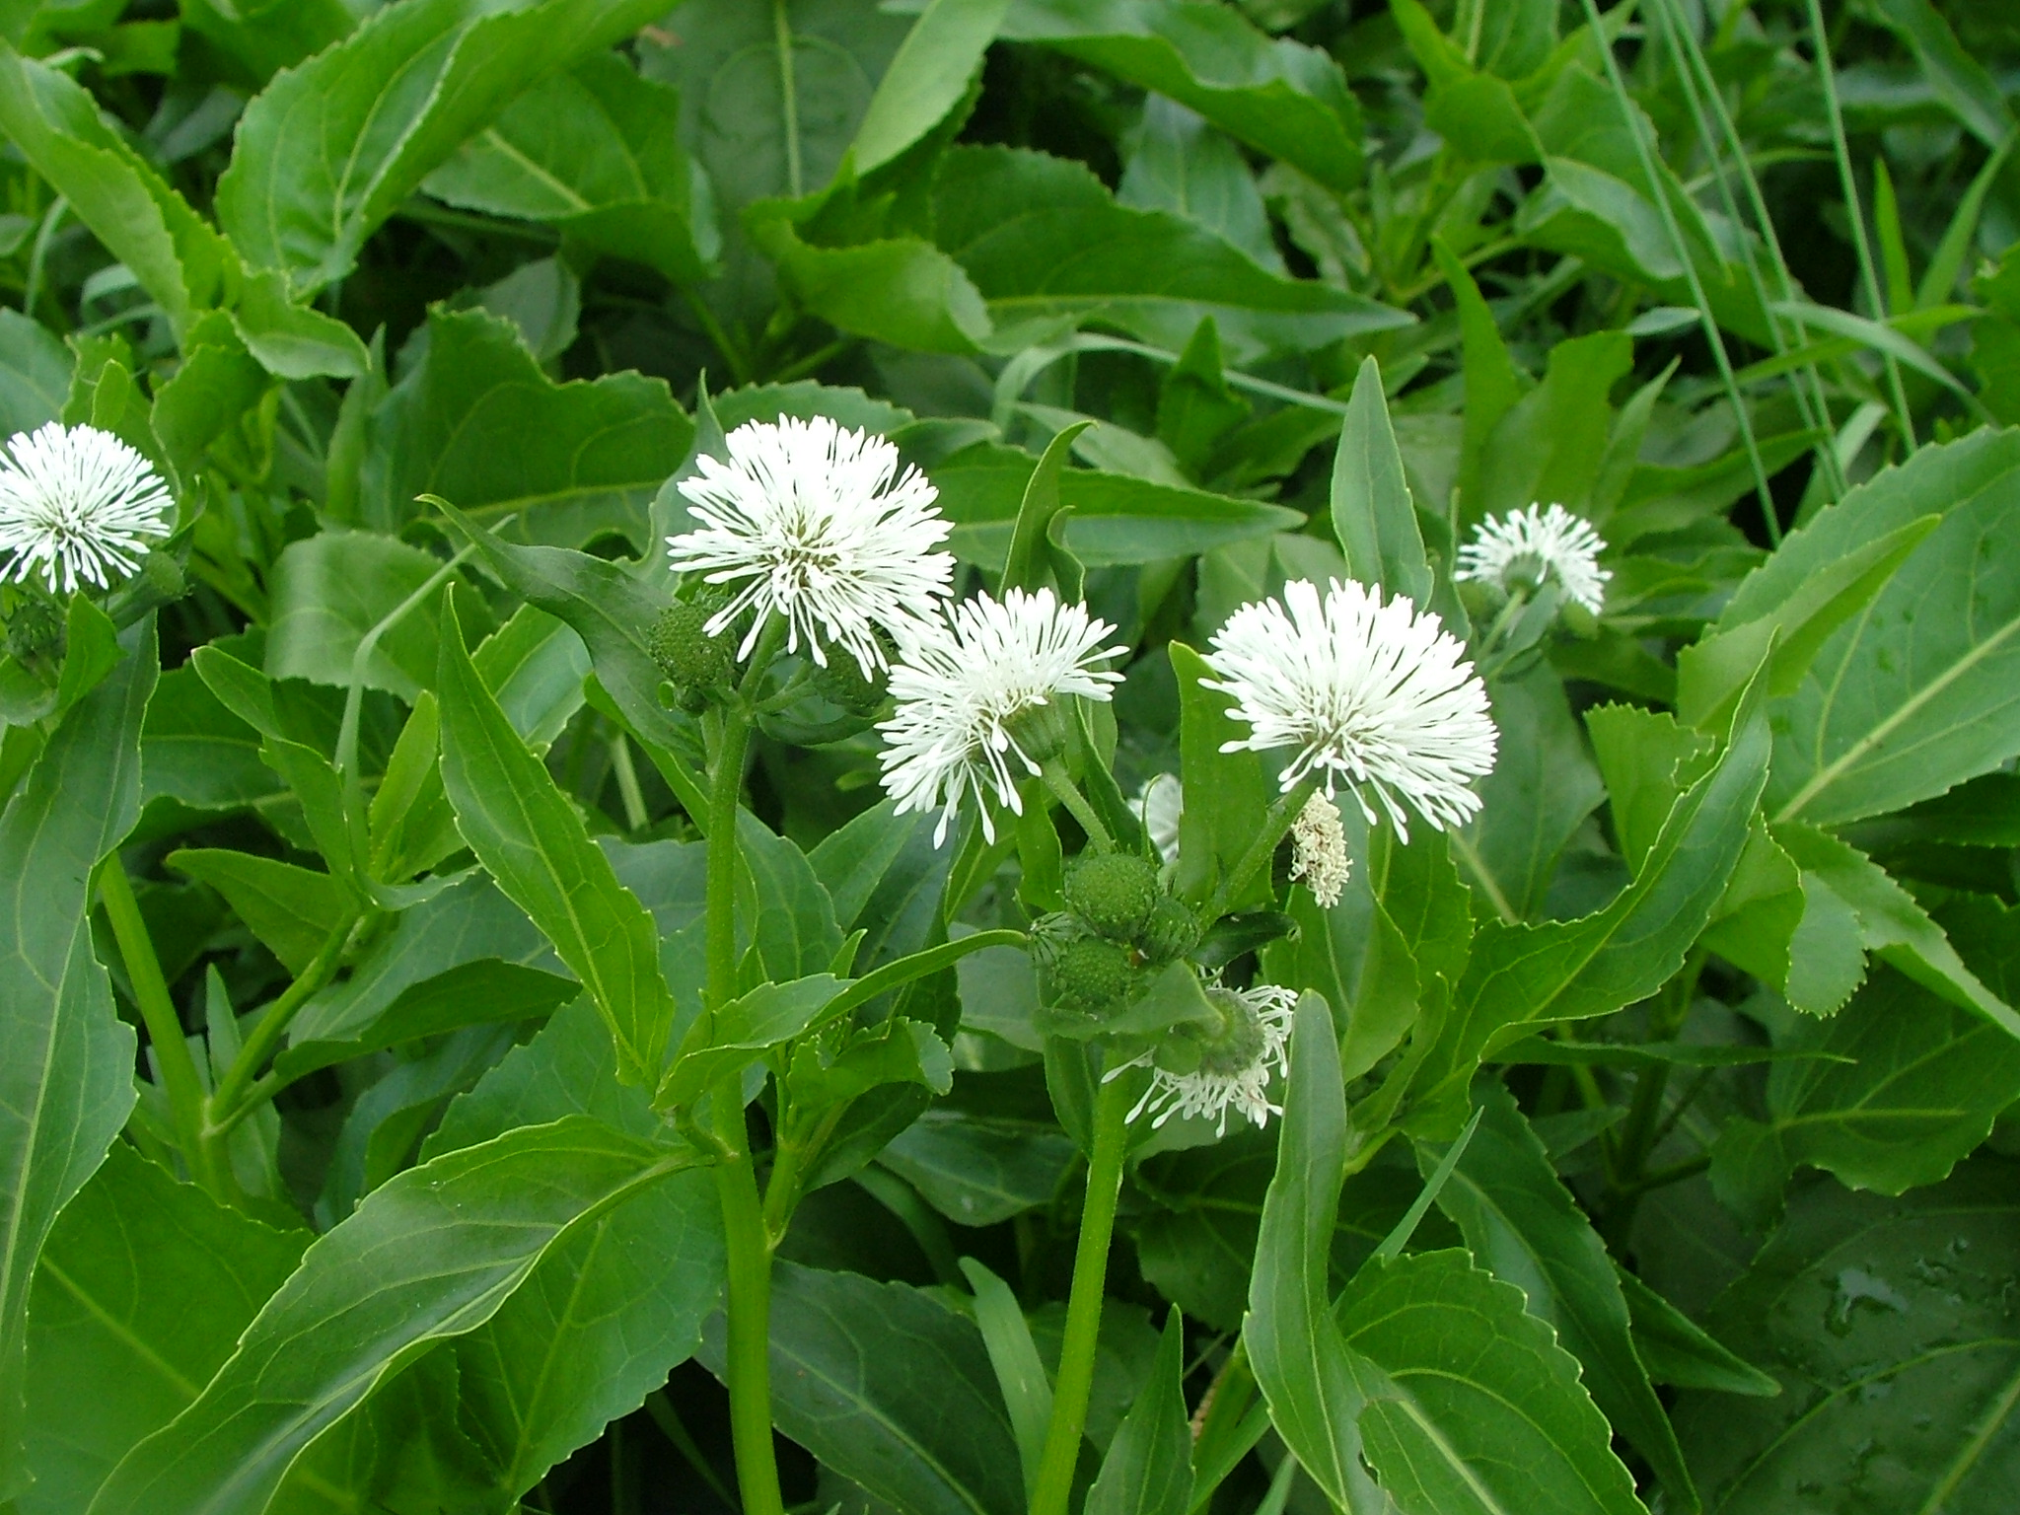
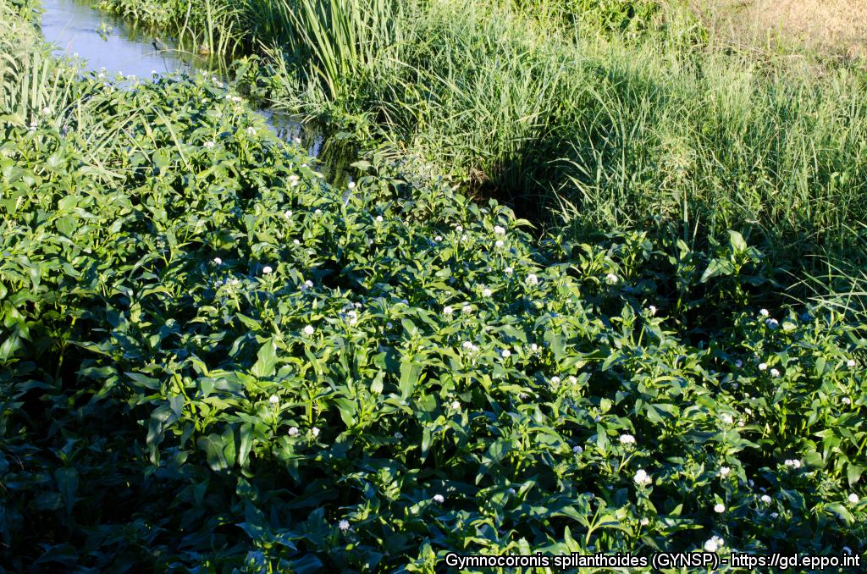



^{BE AWARE!}
^{Gymnocoronis spilanthoides}
A threat to waterways in the EPPO region
Image: Paul Champion (National Institute of Water and Atmospheric Research Ltd.) EPPO Global database, https:\\gd.eppo.int
What is it?
Gymnocoronis spilanthoides is an aquatic water plant, native to South America and is an EPPO A2 pest, recommended for regulation as a quarantine pest. In the EPPO region, G. spilanthoides is recorded from Hungary and Italy. Within its introduced range, G. spilanthoides grows in wetlands, particularly degraded waterways forming marginal clumps on the edge of slow flowing or still water bodies, also forming dense sprawling floating mats in rivers (including tidally influenced areas) and reservoirs, irrigation channels, ponds, lakes, canals and ditches. It also grows in marshes and swamps, especially where nutrient enriched. G. spilanthoides established but did not persist in a rice field in Italy.
Plants for planting is considered the main pathway for entry into the EPPO region. From this pathway, individual plants can be transferred to suitable habitats through either intentional introductions into the environment or unintentionally through the disposal of aquarium material. Although at an early stage of establishment in the EPPO region, G. spilanthoides, like other aquatic invasive plants can threaten biodiversity and causes other environmental damage.
What's the problem?
Flowers of
G. spilanthoides
G. spilanthoides encroaching into
a rice field in Italy
Image: Paul Champion (National Institute of Water and Atmospheric Research Ltd.) EPPO Global database, https:\\gd.eppo.int
Image: Claudio Ballerini: EPPO Global database, https:\\gd.eppo.int
Contact us!
Your contact details, logos, links, QR codes …
Learn more about Gymnocoronis spilanthoides: https://gd.eppo.int
This poster has been prepared within the LIFE funded project LIFE15 PRE FR 001

