Slide 1
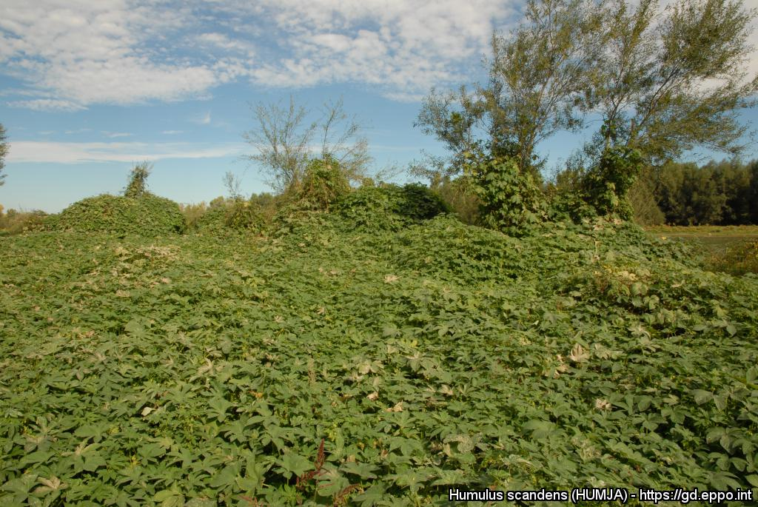
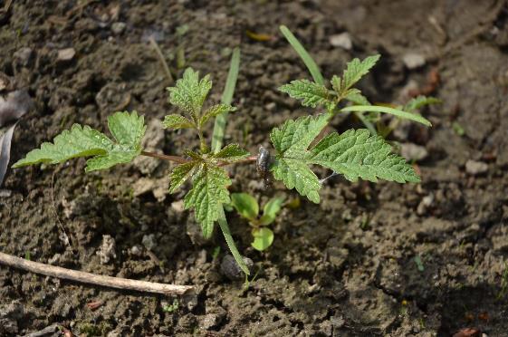
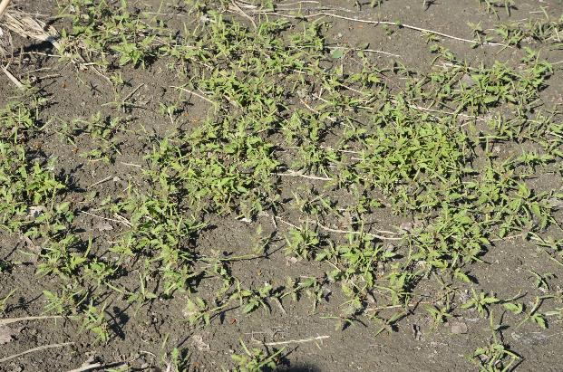
^{BE AWARE!}
^{Humulus scandens}
^{A threat to the EPPO region}
Image: Guillaume Fried (ANSES) EPPO Global database, https:\\gd.eppo.int
What is it?
Humulus scandens is a herbaceous annual vine native to Asia. The species is recorded in the EPPO region from Austria, Belgium, Czech Republic, France, Germany, Italy, Hungary, Romania, Serbia, Slovakia, Slovenia, Switzerland, Ukraine. In both its native range and its introduced range, H. scandens is a plant of riverside, particularly on the loose, bare surfaces of alluvial bars formed by river and stream-sides by temporary floods. The plant can also invade ruderal areas under climates with no dry seasons.
The pathway plants for planting is considered the main entry pathway into the EPPO region. H. scandens has been introduced in Europe as an ornamental species for growing over trellises, arbours or fences. It can outcompete native species and is considered as a transformer species, that threatens plant communities. Dense mats of the species can persist along riverbanks for several years. Ecosystem functioning (for example, reduced species richness and decrease functional richness) is altered when the species invade riparian habitats.
What's the problem?
A seedling of H. scandens
Massive seedling emergence in early spring
Image: Guillaume Fried (ANSES) EPPO Global database, https:\\gd.eppo.int
Image: Guillaume Fried (ANSES) EPPO Global database, https:\\gd.eppo.int
Contact us!
Your contact details, logos, links, QR codes …
Learn more about Humulus scandens: https://gd.eppo.int
This poster has been prepared within the LIFE funded project LIFE15 PRE FR 001

