Slide 1
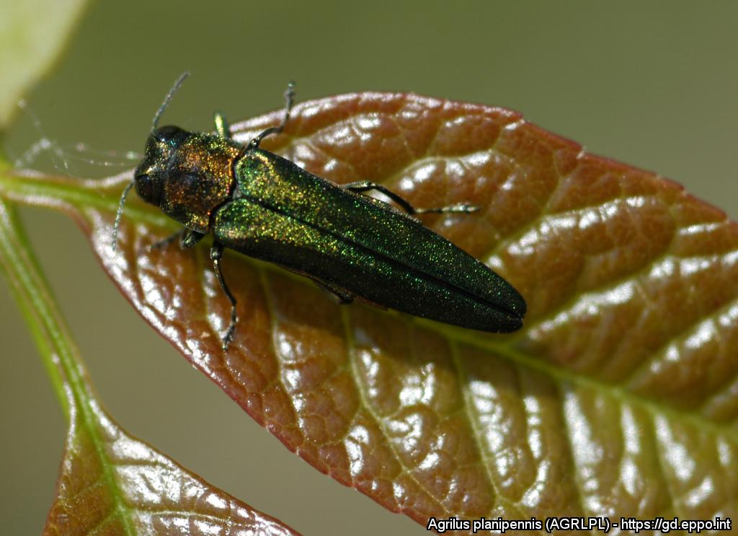
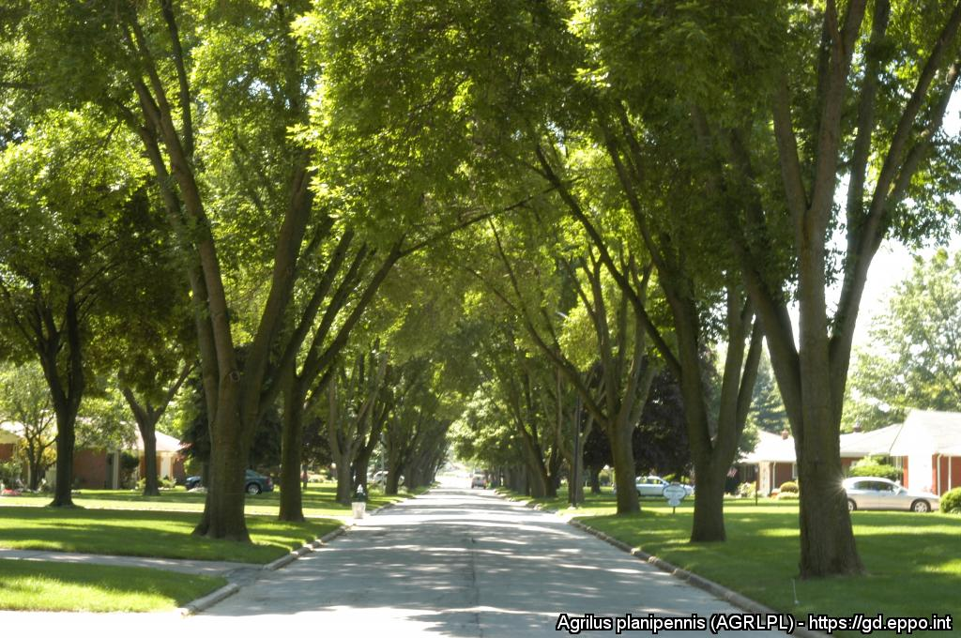
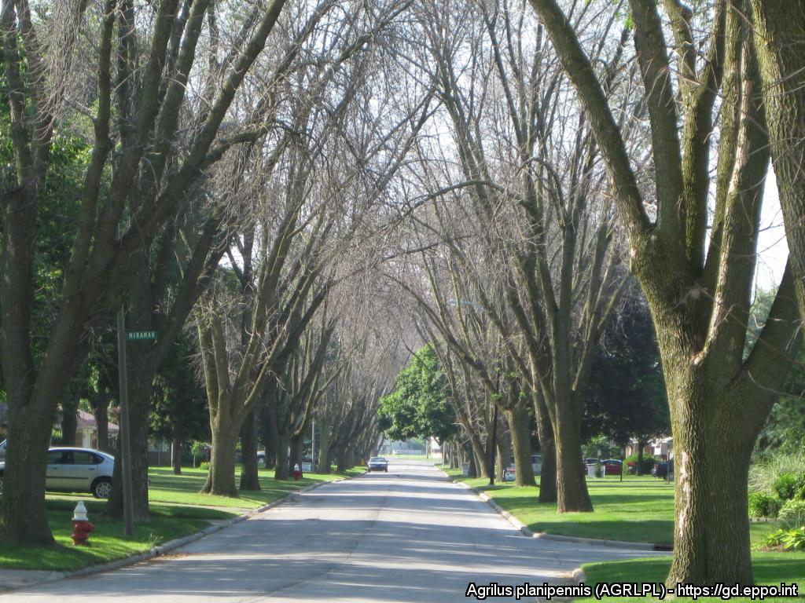
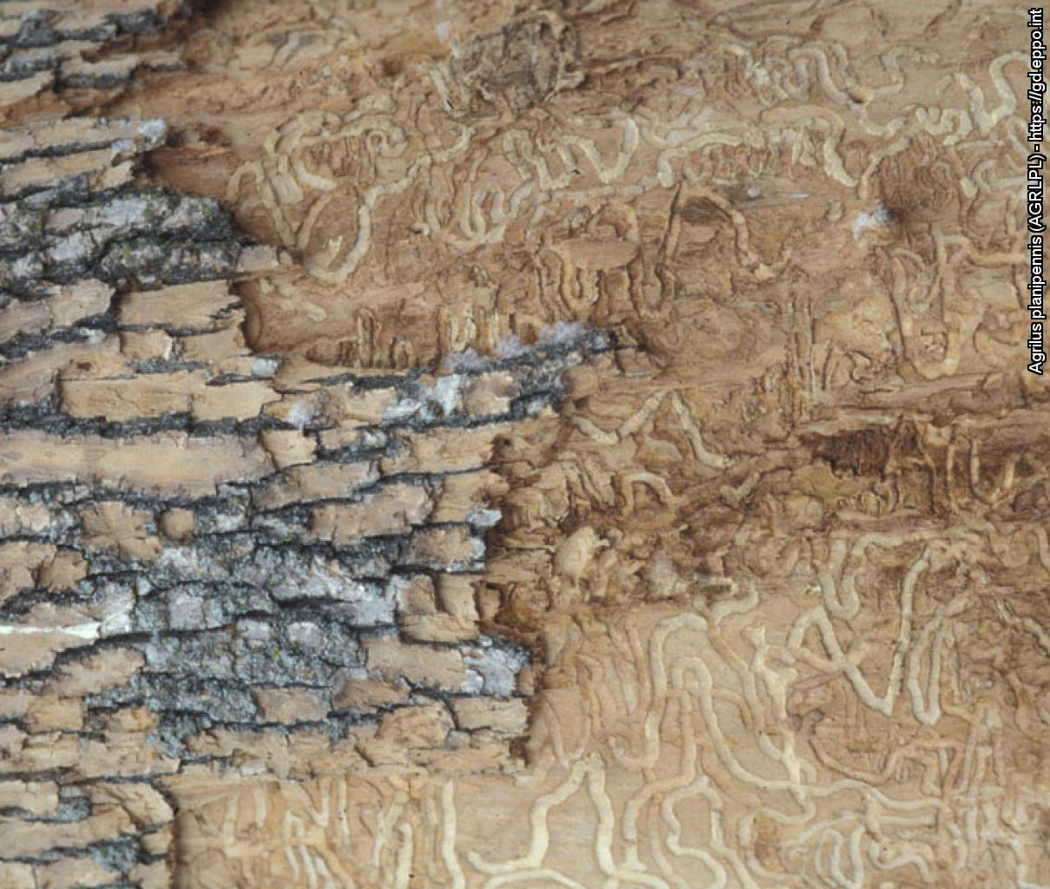
^{HELP US STOP THIS PEST!}
^{Emerald ash borer}
^{A threat to ash trees}
All Images: Daniel A. Herms, The Ohio State University (US). EPPO Global Database, https://gd.eppo.int
What is it?
The emerald ash borer (Agrilus planipennis - Coleoptera: Buprestidae) originates from Asia but has been inadvertently introduced into other parts of the world (e.g. Canada and USA) where it has killed millions of ash trees. In the mid-2000s, it was discovered in the European part of Russia, near Moscow. As its spread is threatening ash trees in our forests and urban environments, it is important to detect it as early as possible.
Damage
Before
After
Contact us !
Contact us!
Your contact details, logos, links, QR codes …
^{Learn more about} ^{the} ^{emerald} ^{ash} ^{borer: www.your.website}
This poster has been prepared in collaboration with EPPO (www.eppo.int)

