Slide 1
EPPO Guides on Information and Communication: Available Materials and Examples of Innovative Ways to Communicate
Katrin Kaminski¹⁾ and Hans Meerman²⁾
¹⁾ Julius Kühn-Institut (JKI), Federal Research Center for Cultivated Plants
Institute for National and International Plant Health
²⁾ Netherlands Food and Consumer Product Safety Authority (NVWA)
EPPO Workshop for Inspectors: Innovative Strategies for Phytosanitary Inspections
Session 4: Information and Communication

Slide 2


EPPO Guides on Information and Communication
Why is good communication essential?
To involve the public and operators in plant health issues
To encourage best practice in business and trading operations and make trade safer
To encourage good practice of private persons (travellers, gardeners, etc.) to avoid pest introduction and spread
To encourage and facilitate early reporting of findings enabling quick response
To create a large number of ‚citizen scientists‘ and therewith improve early finding
To explain measures being taken
To improve understanding and acceptance of preventive and control measures
To build trust and understanding
To increase eradication success of pests
Pixabay, 28 October 2025
Katrin Kaminski and Hans Meerman | EPPO Workshop | 20.11.2025

Slide 3
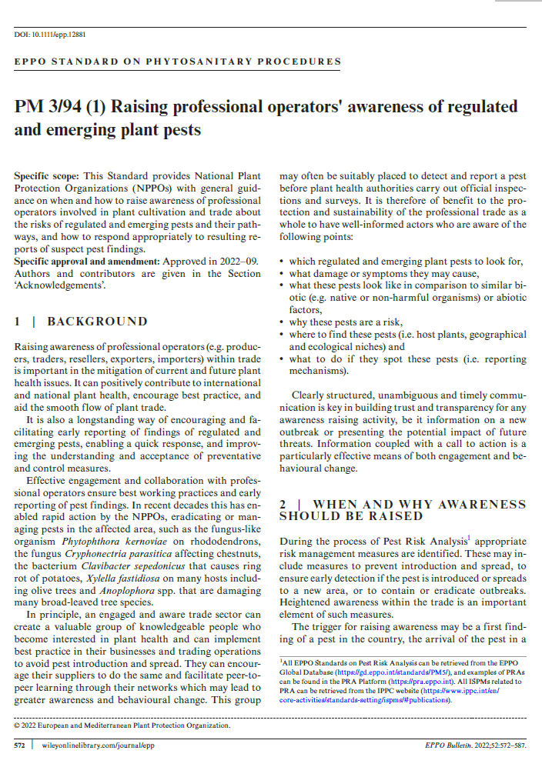
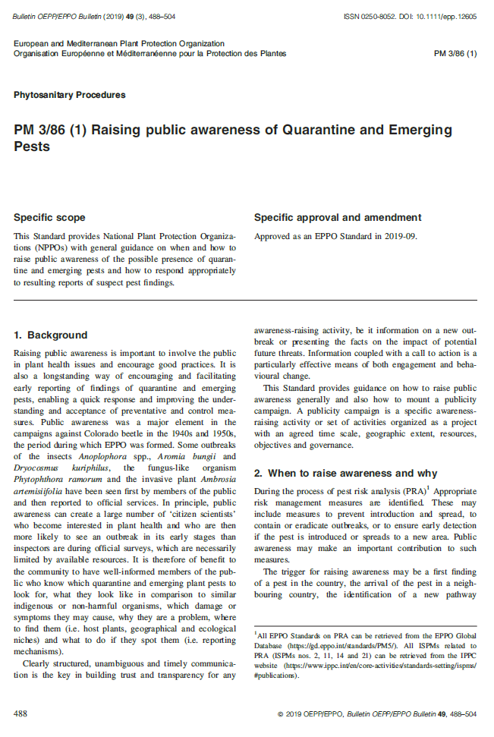
EPPO Guides on Information and Communication
EPPO Standard PM 3/86 (1) Raising public awareness of quarantine and emerging pests (published 2019)
EPPO Standard PM 3/94 (1) Raising professional operators‘ awareness of regulated and emerging pests (published in 2022)
Both include general principles and
specific points to consider
Communication should be:
Clearly structured
Unambiguous
Timely
Katrin Kaminski and Hans Meerman | EPPO Workshop | 20.11.2025

Slide 4

EPPO Guides on Information and Communication
When to communicate?
Preventive - permanent or in the form of a campaign
  First finding of the pest
  Identification of a new pathway
  Implementation of new phytosanitary requirements
  Allways e.g. passenger information
In case of outbreaks
Pixabay, 28 October 2025
Katrin Kaminski and Hans Meerman | EPPO Workshop | 20.11.2025

Slide 5

EPPO Guides on Information and Communication
Target audience and examples of subgroups
Audience – points to consider:
Identification of key audiences
Information consistent for all audiences
Targeted
Consider age demographic, availability, willingness to help, enthusiasm, ability
Examples of possible subgroups of public and audiences:
Scientists
Tree nurseries
Traders
Specialist amateur groups
Travellers
School children and their families
Politicians and senior officials
Media and journalists
Etc.
Pixabay, 28 October 2025
Katrin Kaminski and Hans Meerman | EPPO Workshop | 20.11.2025

Slide 6
EPPO Guides on Information and Communication
Some key factors for awareness campaigns
addressing pests and positive contribution to risk management objectives
Nature and magnitude of the risk (e.g. risk to gardeners or street trees)
Likely pathways of entry and spread / location of outbreaks (outbreaks likely to be found first in private gardens, etc.)
Ease of detection and ease of distinguishing the pests from other symptoms
Geographical targeting (national, regional, demarcated areas, etc.) dependent on the main purpose
Collaboration with other administrations (local, national) or stakeholders, other sectors to be considered
Legal constraints: legal authority, liability and constraints need to be clear to all parties concerned before members of the public are asked to carry out actions (e.g. access to land)
Costs/benefits of the awareness-raising activities
Resources for awareness raising activities and to respond to resulting reports (human, finances, technical, information)
Katrin Kaminski and Hans Meerman | EPPO Workshop | 20.11.2025

Slide 7


EPPO Guides on Information and Communication
Factors suggesting caution about an awareness raising activity
Pests and symptoms are difficult to spot
Pest easily confused with those from other causes
High risk of action being taken inappropriately against ‚lookalikes‘
High risk of negative impact to trade if messages are confusing or unclear
High risk of creating confusion among operators involved
High risk of adverse media coverage
Impact to business
Public awareness when low public role in compliance with measures
Public wareness when outbreaks likely to be seen first in commercial production
Pixabay, 28 October 2025
Katrin Kaminski and Hans Meerman | EPPO Workshop | 20.11.2025

Slide 8
EPPO Guides on Information and Communication
„Risks“ when engaging non-experts in activities - dealing with feedback
Increased pest reporting (simple reporting systems needed)
Inaccurate pest reports can take up resources
Questions about the pest: FAQs can help
Overloading of information from keen individuals/groups
Health and well-being of persons looking for the pests and Land-owner risks
Competing activities
Raising expectations of effective action to control the pest where this may not be possible
Political sensitivities
Effects on trade (data protection and freedom of information)
Inappropriate media reports
Katrin Kaminski and Hans Meerman | EPPO Workshop | 20.11.2025

Slide 9

EPPO Guides on Information and Communication
Practical ways to raise public awareness
Message (well thought through, clear, adapted to the target audience, short messages)
Pre-prepared resources (literature survey before: available Apps, webpages, databases)
Images (high-quality images)
Videos (video-sharing platforms, title, 30 sec.-2 min.)
Posters (placed at strategic spots) and leaflets, postcards, …
All leaflets should contain guidance on what to do if a pest is found!
Citizen science projects
Media and social media (press releases, mailing lists, publication on social media)
Display equipment for special events like fairs, exhibitions, shows, open days
(pop-up displays, pest models)
Verbal presentations
Activity list and evaluation (plan, time schedule, evaluation method)
Pixabay, 28 October 2025
Standards provide format what needs to be considered when initiating an activity
Katrin Kaminski and Hans Meerman | EPPO Workshop | 20.11.2025

Slide 10

EPPO Guides on Information and Communication
EPPO Media Platform on Communication Material
idea exchange
Released in 2022
Moderated by the EPPO secretariat
NPPOs of EPPO member countries are invited to share communication material prepared during their communication campaigns on plant health (e.g. leaflets, photos, videos, posters)
22 countries, EFSA and IPPC registered for posting campaigns
In 2025, 18 new campaigns added
Some links to campaigns added to EPPO GD
Visitor worldwide (220 visits a month)
Link can be found on EPPO Website / Resources / Databases
Katrin Kaminski and Hans Meerman | EPPO Workshop | 20.11.2025

Slide 11
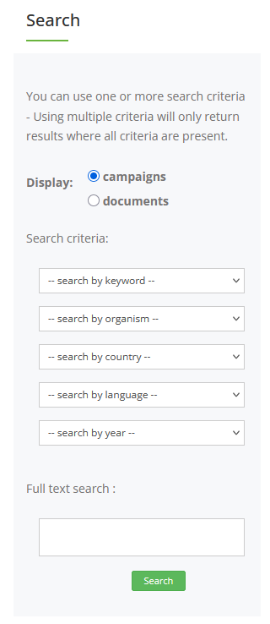
EPPO Guides on Information and Communication
EPPO Media Platform on Communication Material
Content can be searched by
Keyword (audio, flyer, postcard, insect model, social media etc.)
Organism
Country
Language
Year (oldest entry from 2000)
and full text search
Katrin Kaminski and Hans Meerman | EPPO Workshop | 20.11.2025

Slide 12
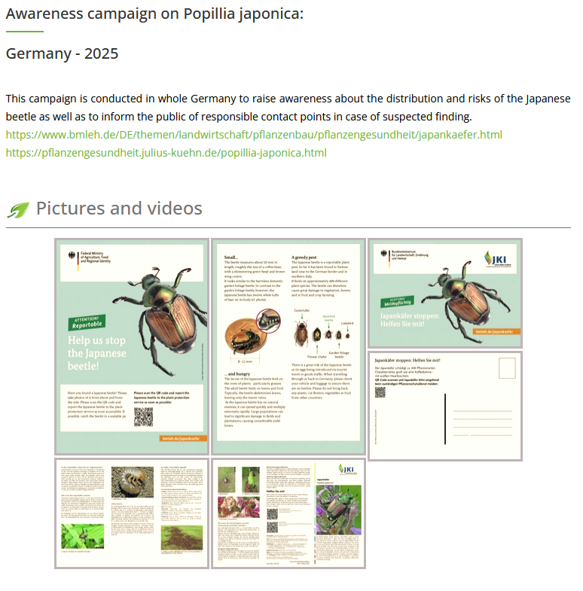
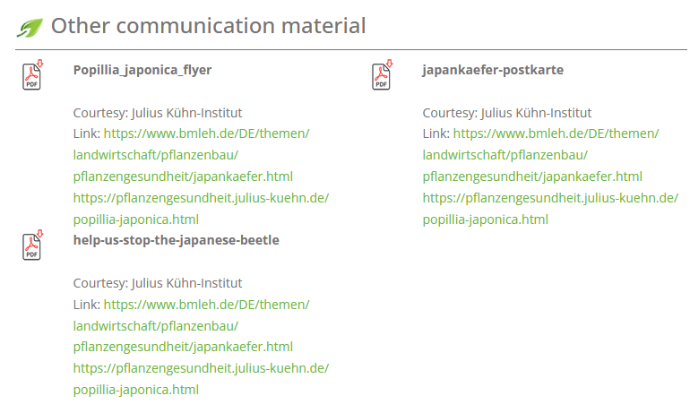
EPPO Guides on Information and Communication
EPPO Media Platform on Communication Material - Examples
Katrin Kaminski and Hans Meerman | EPPO Workshop | 20.11.2025

Slide 13
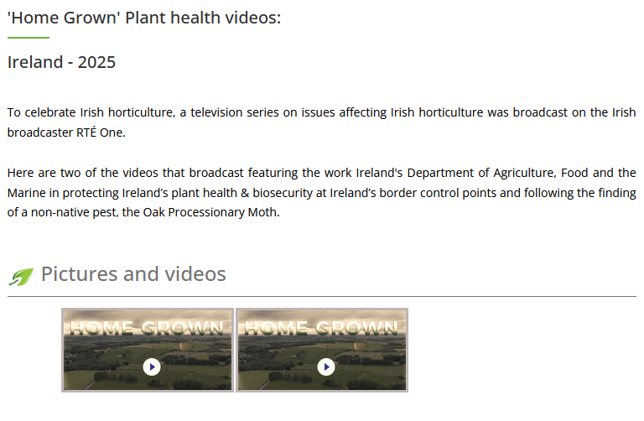
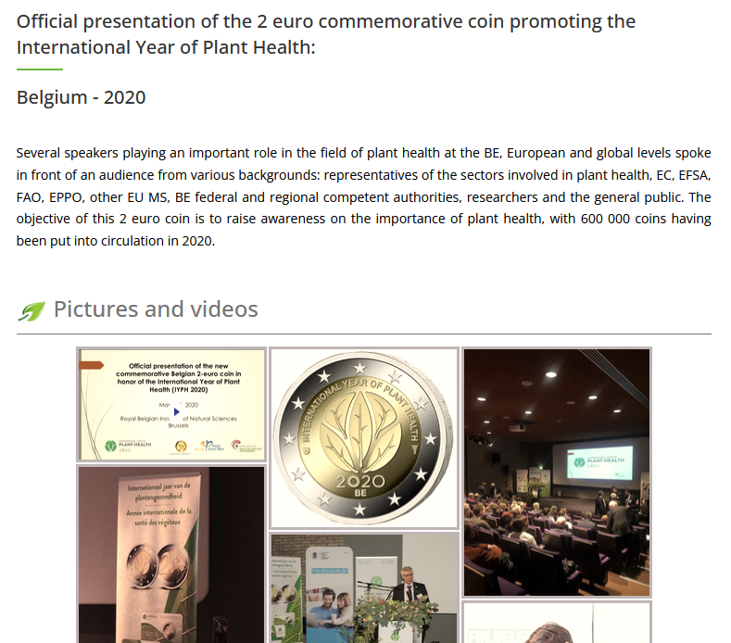
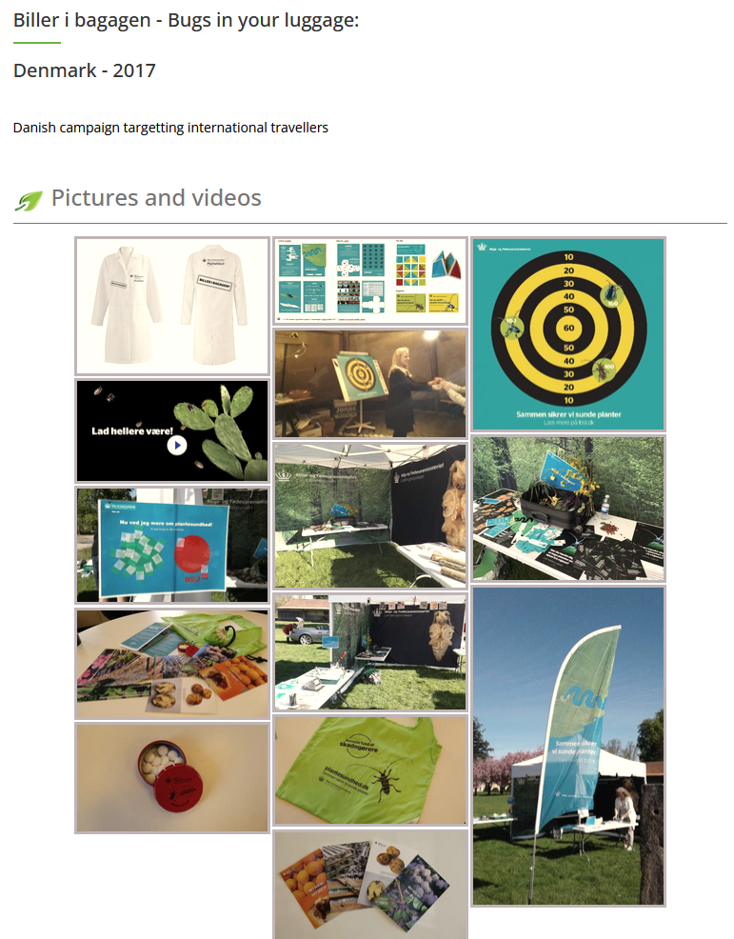
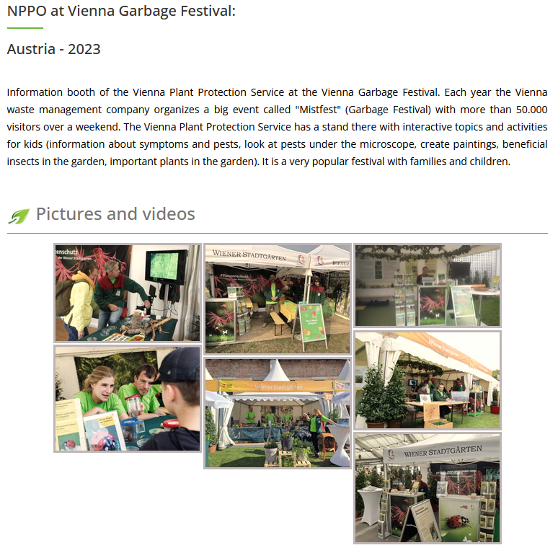
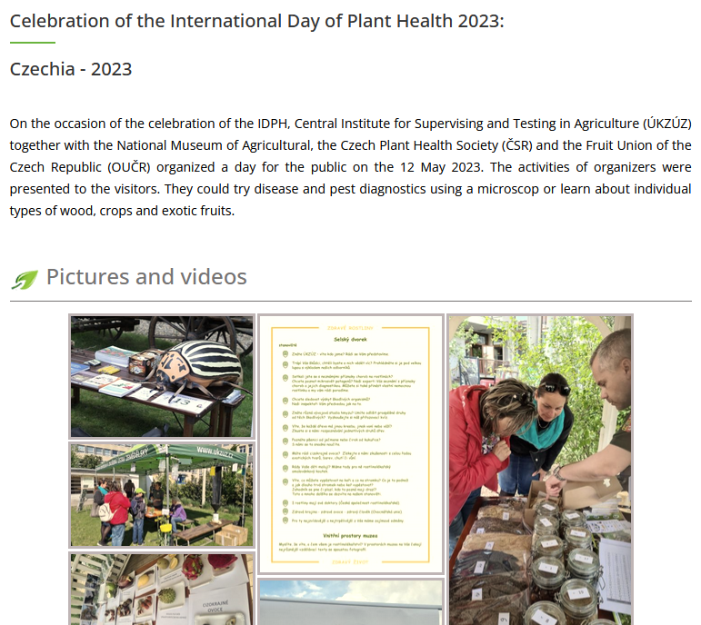
EPPO Guides on Information and Communication
EPPO Media Platform on Communication Material - Examples
Katrin Kaminski and Hans Meerman | EPPO Workshop | 20.11.2025

Slide 14

Thank you for your attention

