Slide 1



Use of loop mediated isothermal amplification (LAMP) at border control posts
Ben Walpole

Slide 2
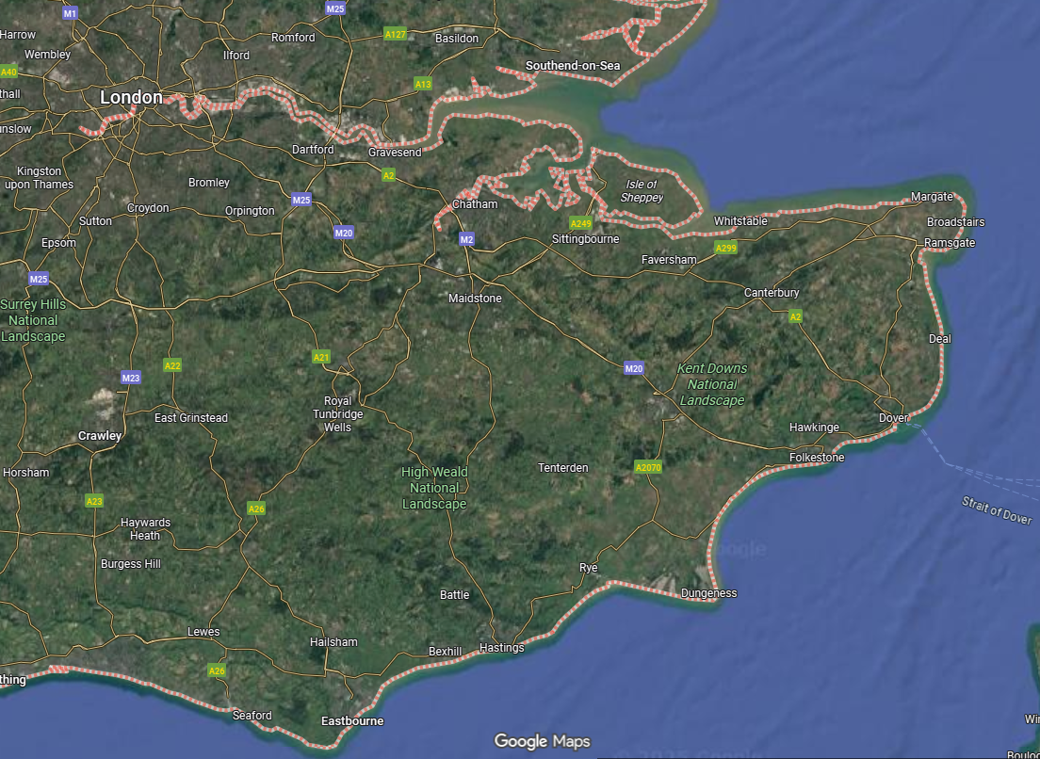


Introduction
Who am I?
Where do I work?

Slide 3
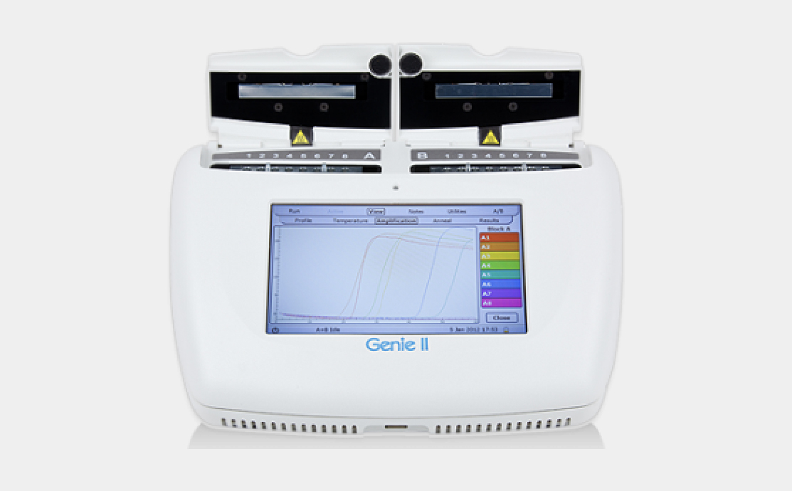
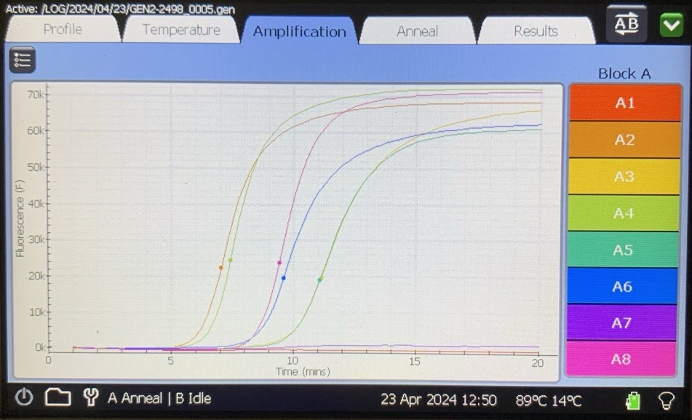
What is LAMP?
Loop-mediated isothermal amplification (LAMP) is a DNA amplification technique that allows for rapid and efficient DNA replication under isothermal conditions.
Target DNA is amplified with a probe which fluoresces only when bound to the target DNA.
We then receive real time fluorescence readings on the Genie II machine.
An ‘S’ curve and a correct anneal temperature is a positive result.

Slide 4
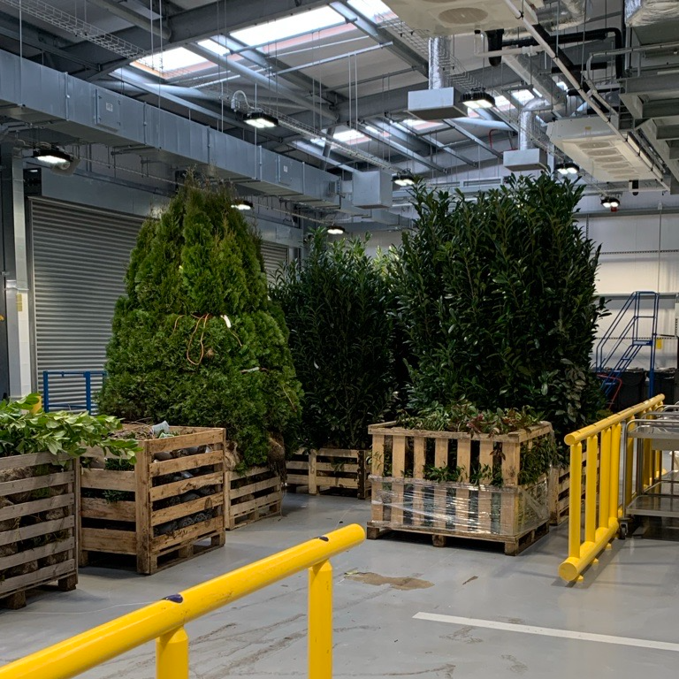
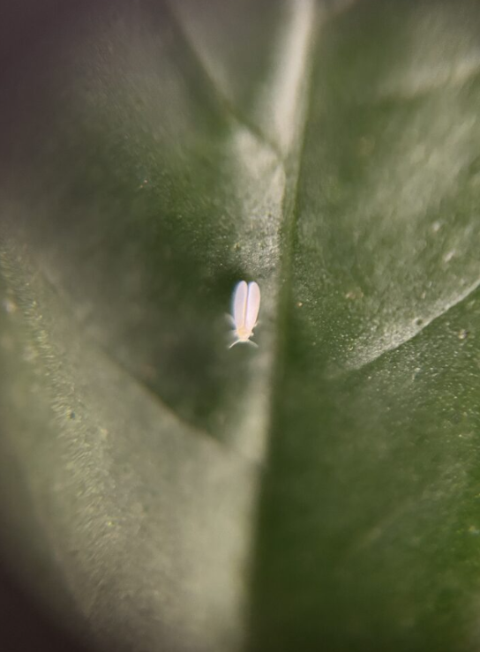
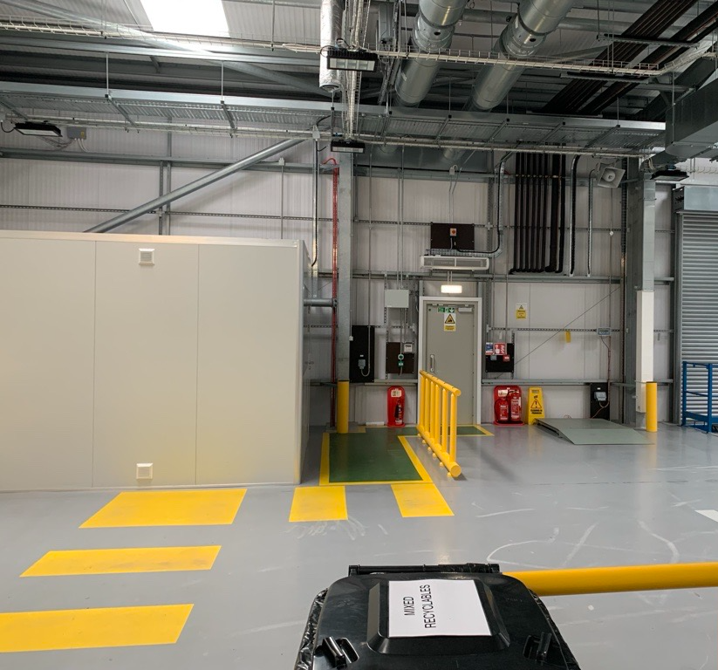
How to run a LAMP test

Slide 5
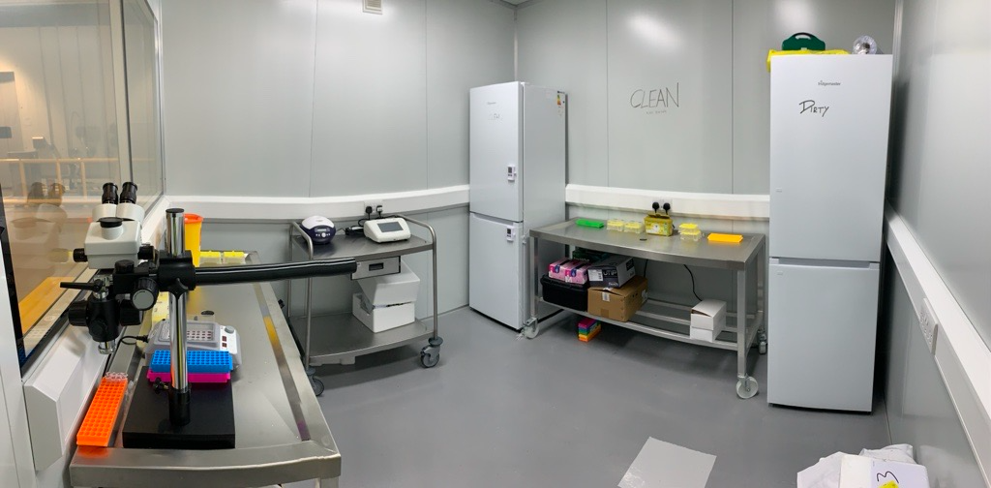
How to run a LAMP test

Slide 6
How to run a LAMP test
‘Dirty’ Area
Sample Extraction
Reaction Mix Preparation
‘Clean’ Area
Add Sample(s) and Controls
Run the Reaction in the Genie Machine

Slide 7
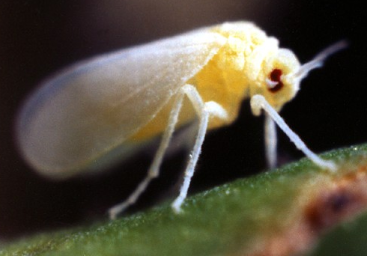
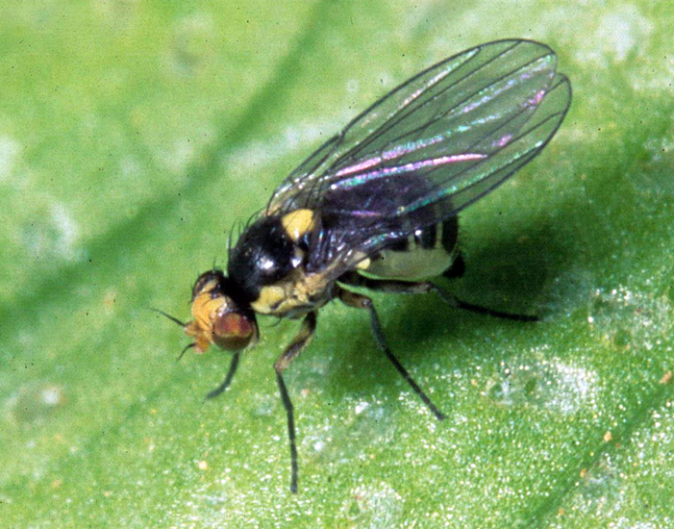
Why do we need it?
In the 24-25 financial year we had 193 interceptions of Bemisia tabaci and Quarantine Liriomyza species.
Previously each of these interceptions would take between 24-96 hours to receive a diagnosis from the lab.
With on-site LAMP we can get an actionable result within 2 hours.
Changing and Improving.

Slide 8

The Impacts of Introducing the Technology for Trade
Quicker diagnosis times therefore less delays.
Reduced financial implications.
Shorter BCP dwell times for consignments and drivers.
Site storage restrictions.

Slide 9



Challenges of introducing
ISO accreditation.
Resourcing training and proficiency testing.
Frequency of inspections/interceptions.
Seasonality

Slide 10

Future applications of the technology
New assays.
Mobile labs.
Simplified procedures.

Slide 11
Summary
Loop-mediated isothermal amplification (LAMP) is a real time DNA amplification technique.
It has the potential to provide large positive impacts to trade.
However, there are several blockers to overcome.

