Slide 1
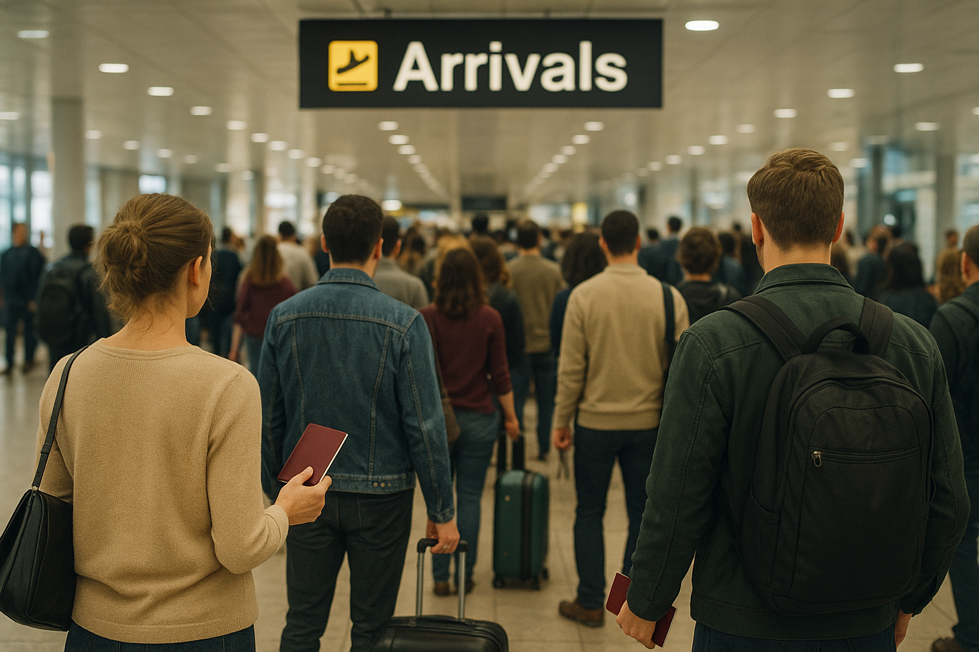

Conducting Passenger Baggage Inspections for International arrivals
November 2025
Presenter – Andrew Palmer
Traveller Operations and Policy Branch
Biosecurity Operations Division
Notes:
Presentation to the European and Mediterranean Plant Protection Organisations’ (EPPO) Workshop for phytosanitary inspectors.
The request was for DAFF to present on its approach to checks on passenger luggage.

Slide 2
12-month period to 31 August 2025
Arriving travellers | Number of travellers with baggage biosecurity screened (x-ray, detector dog, or manual inspection)
Cruise
475,325 | 21,860 (4.6%)
Air
22,857,623 | 2,983,893 (13.1%)
Notes:
This slide shows:
the total number of travellers that arrived, during the 12 months up to 31 August, via cruise and air.
the number of travellers that had baggage biosecurity screened by x-ray, detector dog, or manual inspection (also expressed as a percentage of the total number arriving) via cruise and air.
(Source: Traveller summary and data report, DBD – Biosecurity Travellers)

Slide 3






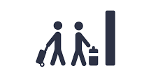





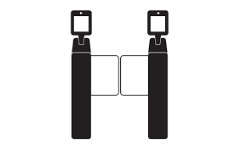

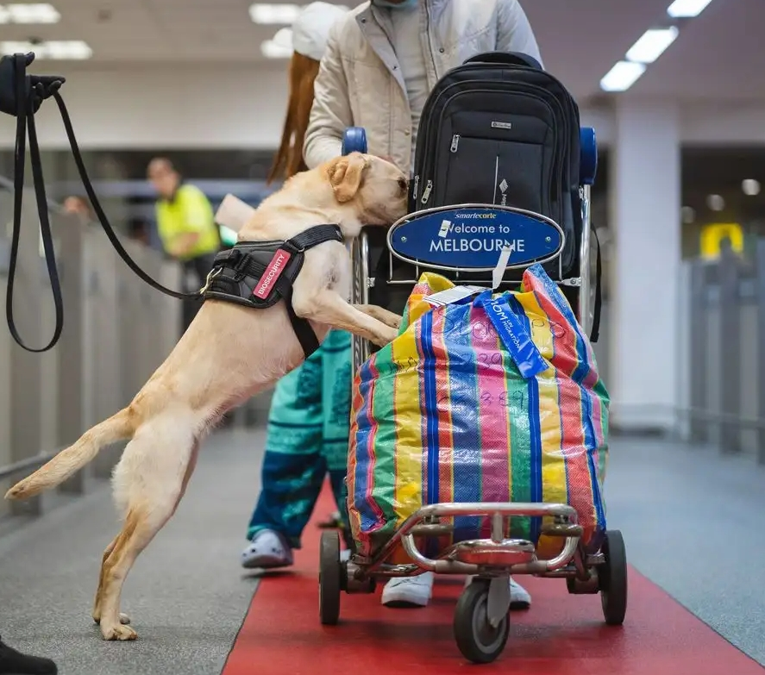
Air traveller pathway
Pre-arrival
Primary line
Baggage reclaim
Exit queue
Exit Marshal Point
Secondary examination area
(baggage checkpoints)
Australian Border Force (ABF)
officer
DAFF rover
Incoming passenger card
DAFF rovers can question travellers and view information to form a decision to release travellers or refer them for screening
Secondary examination area (SEA) queue
ABF
Marshal
Current trial for digital declaration
DAFF
Marshal
Data entry
EXIT
Smartgate
DAFF K-9
Biosecurity detector dogs screen travellers - positive hits are referred for inspection
DAFF marshal can review declarations and information to decide most appropriate screening (X-ray, K-9, inspection) or send traveller to exit.
EXIT
Baggage checkpoints for biosecurity screened travellers in the secondary examination area: Air travellers – Biosecurity detector dogs, X-ray, manual inspection Cruise travellers – Manual inspection, detector dogs and/or X-ray (in cruise terminals where detector dogs and/or X-ray are deployed)
Notes:
The simplified process map shows the baggage check points in the secondary examination area for the air traveller pathway – x-ray, detector dog, manual inspection.
The bottom left of the slide lists the baggage check points for air and cruise travellers.
If asked what happens to goods that require a phytosanitary certificate but arrive with an unsatisfactory certificate, or without a certificate, the traveller is given the option to: - voluntarily dispose of the goods
if there is an effective treatment available for the goods, treat the goods at their expense
if export is offered by the biosecurity officer, export the goods at their expense.

Slide 4
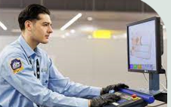
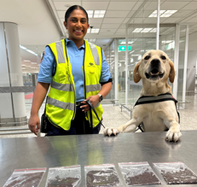
Tool | Strengths | Limitations
X-rays | Detect all organic material carried in baggage | Density of goods can impact visibility on x-ray image (i.e., dried plant material and seeds may not be visible on x-ray image)
Detector dogs | Operate flexibly in a range of areas (i.e., baggage reclaim area, conveyor belts, queues of travellers) | Presentation of goods can impact on available odour (i.e., vacuum packaging)
 | Screen large number of travellers quickly for undeclared high-risk goods | Not trained to respond to biosecurity risk material outside of target odours
 | Detect goods that are difficult to find using other methods (i.e., seeds and on-body concealments) | Intermittent traveller flow for long periods results in reduced efficiency in detecting target odours
Notes:
This slides explains the strengths and limitations of x-rays and biosecurity detector dogs.
If asked, biosecurity detector dogs are trained to detect the following high-risk goods:
Fresh fruit, vegetables, plant material
Viable seeds and bulbs
Meat
Fresh eggs
Cheese and milk
Brown marmorated stink bug (BMSB)
Queen bees

Slide 5
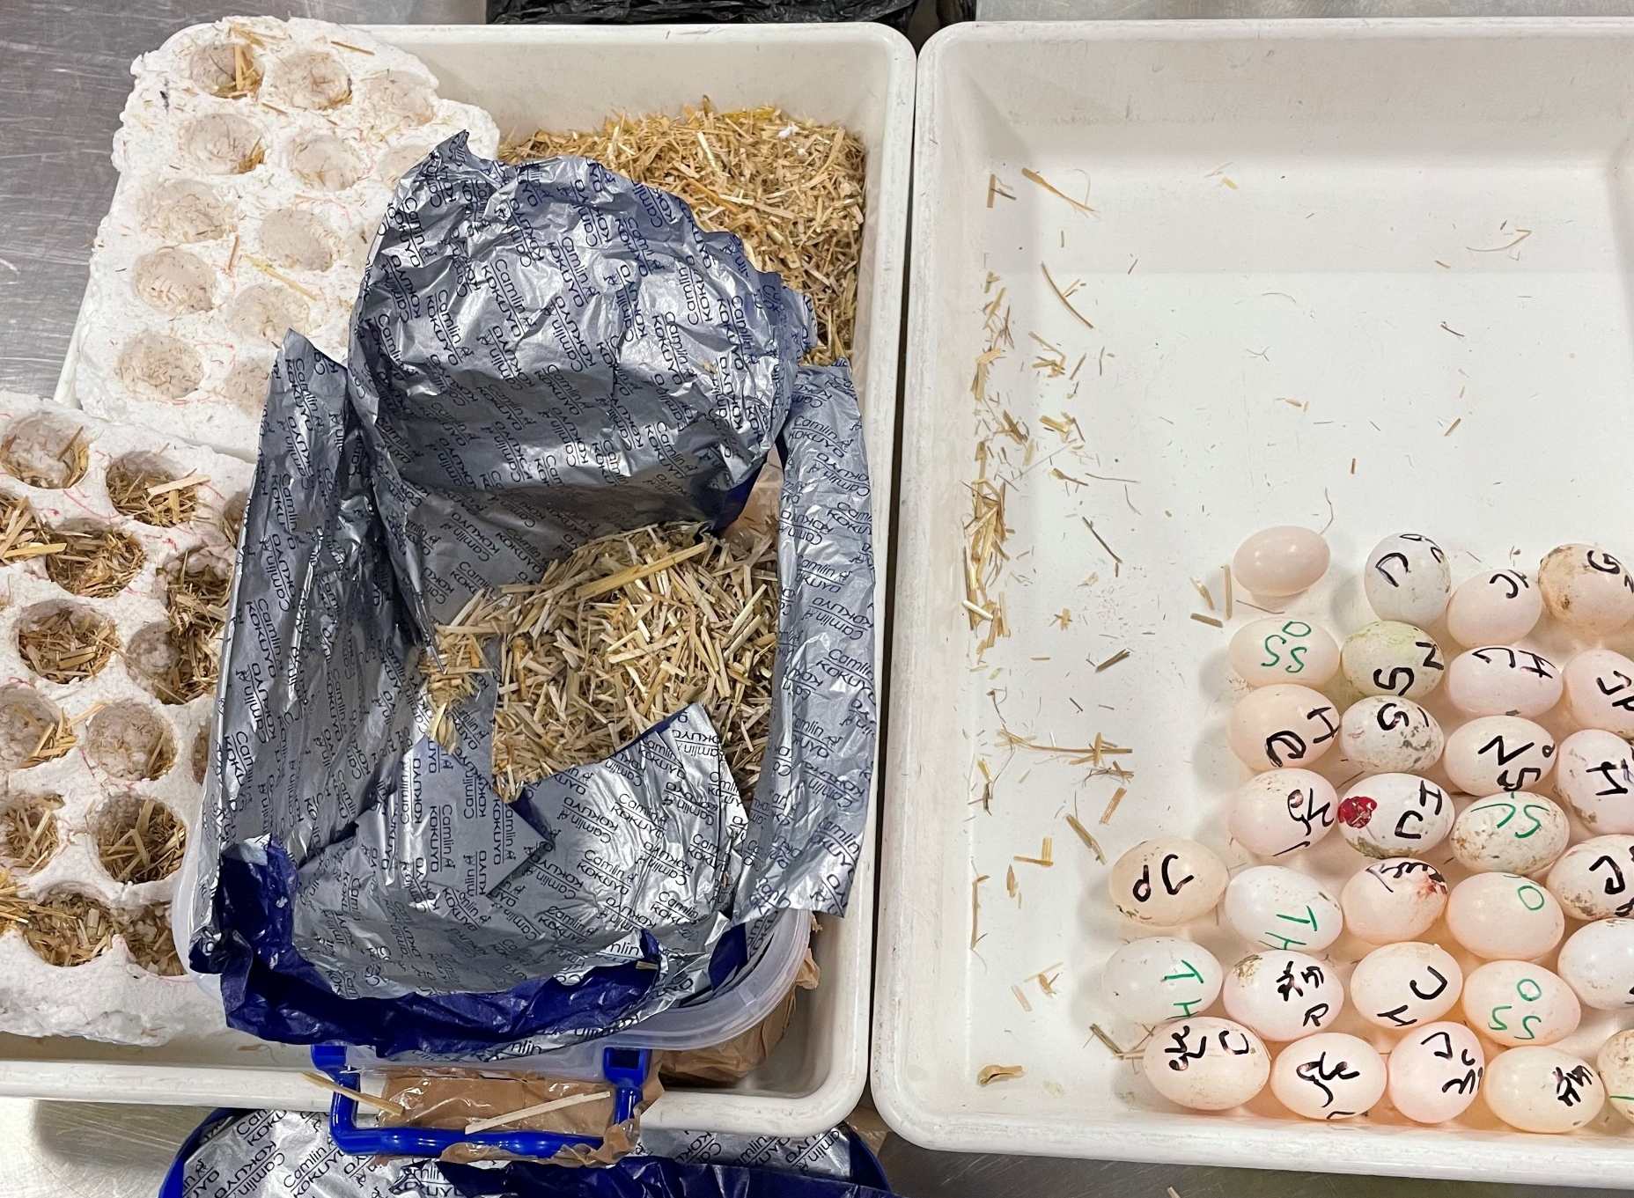
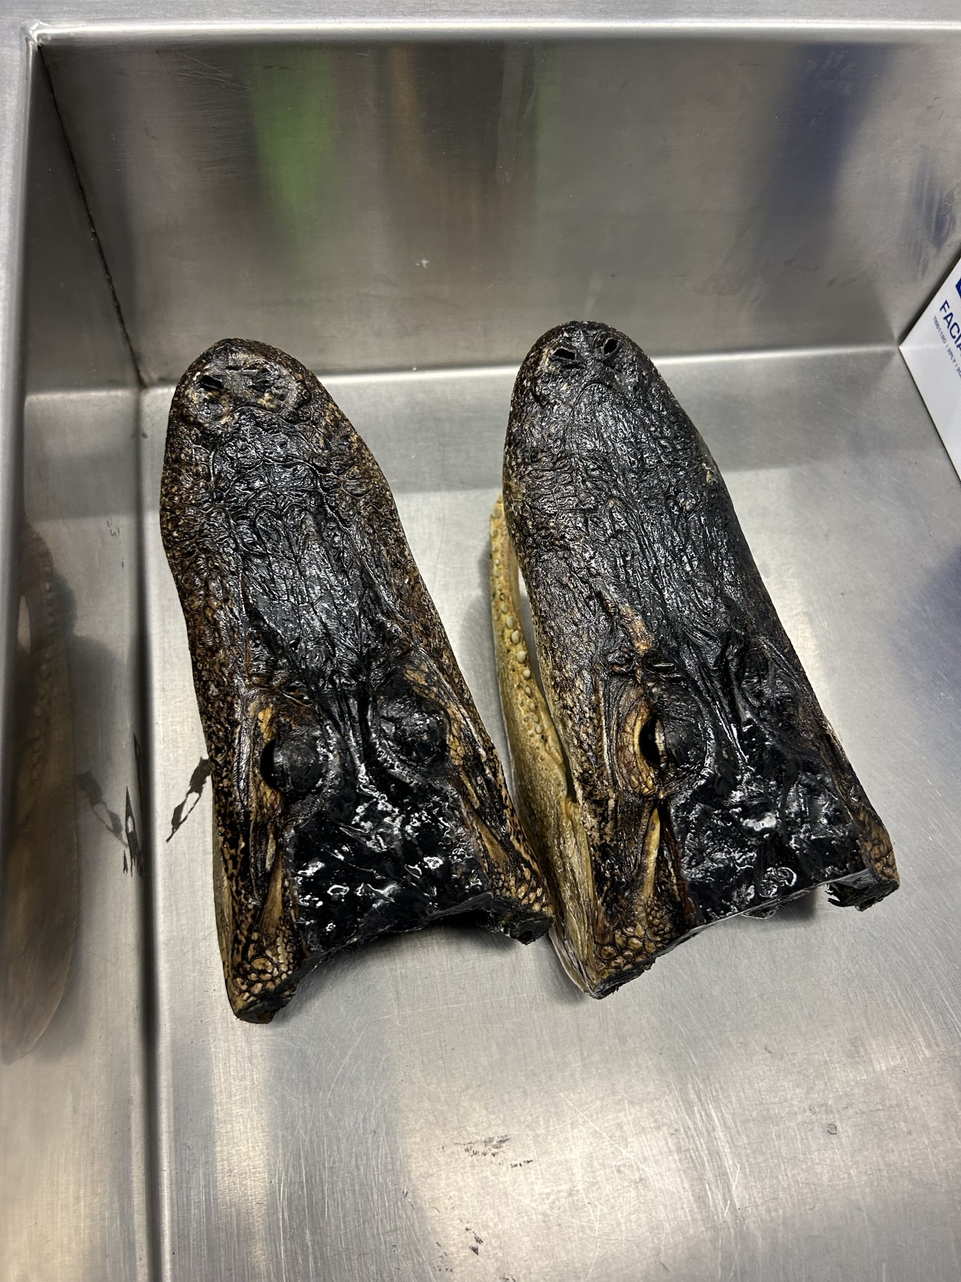
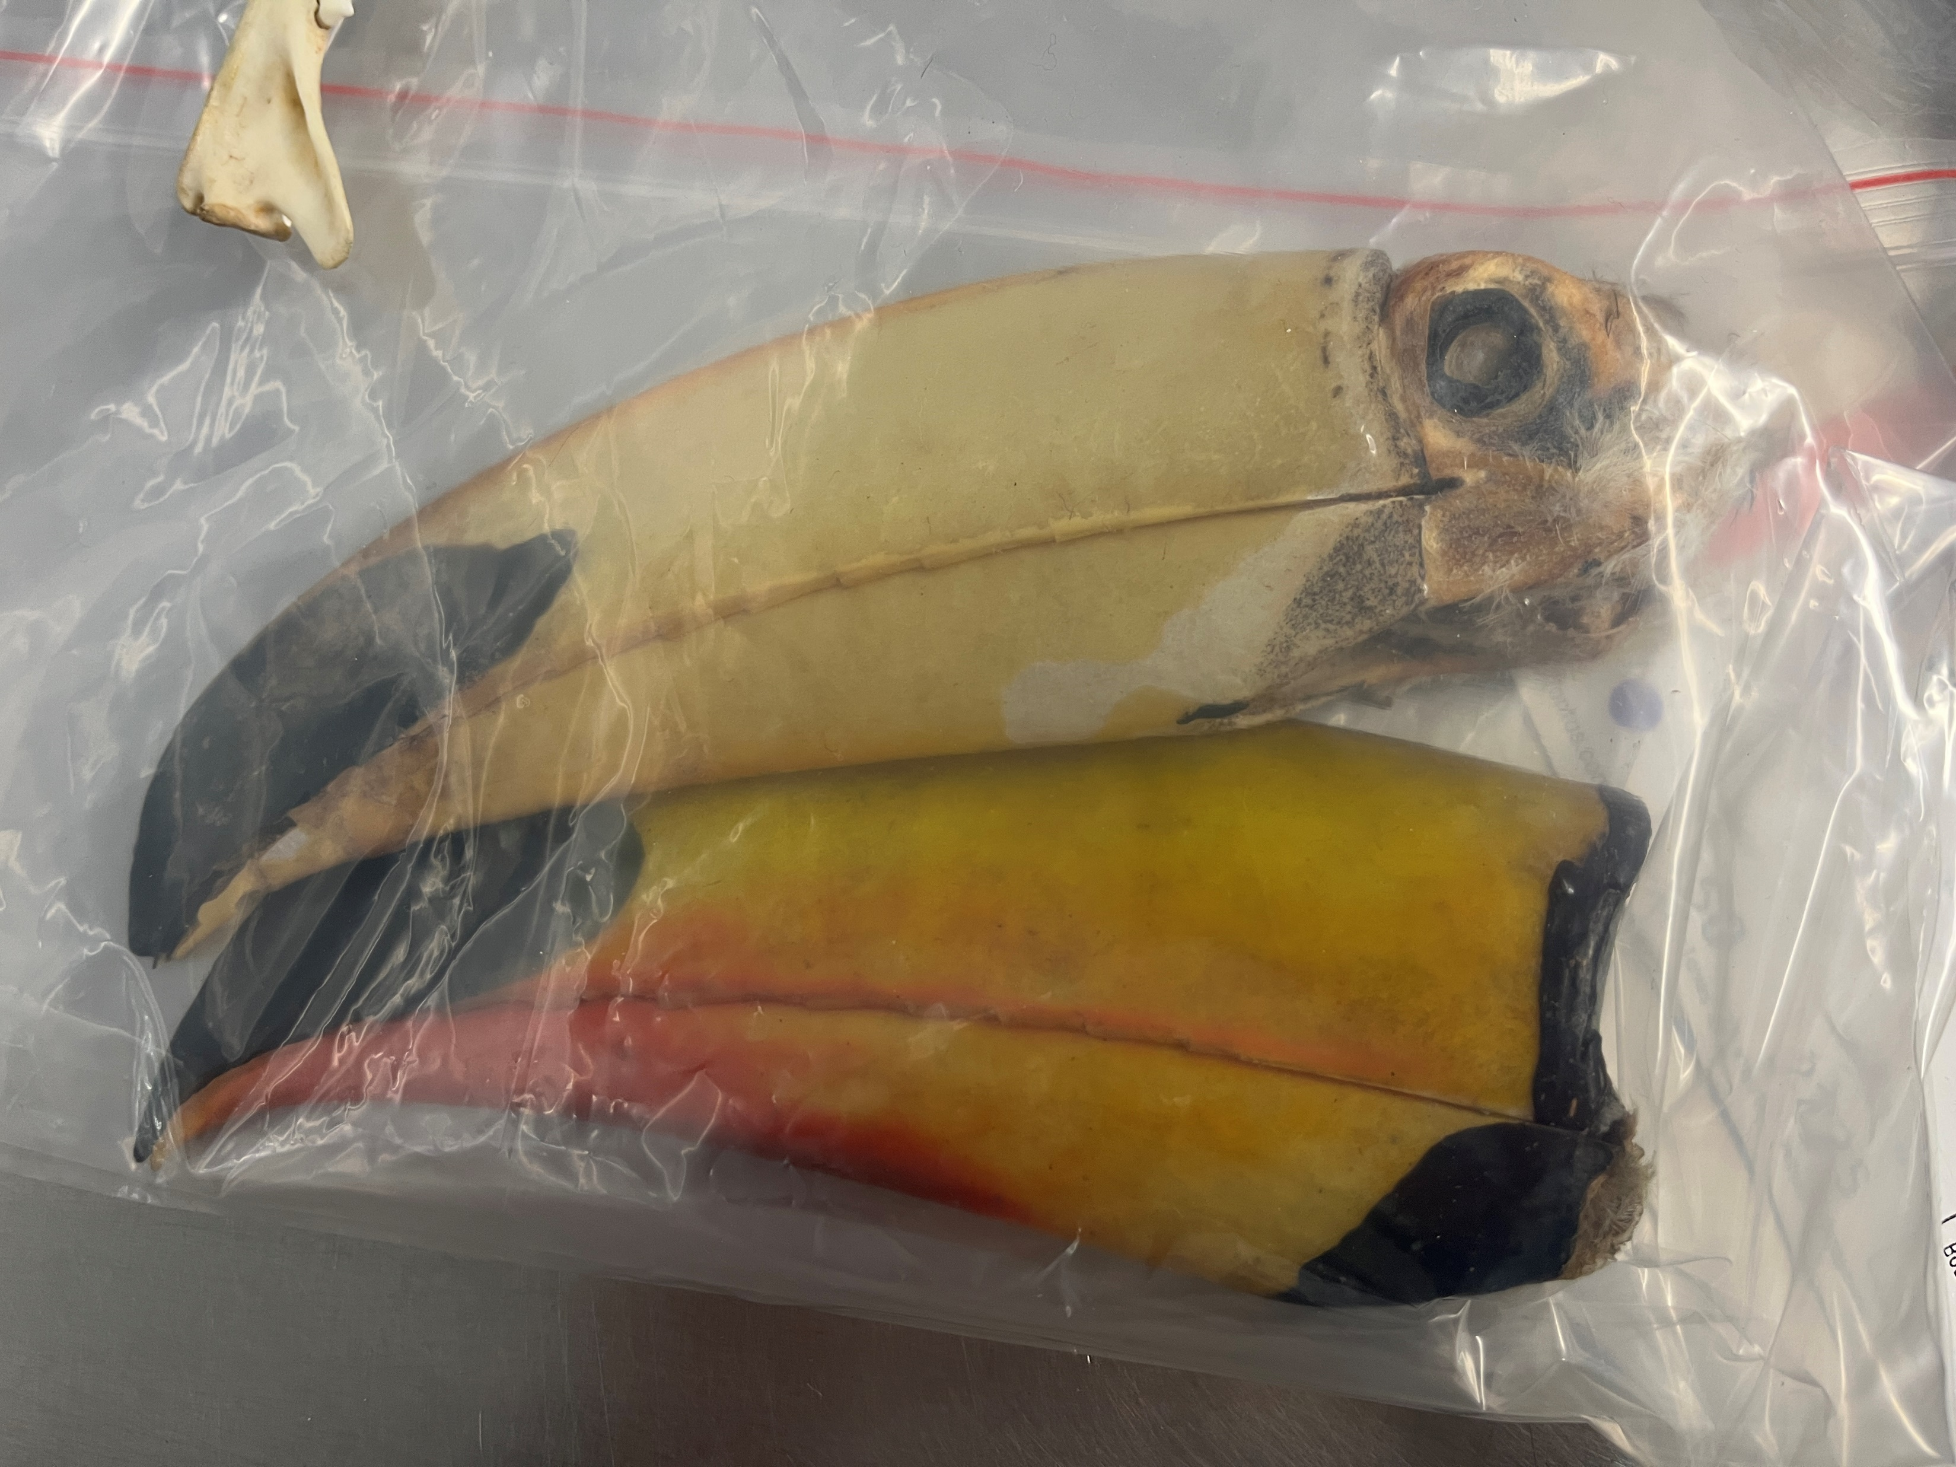
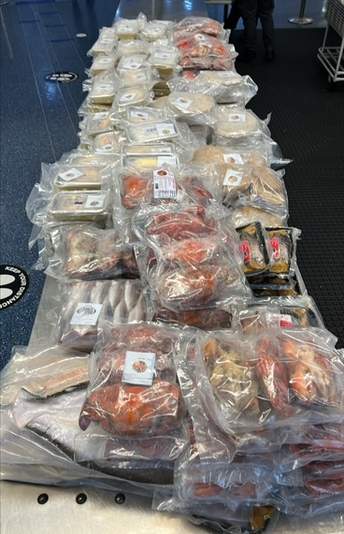
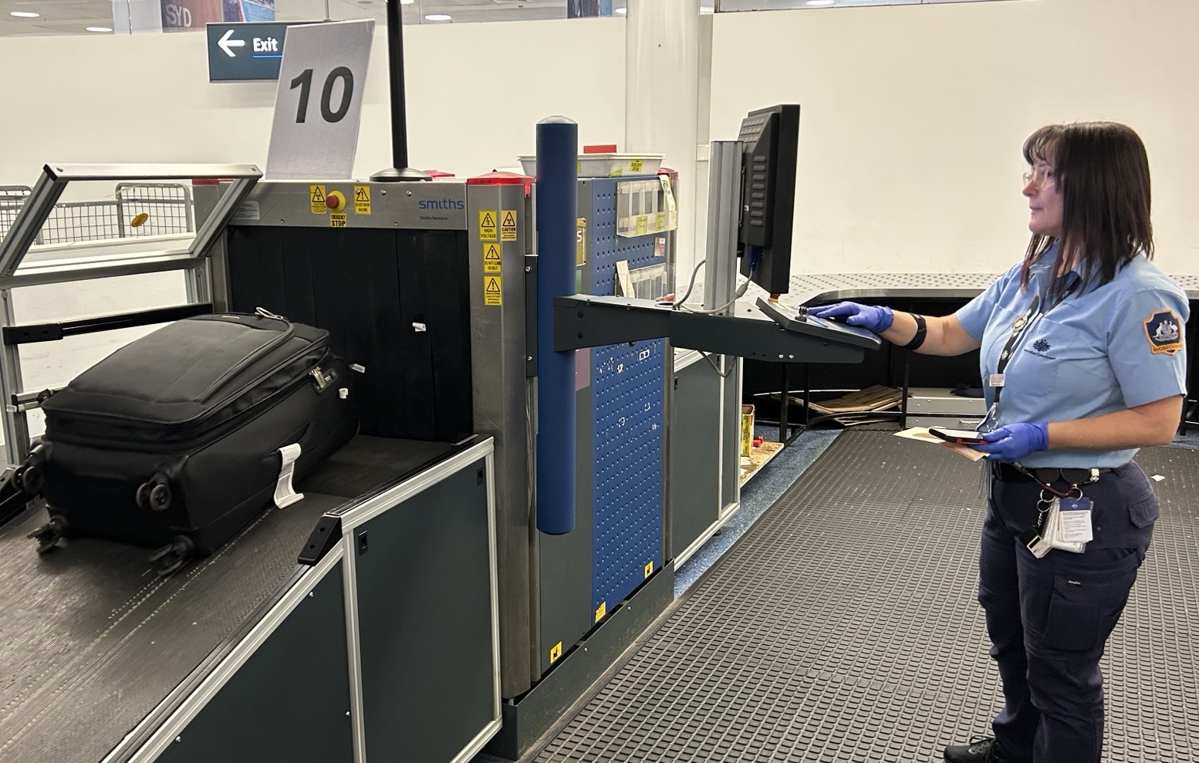
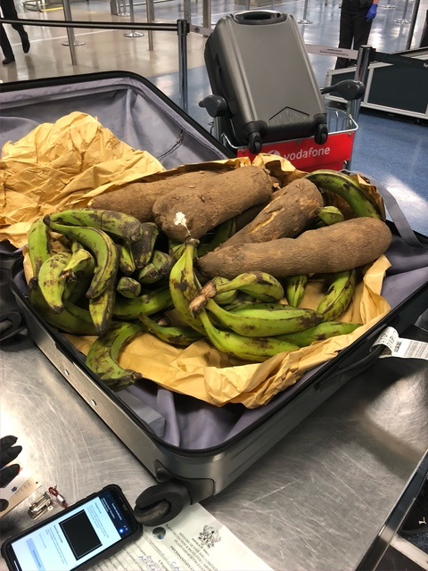
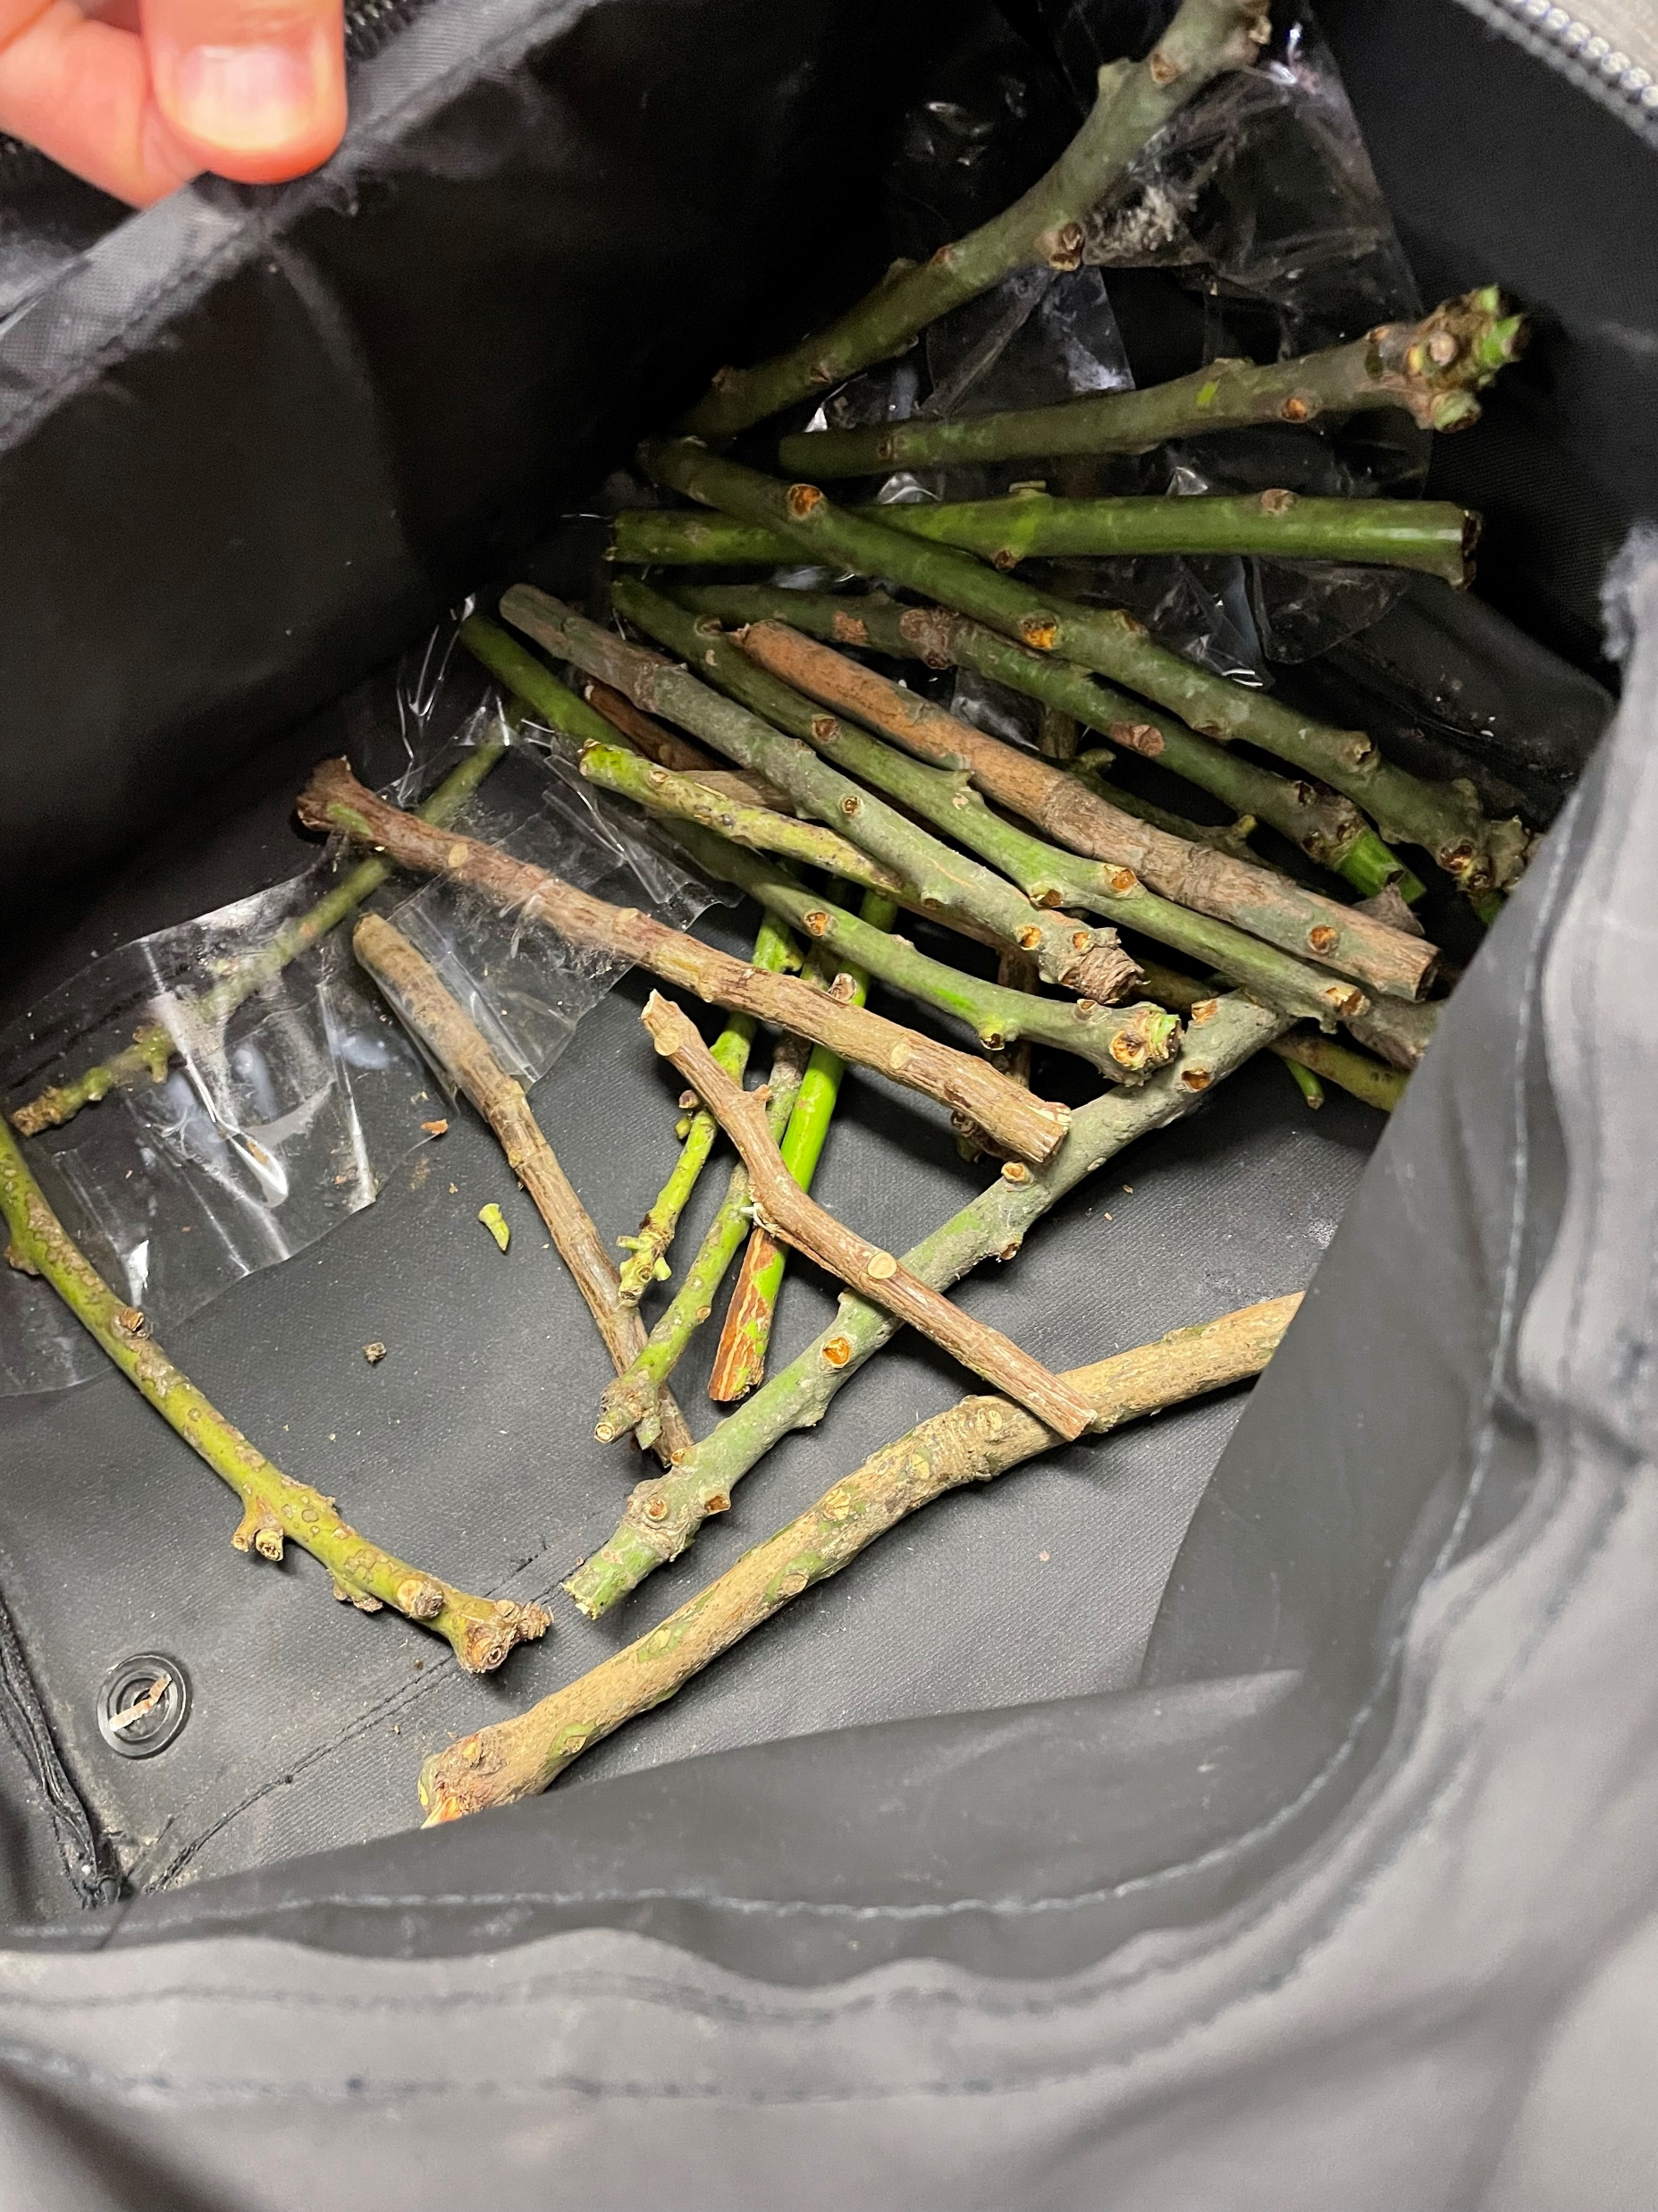

Slide 6
Questions?
You can email us at Travellers@aff.gov.au
Notes:
Attendees are welcome to contact the department at Travellers@aff.gov.au with any questions.

