Slide 1
The IPPC Guide on E-commerce
A guide to managing the pest risk posed by goods ordered online and distributed through postal and courier pathways
Thorwald Geuze
E-commerce lead, Implementing and Capacity devellopment Committee

Slide 2
What is e-commerce?
E-commerce transactions involve the sale or purchase of goods or services between businesses, households, individuals, governments, and other public or private organizations, conducted over the internet (OECD, 2002).
For the purposes of the IPPC guide, e-commerce is only considered to include those electronic transactions, whether selling, trading or gifting, that result in the movement of physical goods that are packaged and shipped as small parcels across one or more international borders via postal or courier carriers.

Slide 3
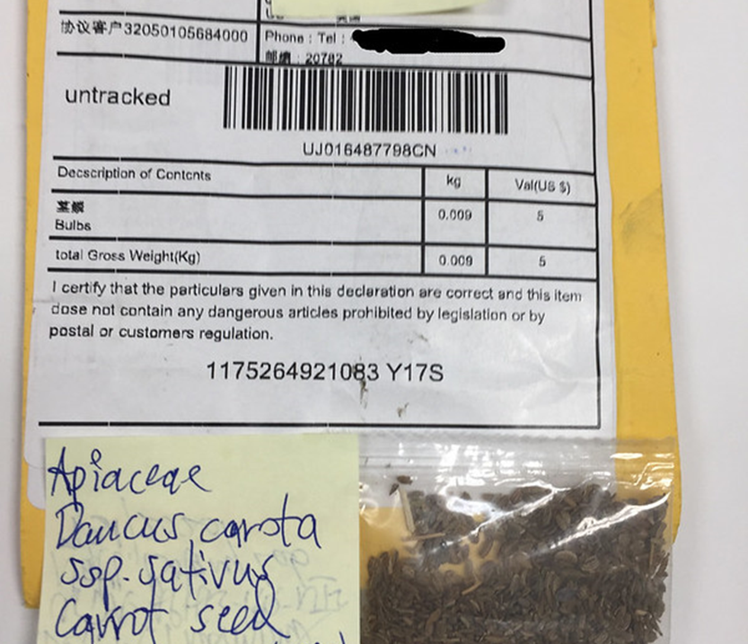
E-commerce challenges
huge volume of small parcels moving on the postal and courier pathways (often away from normal inspection points)
direct sales to consumers who demand rapid delivery
many new, casual or infrequent sellers and buyers
limited information on the content of the parcels
anonymity of the internet makes it difficult to identify sellers
deliberate misrepresentation and fraud is common
-> Put strain on normal phytosanitary export and import procedures (documentary check, physical inspection, testing etc.)
Notes:
Buyers may not be aware that the products they are purchasing originate in another country; the products (plants) may originate in another country than the webshop.
Sellers may not be aware of the import requirements of their customers’ countries or may choose to ship non-compliant goods on the assumption that most consignments will not be intercepted. The seller may consider seized consignments and any associated fines to be a normal business cost
These factors put pressure on the normal components of both phytosanitary export systems (e.g. inspection and
export certification) and import systems (e.g. risk-based intervention, inspections at the border, processing transactions)

Slide 4
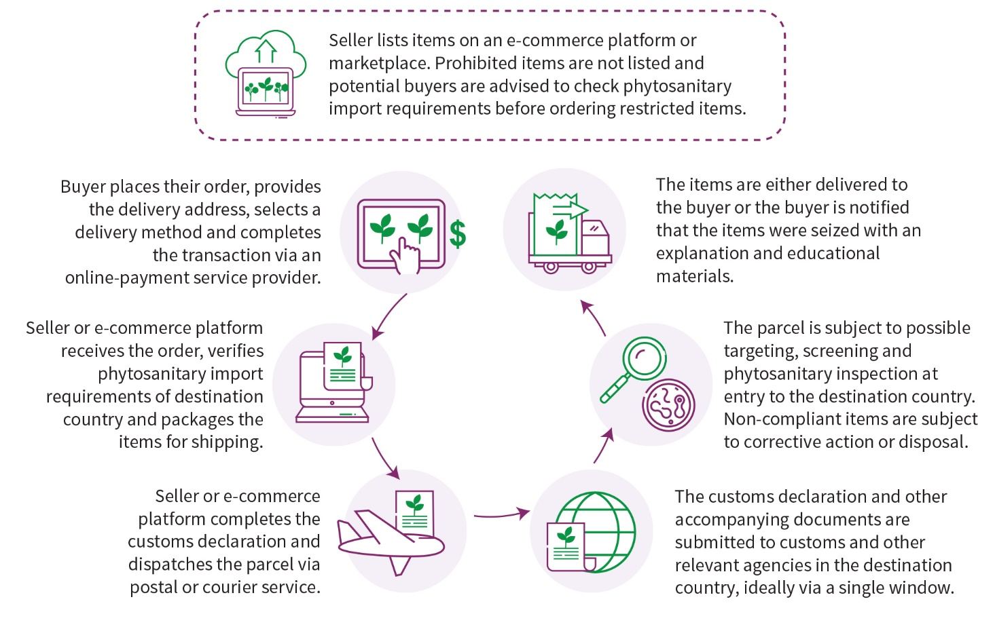
E-commerce supply chain
Notes:
This diagram desccribes the e-commerce supply chain and the critical points in this chain. It starts with a buyer purchasing some plants or plant products on the internet. Often, the buyer is not aware of the origin of the products (plants) that are being sold. Even if the buyer is aware of the nationality of the webshop, this does not mean that the plants originate in that country.
The seller processes the order. Ideally, the seller would check the import requirements of the country of destination (where the buyer is located), but in most cases, they do not. Often knowingly or unknowingly non-compliant plants are shipped (e.g. seeds without a Phytosanitary Certificate).
The Parcel is dispatched through a courier service or a postal service. The seller should provide sufficient information to the courier service or postal service for the import declaration in the country of destination, but often the information provided is very limited and customs do not always recognise regulated goods that should be stopped until cleared for import by the NPPO.

Slide 5
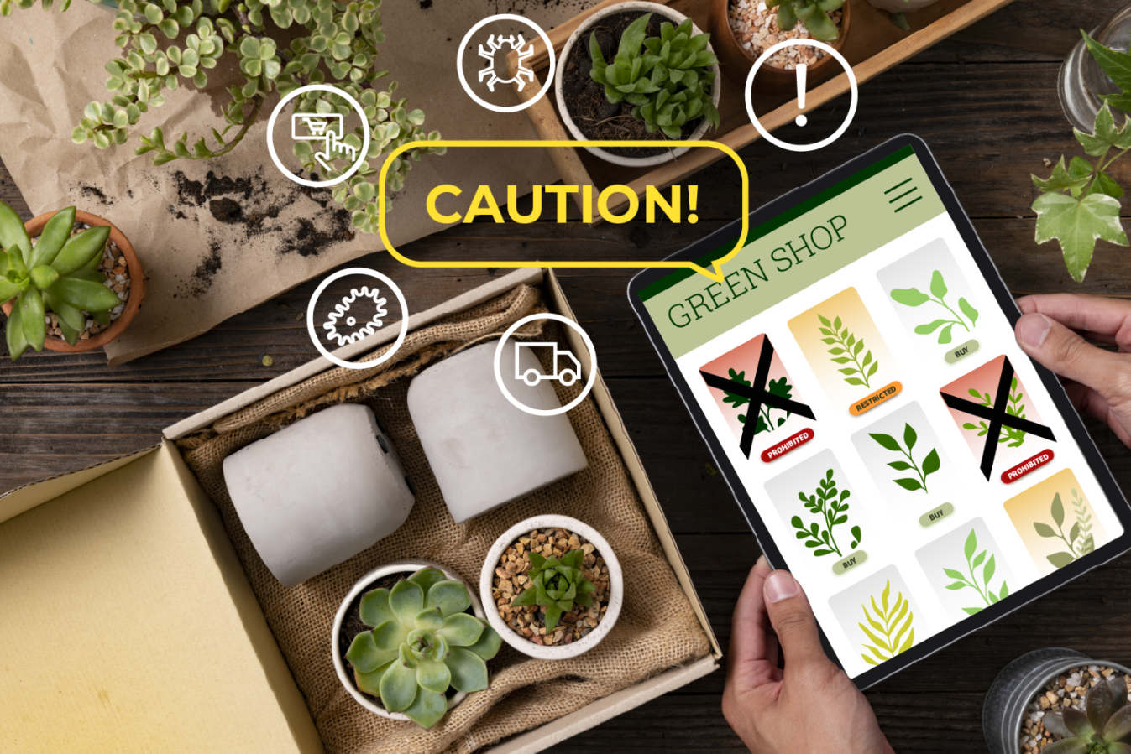
IPPC resources on e-commerce
Infographic video (English with subtitles to all FAO languages)
E-commerce webpage on the International Phytosanitary Portal (IPP → Strategic objectives → Plant Health & Safe Trade → E-commerce)
Videos
News stories
Contributed resources
IPPC e-commerce guide
Notes:
There are different IPPC resources on e-commerce, the infographic video we have just seen, is available with subtitles in all FAO languages.
This video and the other resources can be accessed through the International Phytosanitary Portal, under Strategic Objectives go to Plant Health and Safe Trade and click on e-commerce. On this page you can see how the IPPC work on e-commerce relates to the strategic objectives of the IPPC and to which UN sustainable development goals it contributes.

Slide 6
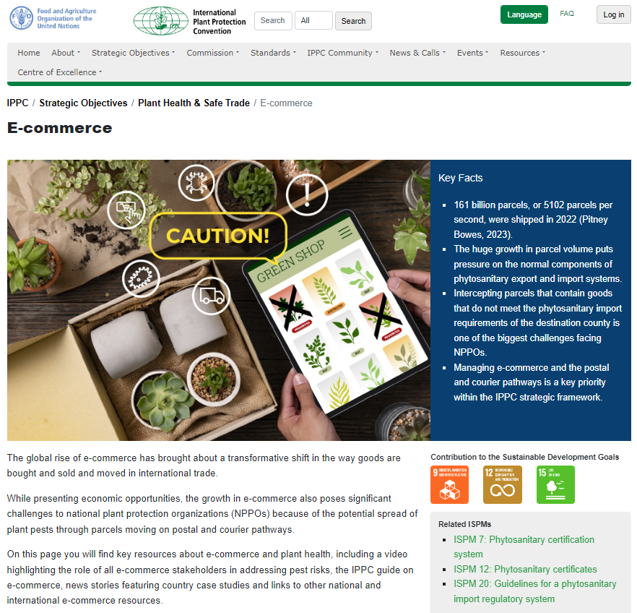
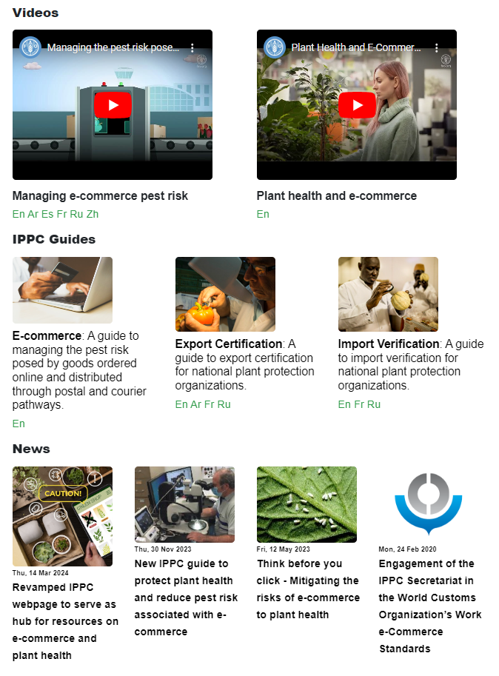
Notes:
This is a screenshot of the new e-commerce webpage
Key facts and general information
Contribution to SDGs
IPPC videos (infographic that we just saw and another video)
Link to IPPC guides on e-commerce, export certification and import verification
News articles relevant to e-commerce
Link to contributed resources. Contributed resources are relevant phytosanitary materials that were developed by an NPPO, RPPO or another organization and shared with the phytosanitary community.

Slide 7
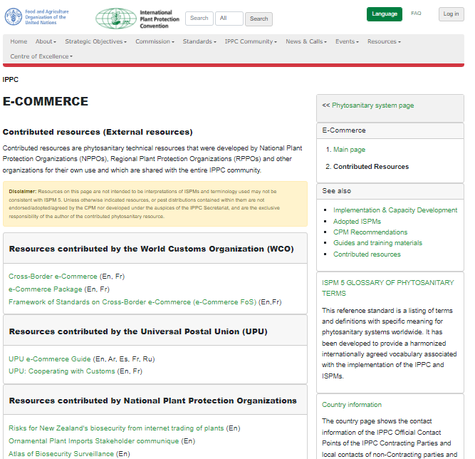
Notes:
Contributed resources from World Customs Organisation, Universal Postal Union and some NPPOs. Ms. Susan Patnode from the Universal Postal Union will later in this session explain how NPP’’s can cooperate with the UPU.
If you have interesting case studies, experiences or procedures or any other relevant material, please send them to the IPPC secretariat.

Slide 8
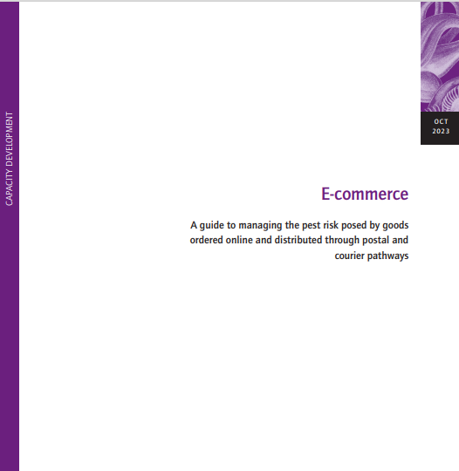
E-commerce: A guide to managing the pest risk posed by goods ordered online and distributed through postal and courier pathways
  identifies key challenges faced by NPPOs
  provides practical guidance for improving cooperation and collaboration with key stakeholders
  highlights pre-border and border activities that NPPOs may use to help mitigate pest risk on postal and courier pathways, how to identify and respond to non-compliance, and the importance of monitoring regulated articles moving on postal and courier pathways
  includes a diagram of a typical e-commerce supply chain
  several country case studies
Notes:
The English version of the guide was published in October 2023
Spanish translation will be available soon
We are seeking partners to translate the guide to other official FAO languages
The guide contains information on the e-commerce supply chain and interesting case studies from various parts of the world that showcase challenges, practices and experiences from NPPOs in dealing with e-commerce.

Slide 9
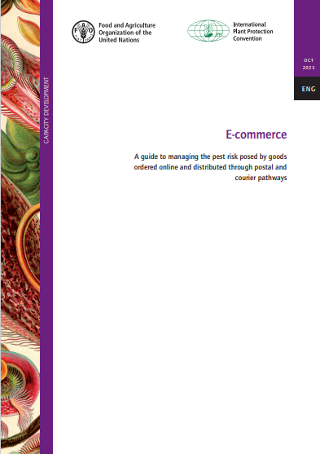
Content of the guide
Introduction to e-commerce
Items for sale
E-commerce supply chains
Payment and dispatch
Transportation and distribution
Risk-based border management
Border operations
Promoting compliance
Case studies

Slide 10
Thank you
Questions?

