Slide 1
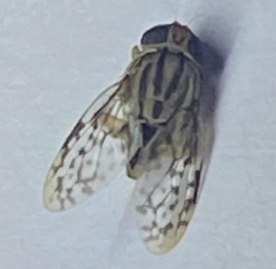
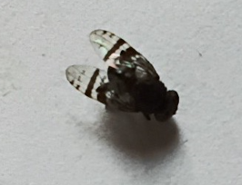
Use of ArcGIS tools in the proactive surveillance of fruit flies and the facilitation of access to international trade.
NEAKOH Roland MENGYI
EPPO workshop for inspectors: Innovative strategies for phytosanitary inspections.
18 November 2025

Slide 2
Introduction
Cameroon has 5 agroecological zones
Fruits and vegetables (F&V) are major export earnings for economy (banana, mangoes, capsicum, avocado etc)
In the bimodal rain forest, mangoes produce twice a year
SMEs are increasingly investing in F&V value chains
Littoral region has rich volcanic soils and proximity to the Douala International airport
ATCMA program (26M€ for ECCAS-2 years): market access & trade competitiveness. ITC & UNIDO

Slide 3
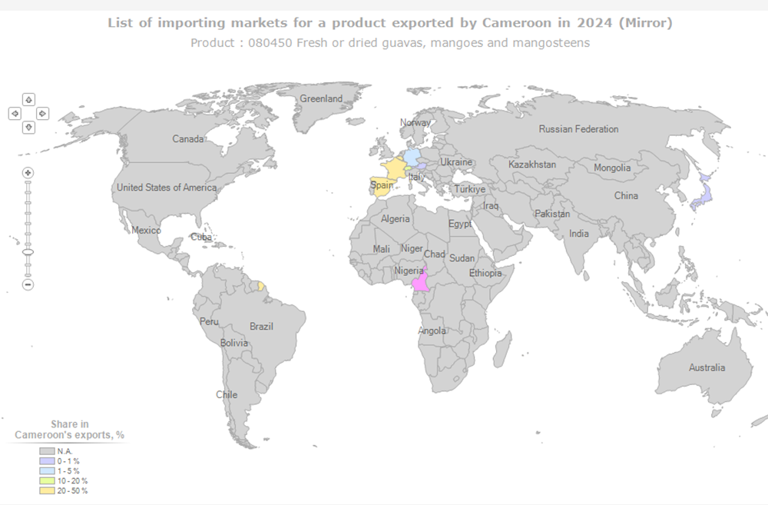
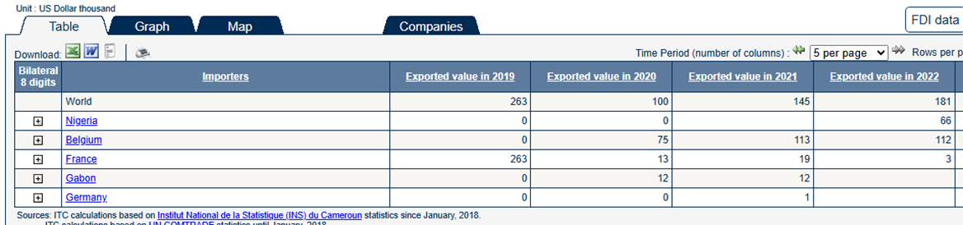
European Union market: France, Belgium, Spain, Germany
African Continental Free Trade Agreement Market (AfCFTA: Nigeria
- Steady increase in export immediately after Covid-19 sharp drop

Slide 4
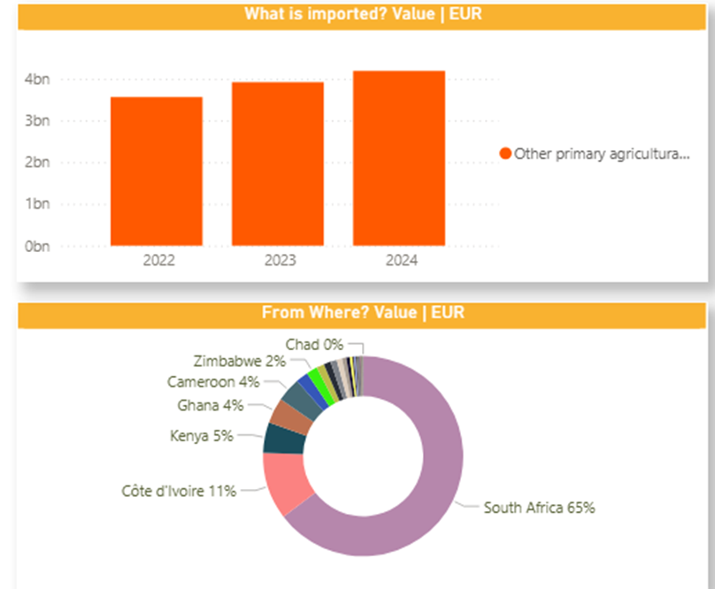
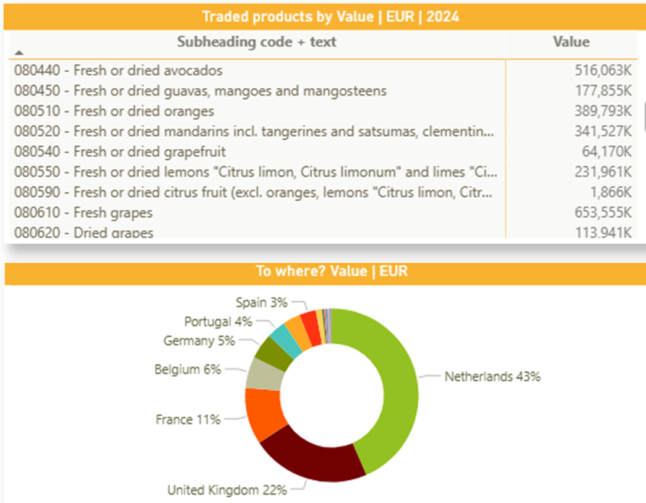

Slide 6
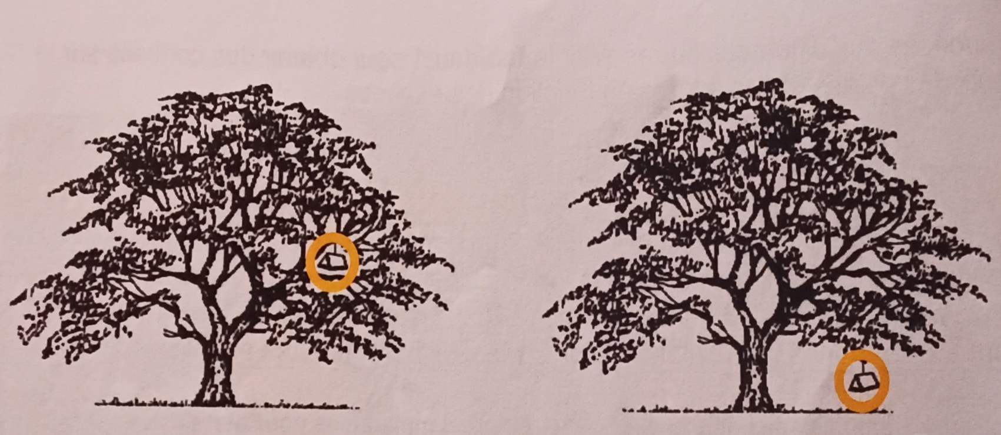
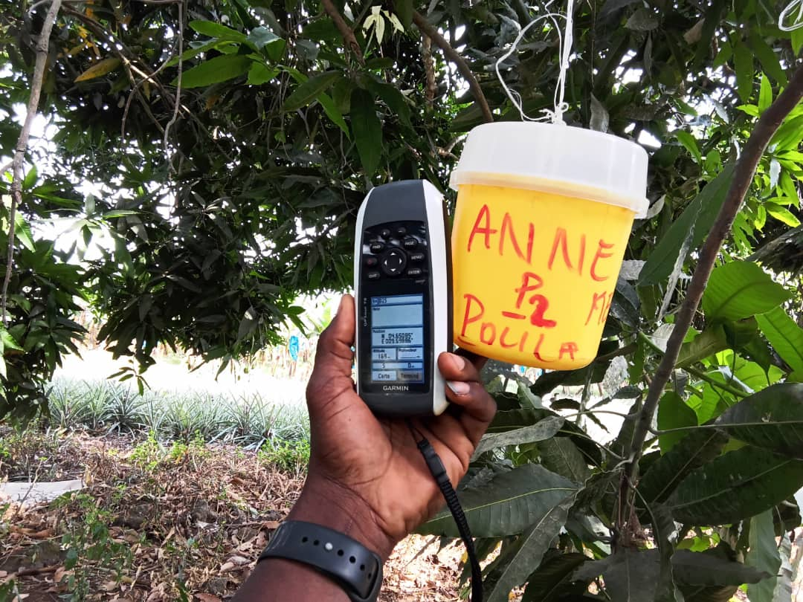
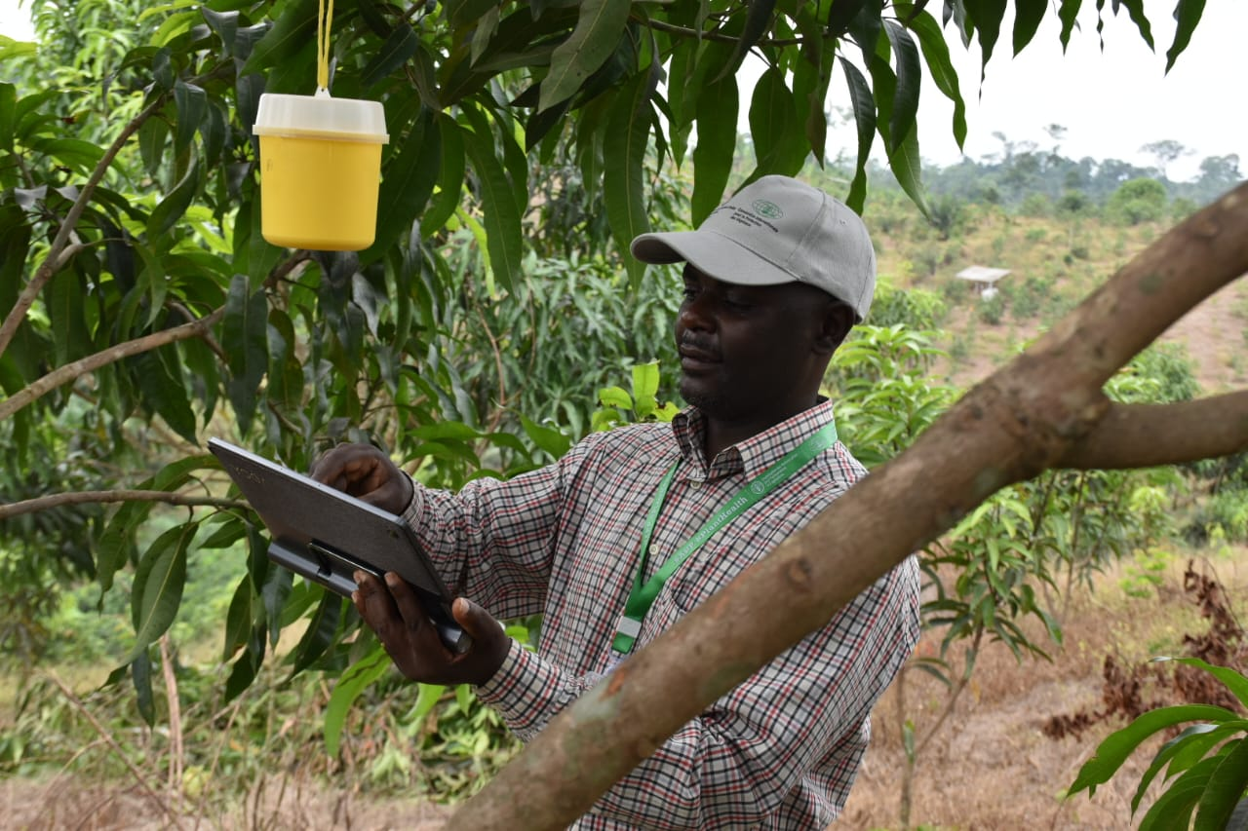
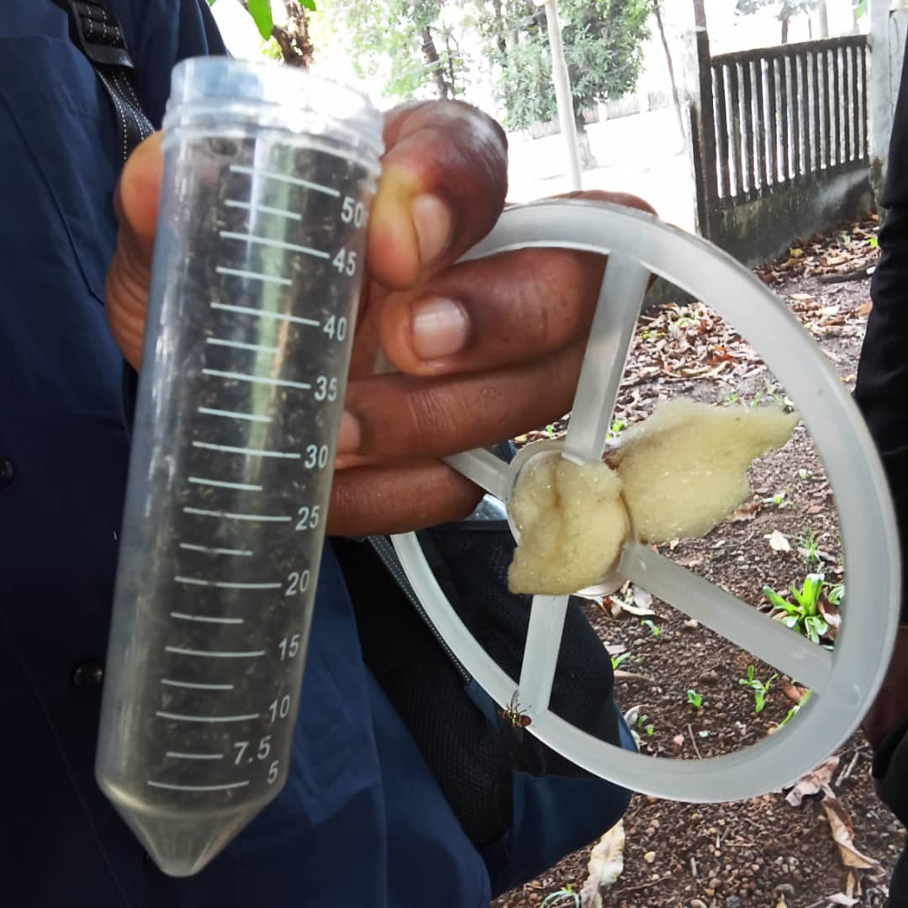
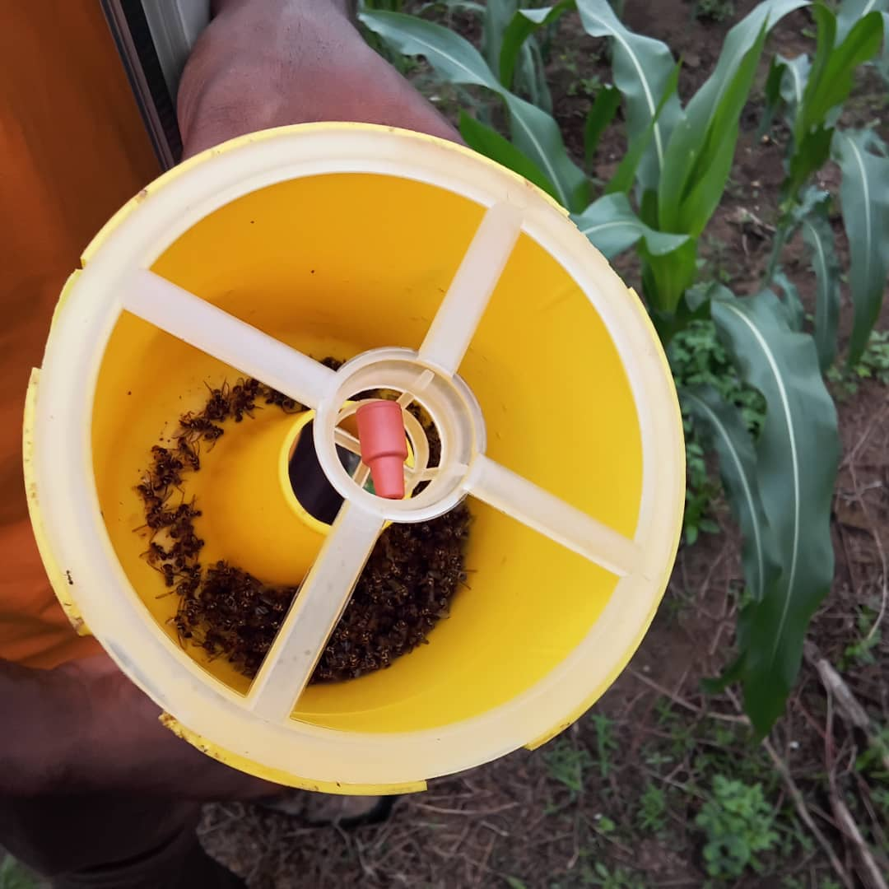
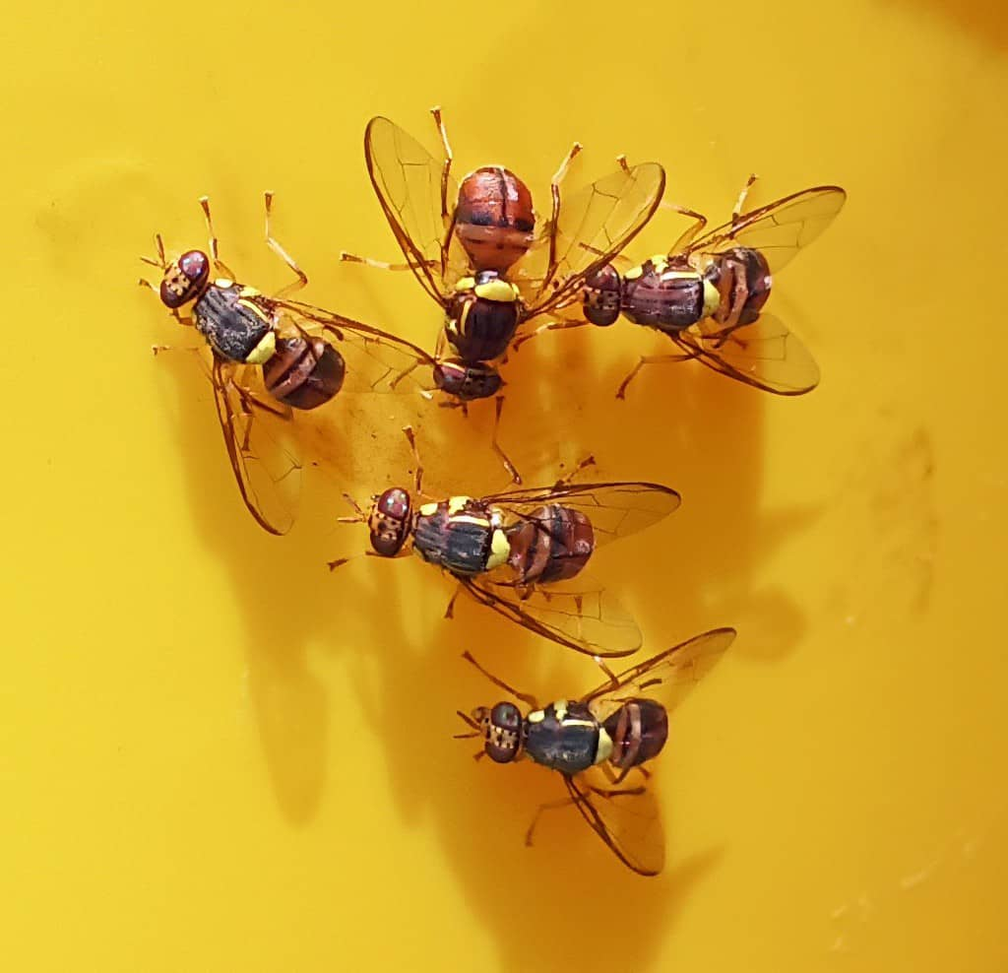
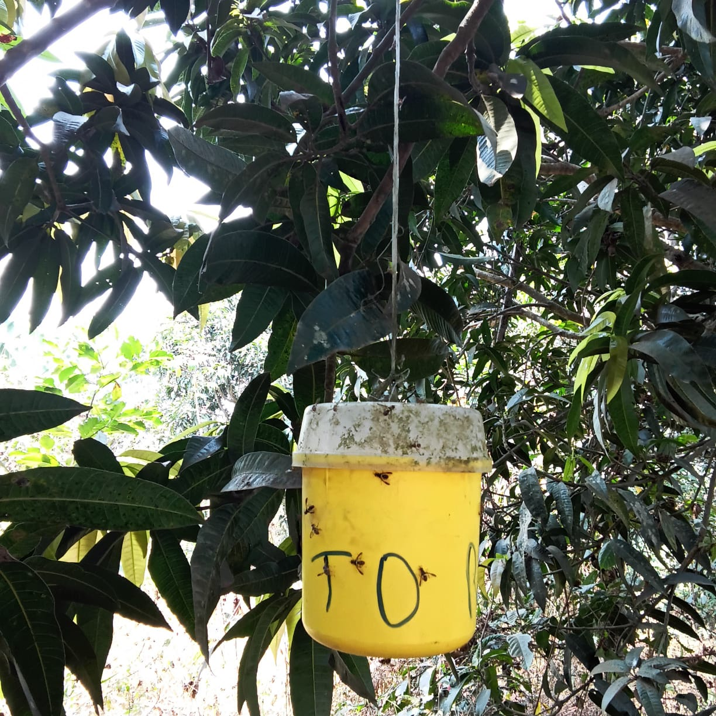
Method and materials
Trapping targeted more on export fields
Places with more host plants
Install traps & label
Renew pheromones 7 days
Collect fruit flies in vials
Count and record data
Determine FTD

Slide 7
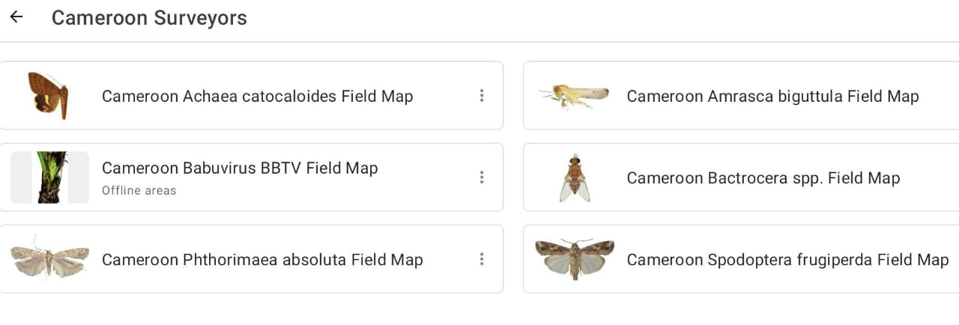
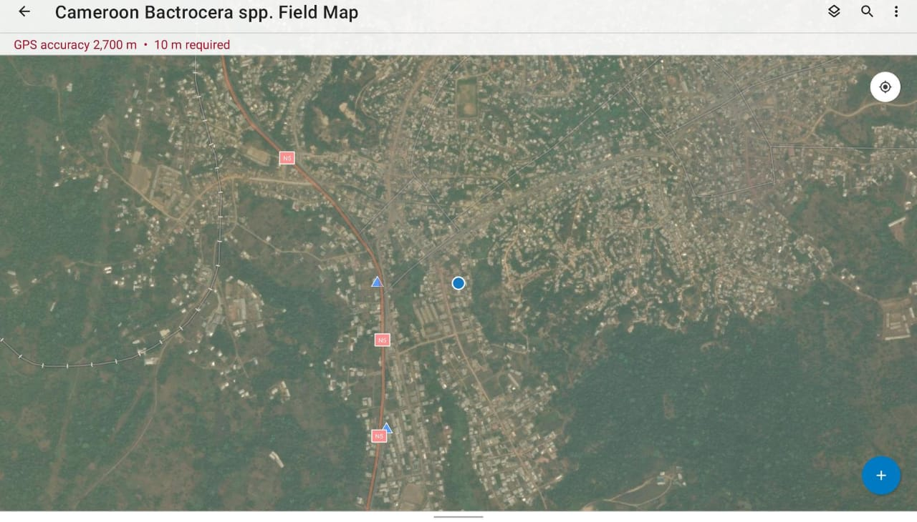
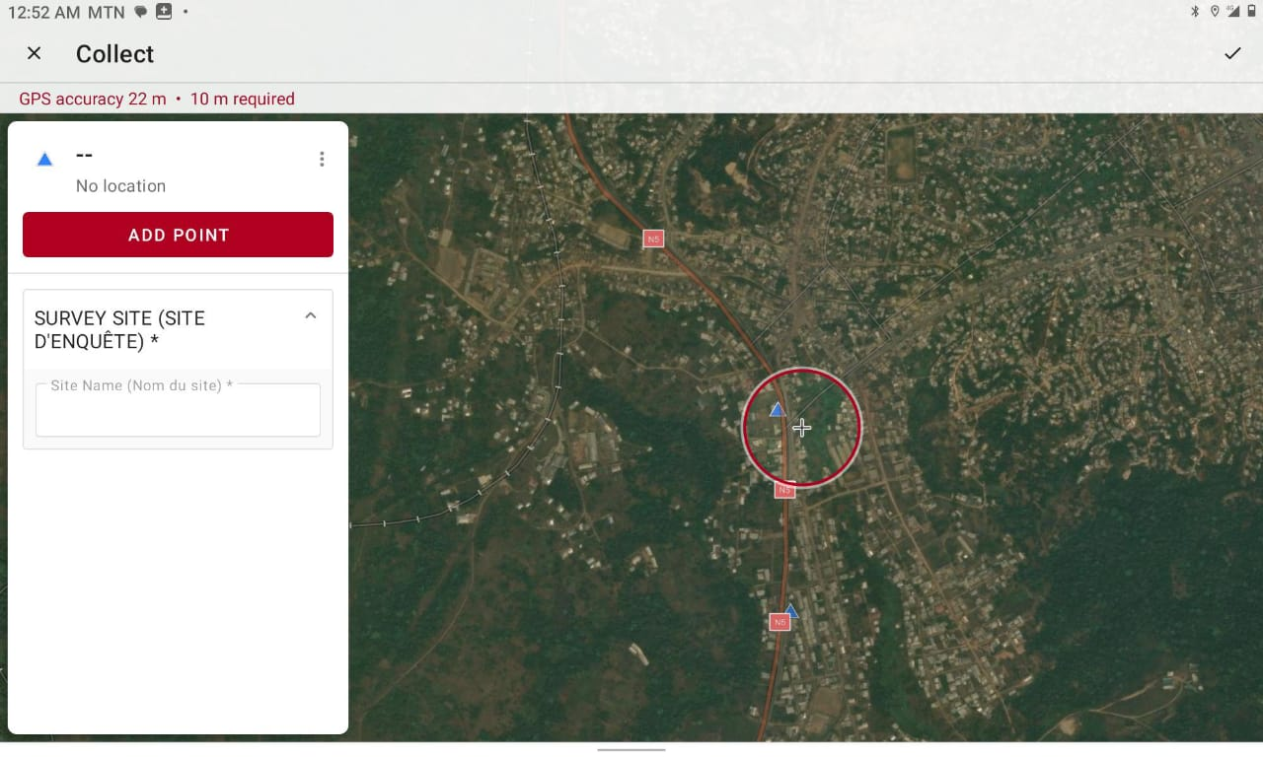
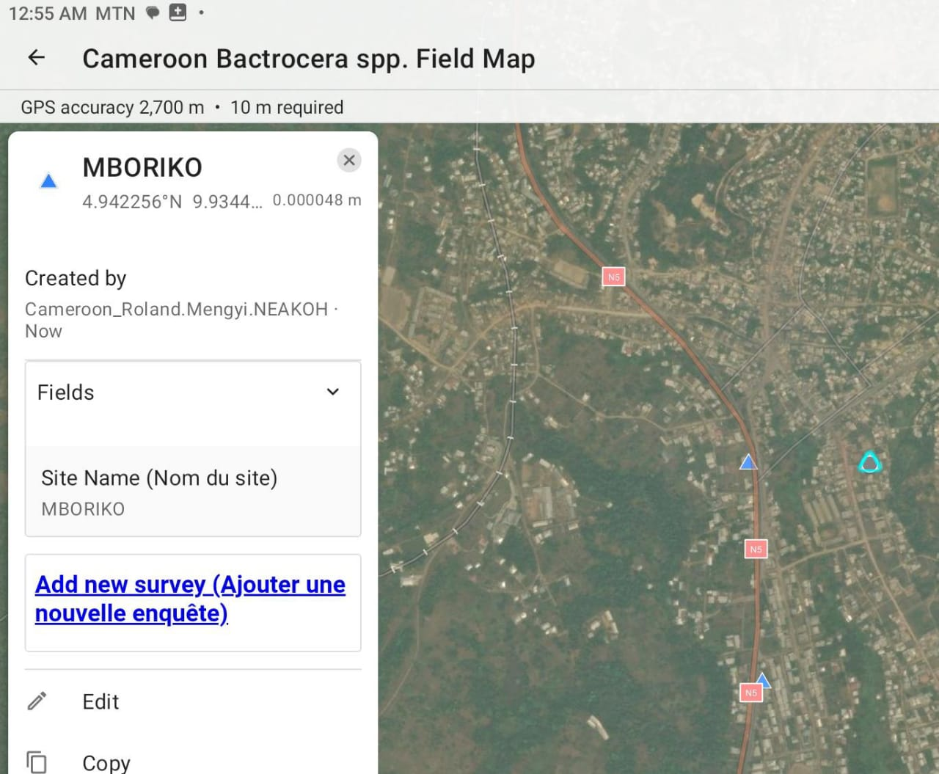
Method and materials
Log in to ArcGIS Field Map and ArcGIS Survey123
Select pest of interest
Click of the blue + sign
Enter site name
Click on ‘add new survey’

Slide 8
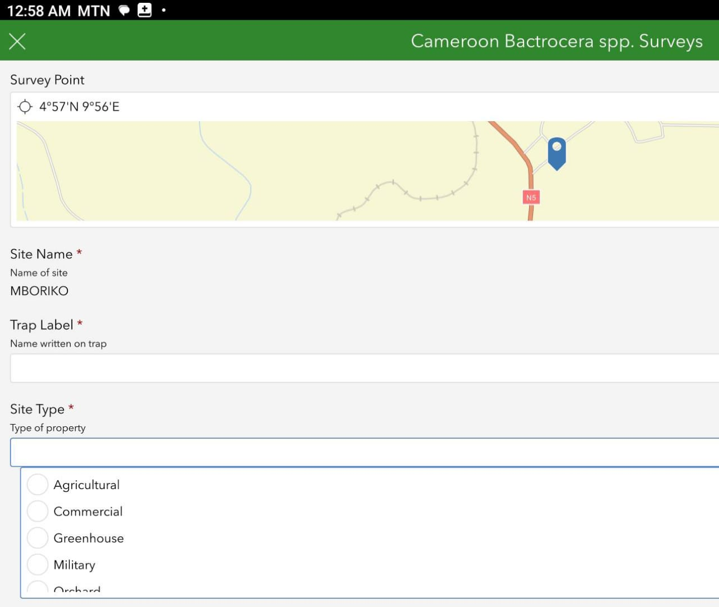
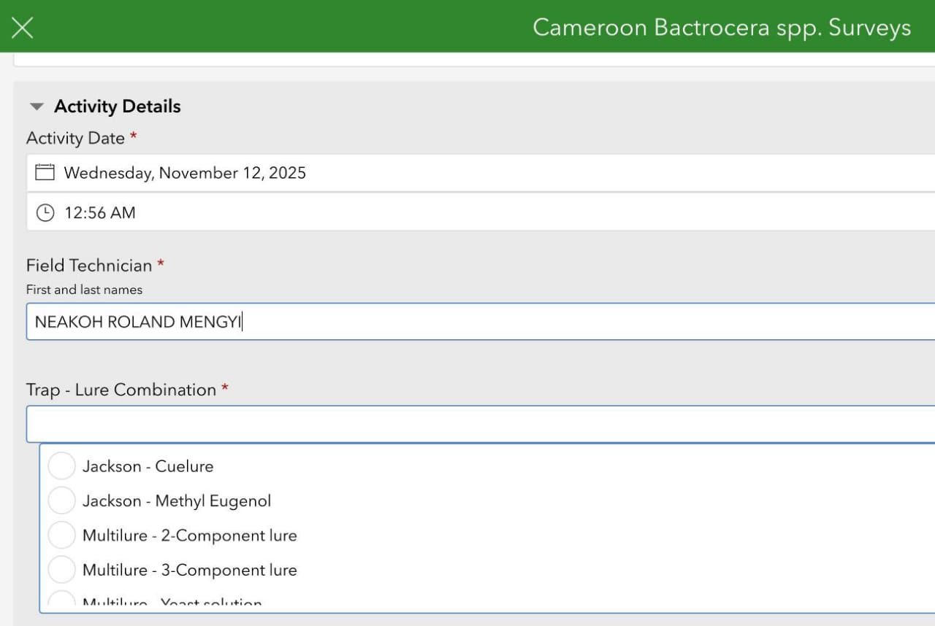
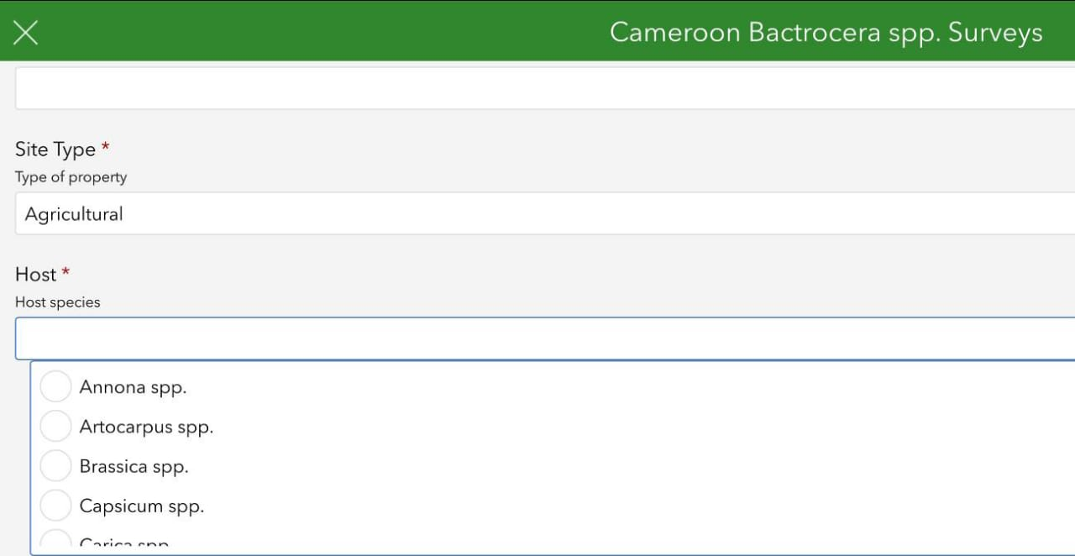
Method and materials
Fill in trap label and select trap type
Select host species
Enter surveyor name
Select trap-lure combination

Slide 9
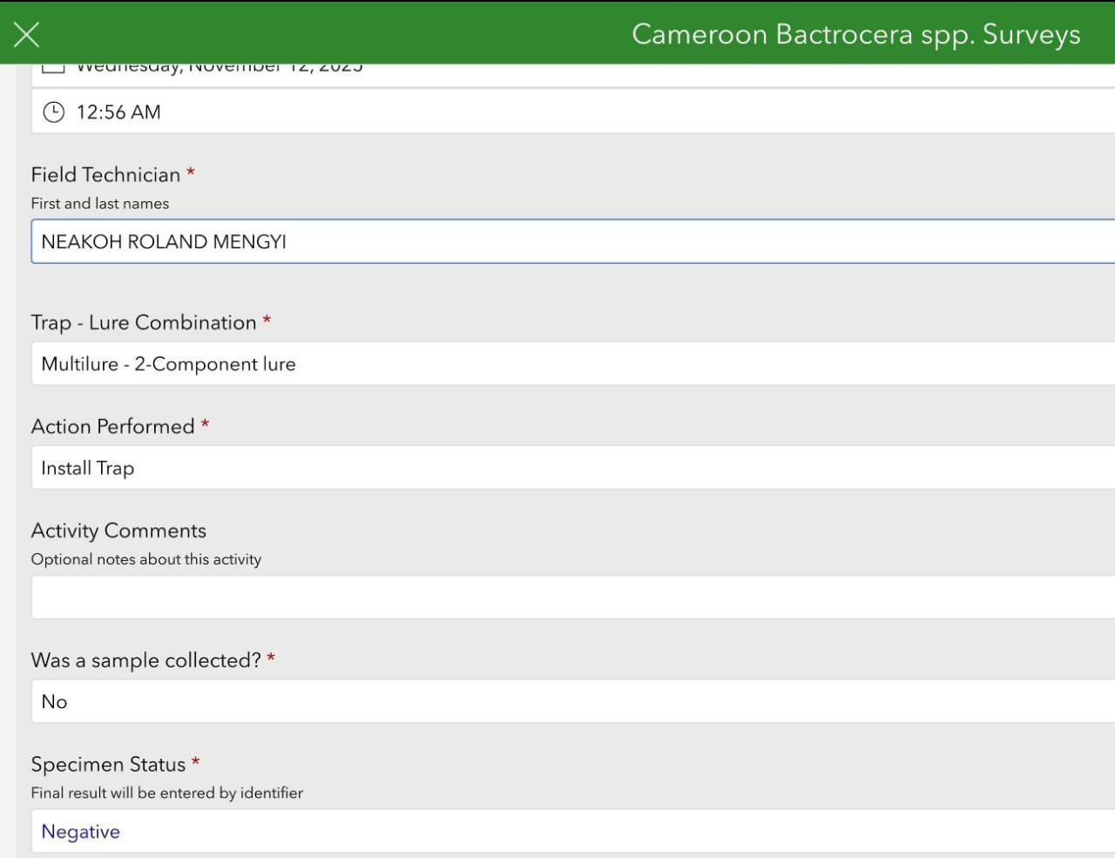
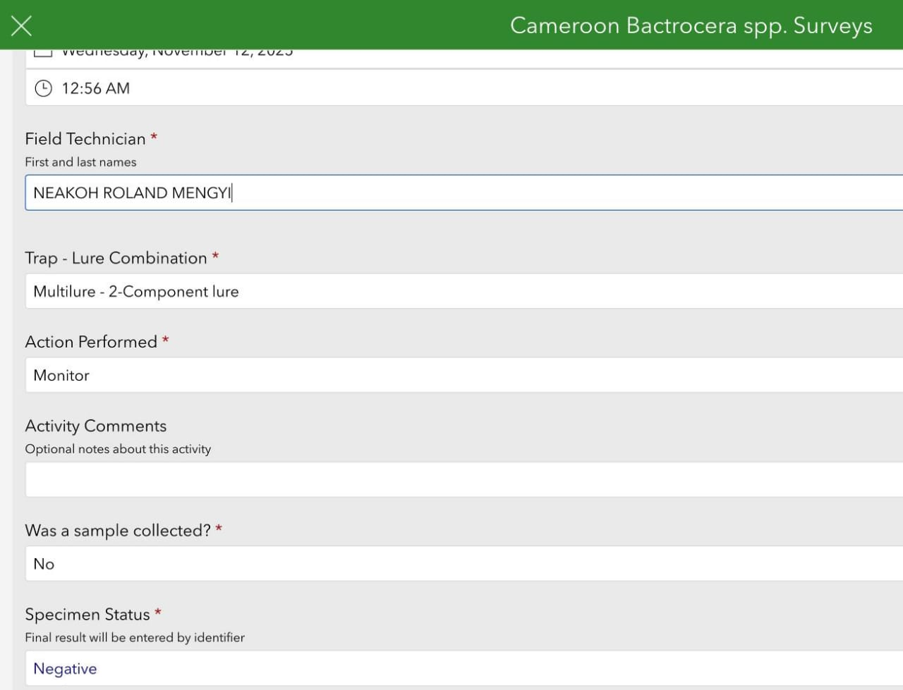
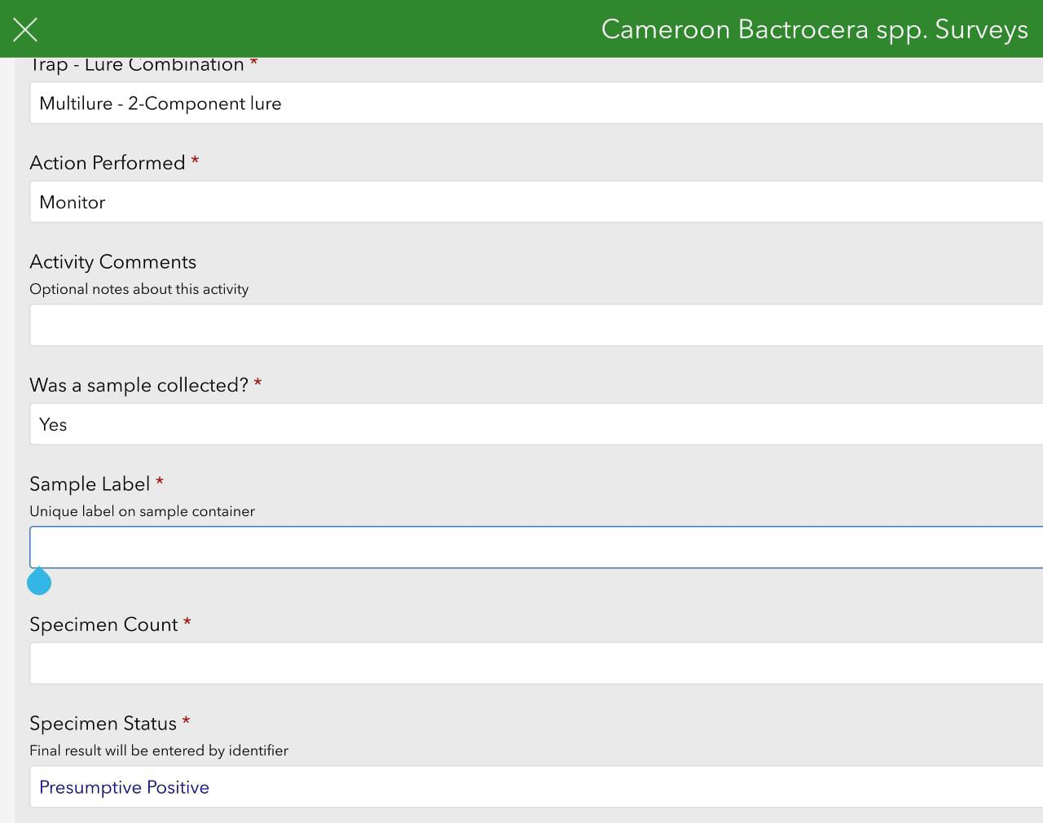
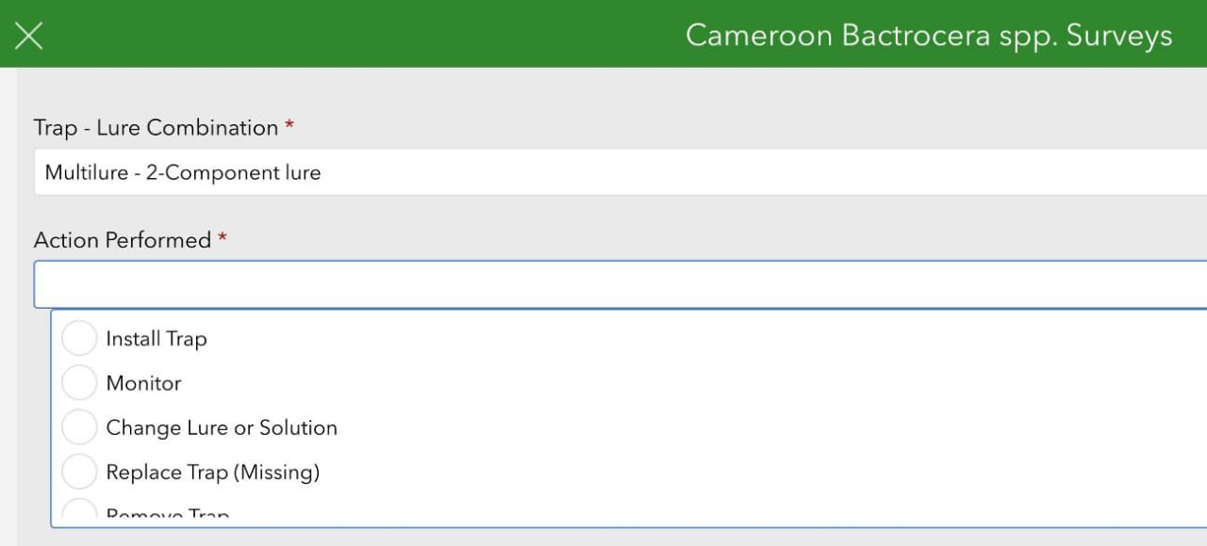
Method and materials
Select action performed
Indicate sample collection

Slide 10
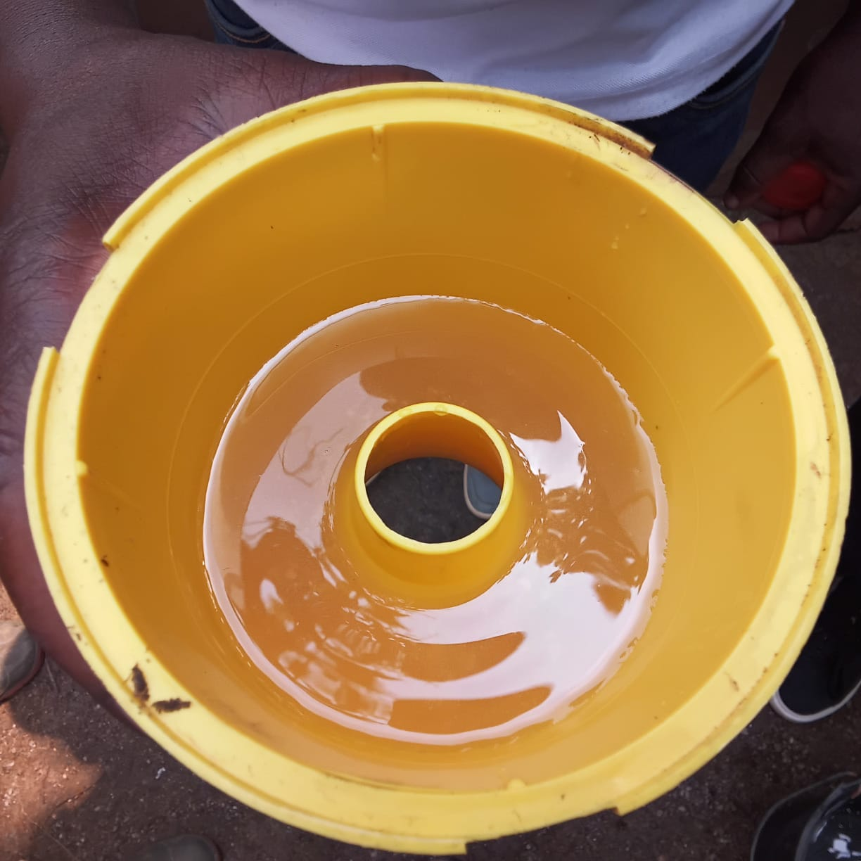
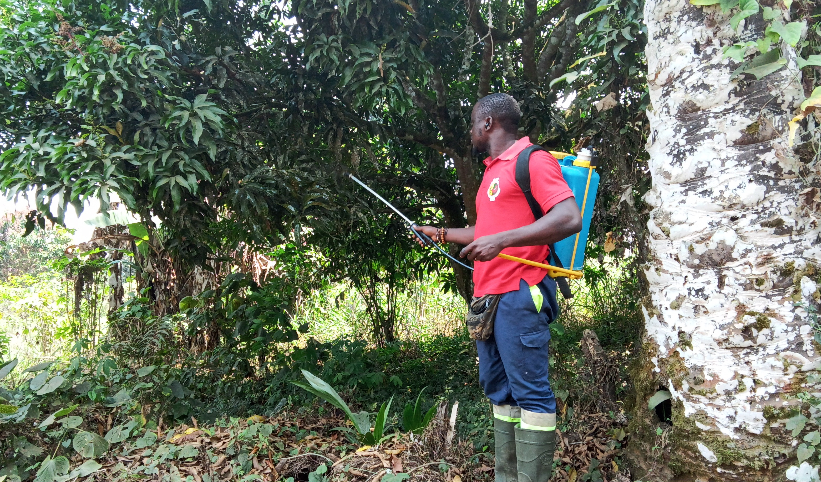
Method and materials
Dissolve Torula Yeast in water and put in Tephrite traps
Mix JF120 in 50% water and spray on foliage and bait station

Slide 11
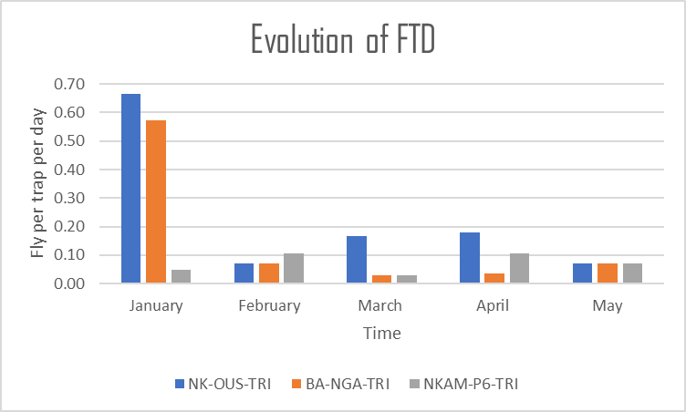
Results
Trimedlure traps

Slide 12
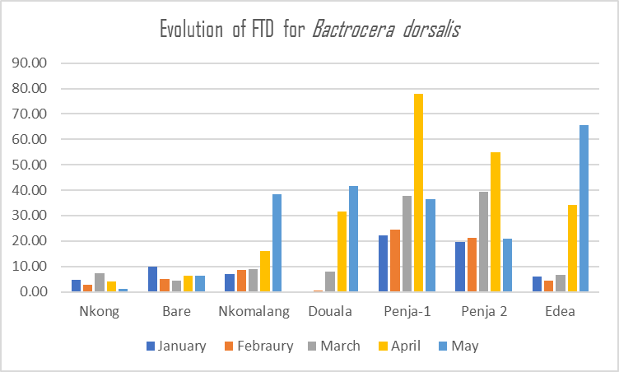
Results

Slide 13
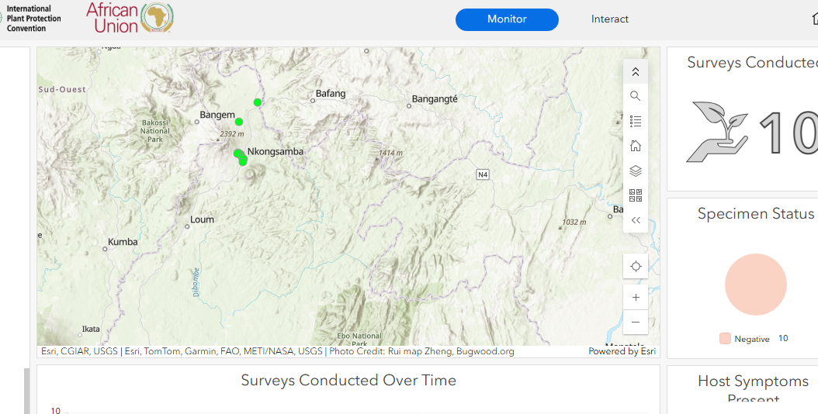

Slide 14
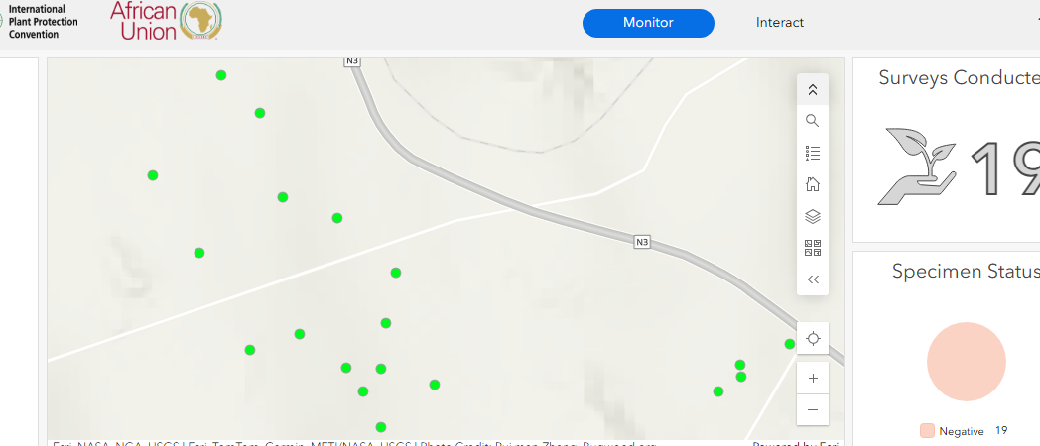
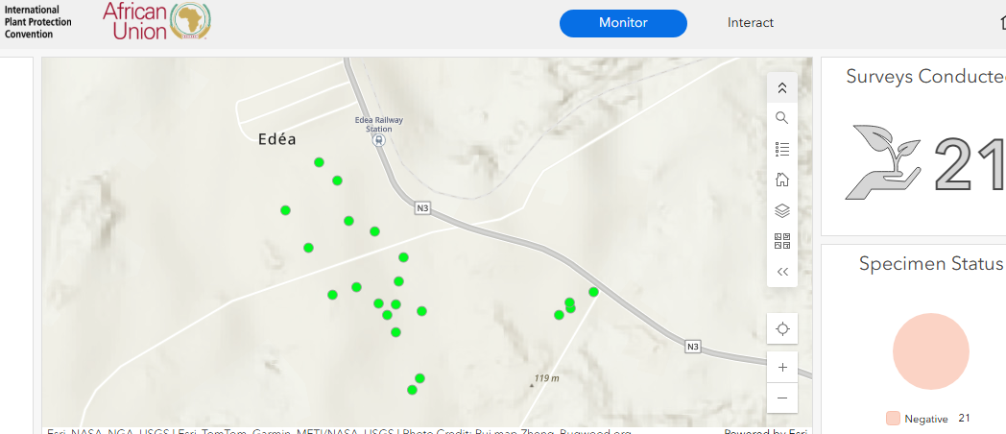

Slide 15
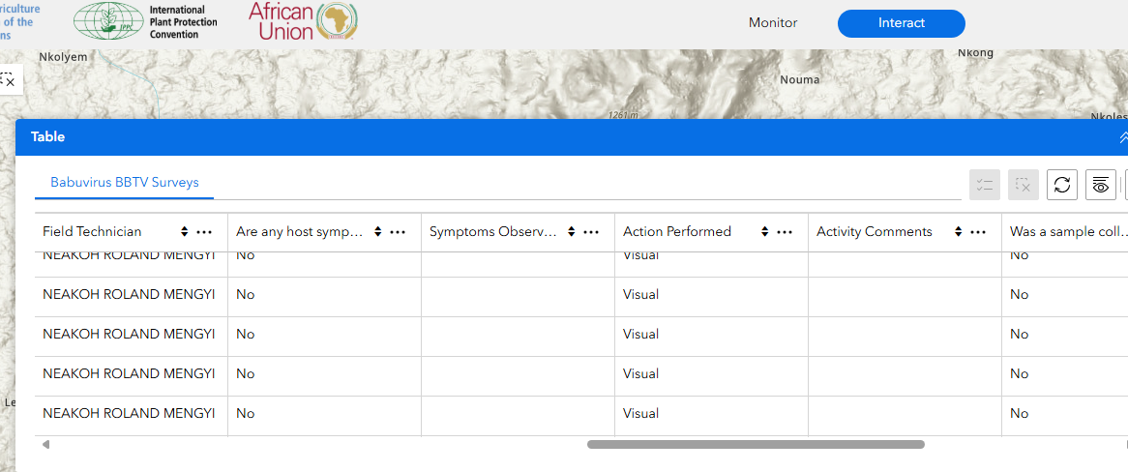

Slide 16
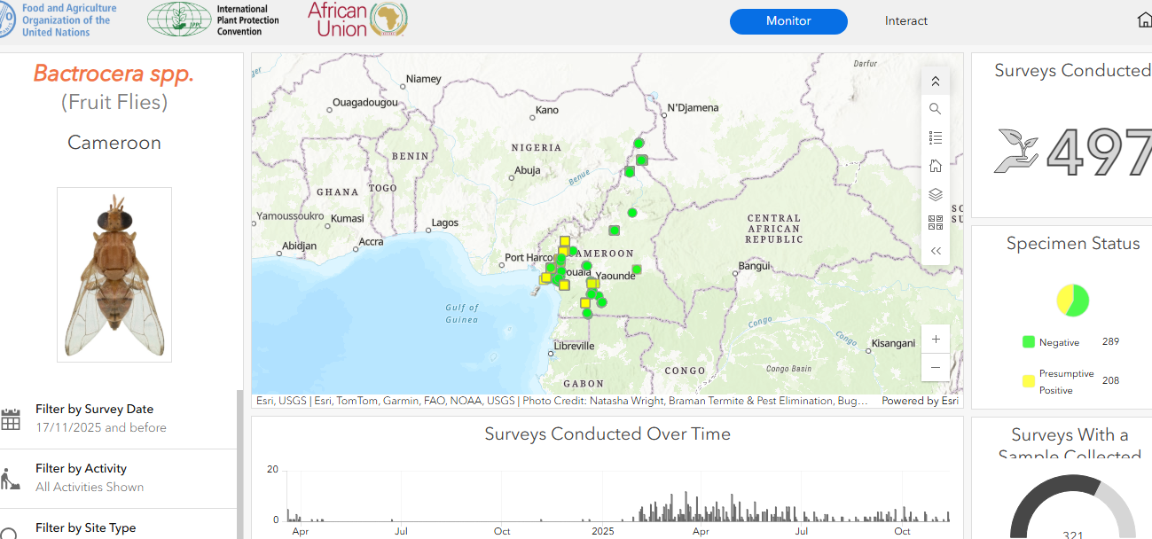

Slide 17
Challenges
Sporadic and poor internet access:
difficult to download offline maps
Prevalence threshold indicator not integrated:
Fly per Trap per Day (FTD)
Missing traps and cross contamination

Slide 18
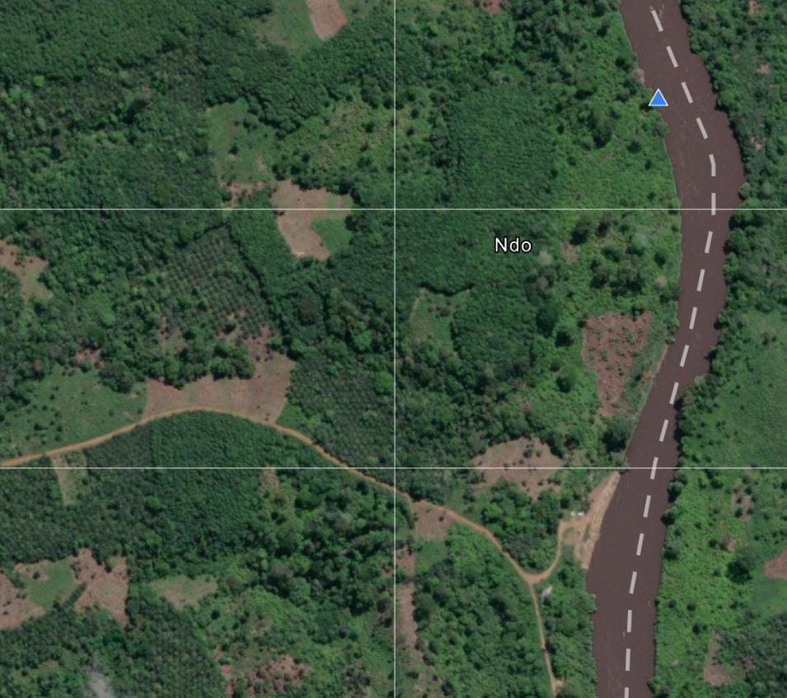

Thank you for your kind attention
neakohrola@yahoo.co.uk
+ 237 670 61 61 43

