Slide 1
Official controls of passenger luggage at points of entry
Katrin Kaminski
Julius Kühn-Institut (JKI), Federal Research Center for Cultivated Plants Institute for National and International Plant Health
Braunschweig, Germany
EPPO Workshop for Inspectors: Innovative Strategies for Phytosanitary Inspections Session 2: Inspection of passenger luggage at points of entry

Slide 2
EPPO Standard PM 3/96 Official controls of passenger luggage at points of entry
Example: Implementation of passenger controls in Germany

Slide 3
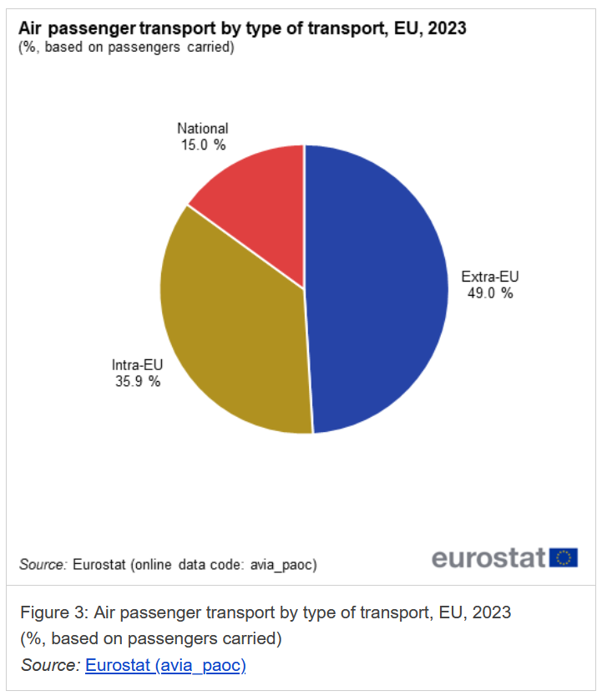
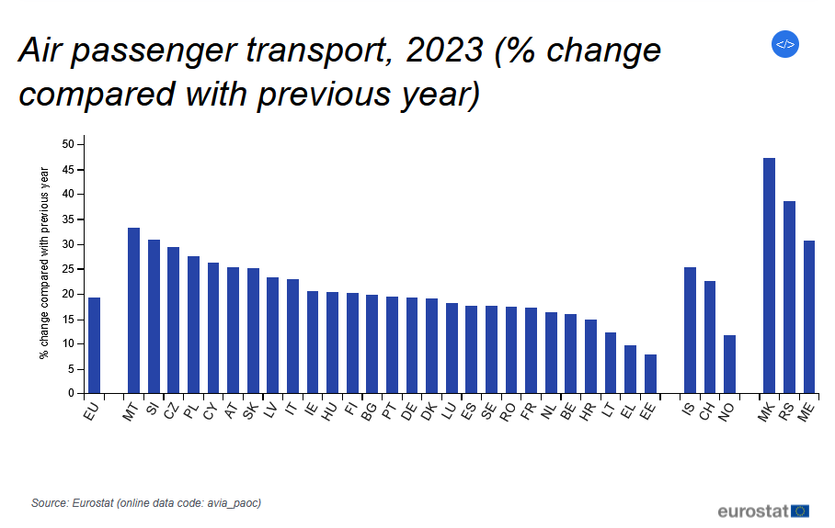
Official controls of passenger luggage at points of entry
Introduction
Plants, plant products or other regulated articles in passenger luggage can be a pathway for pest introduction
Passengers bring plants for consumption or planting, as souvenirs or for sale
Number of passengers is rising (in 2023, 8.7 billions worldwide*)
in the EU:
* According to Airport Council International (ACI) World
Katrin Kaminski | EPPO Workshop for Inspectors | 19.11.2025

Slide 4
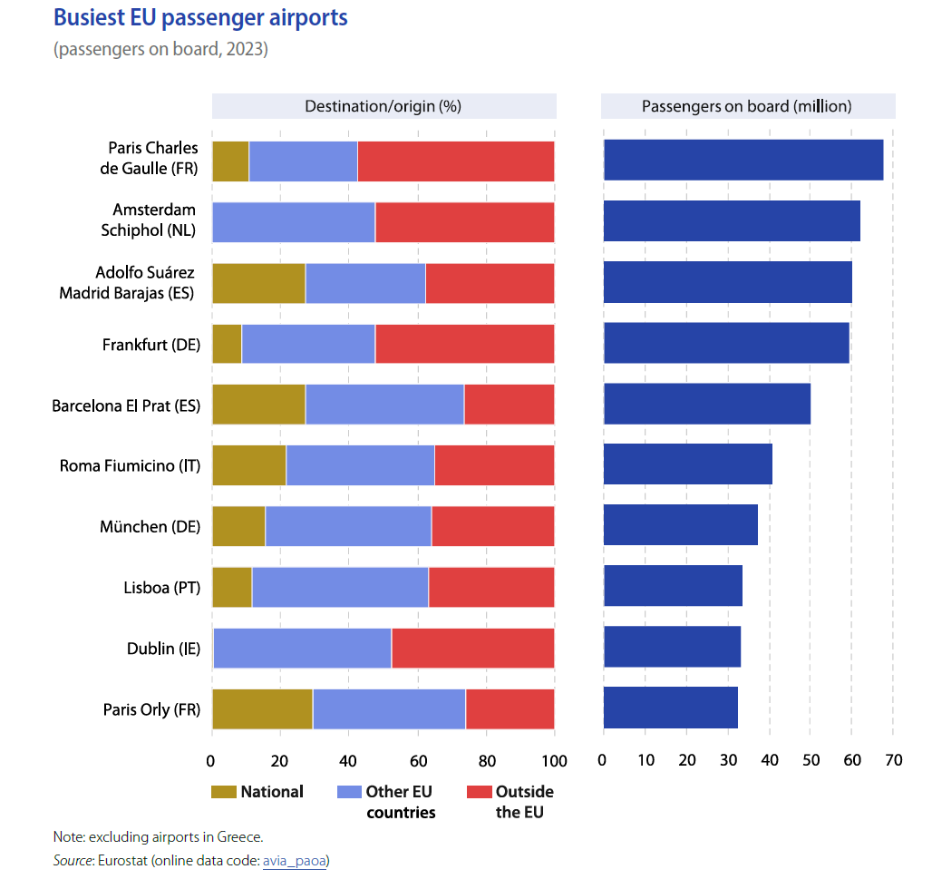
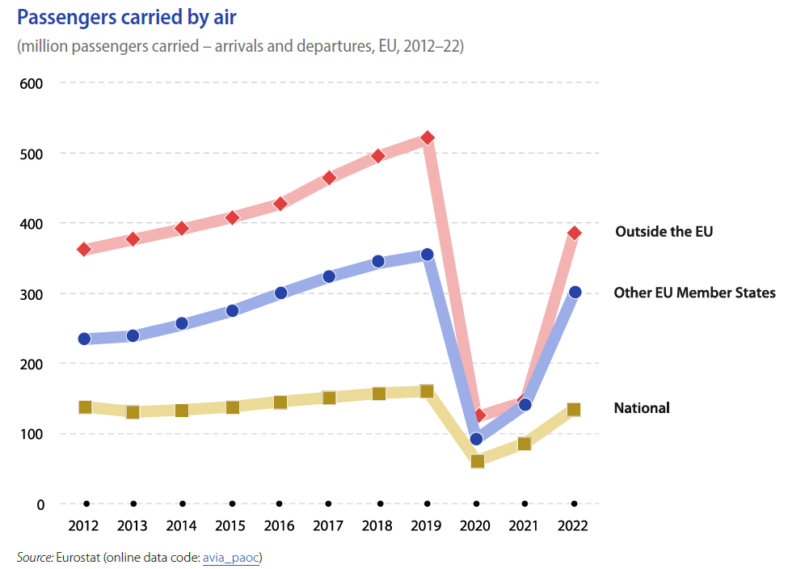
Official controls of passenger luggage at points of entry
Introduction
Proportion of passengers outside the EU
In the EU:
Katrin Kaminski | EPPO Workshop for Inspectors | 19.11.2025

Slide 5
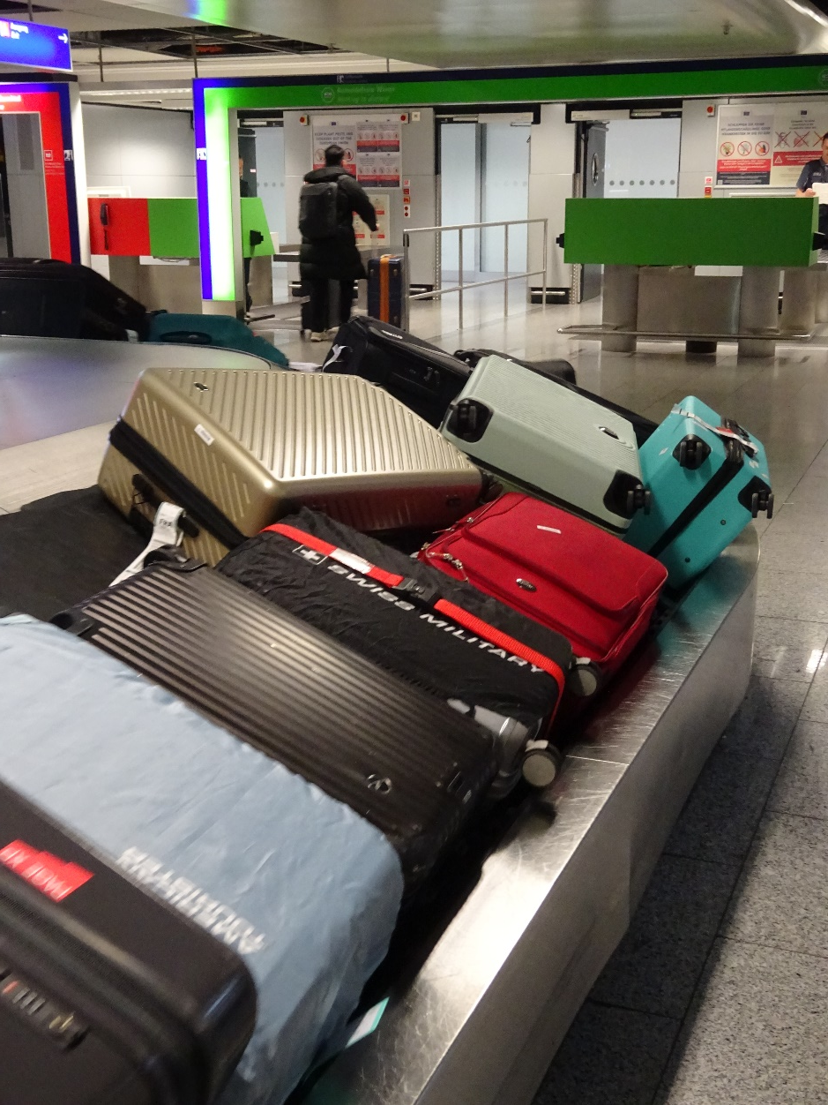
Official controls of passenger luggage at points of entry
Introduction
Plants in passenger luggage may originate in nurseries, private gardens or natural environment
Phytosanitary risk: plants are usually not treated or checked for compliance with import requirements
Many passengers lack awareness of the pest risk of carrying plants and regulations
Passenger luggage may be used for commercial purposes to bypass the phytosanitary controls
Katrin Kaminski | EPPO Workshop for Inspectors | 19.11.2025

Slide 6
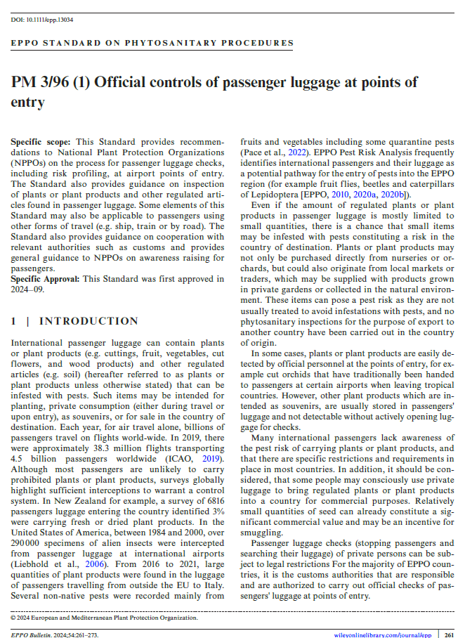
Official controls of passenger luggage at points of entry
EPPO Standard PM 3/96 Official controls of passenger luggage at points of entry (First published on 16 November 2024)
Passenger Awareness
Responsibilities, Procedure, Training and Regulations
The main products of concern and their associated pests
Inspection
Sampling for laboratory testing
Katrin Kaminski | EPPO Workshop for Inspectors | 19.11.2025

Slide 7


Official controls of passenger luggage at points of entry
Passenger Awareness
Awareness raising campaigns and permanent activities are important tools
Provide key information for travellers, including regulations
Leaflets, posters, short videos, interactive stands at points of entry and other actions
Aim of raising awareness and influence the behaviour of passengers, therewith minimize the phytosanitary risk
EPPO Standard PM 3/86 Raising public awareness of quarantine and emerging pests
Information on LinkedIn
Katrin Kaminski | EPPO Workshop for Inspectors | 19.11.2025

Slide 8
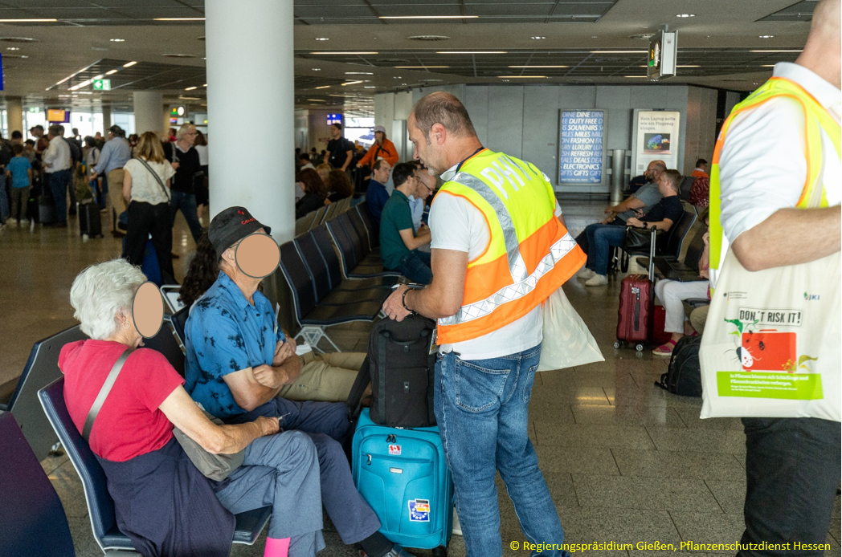
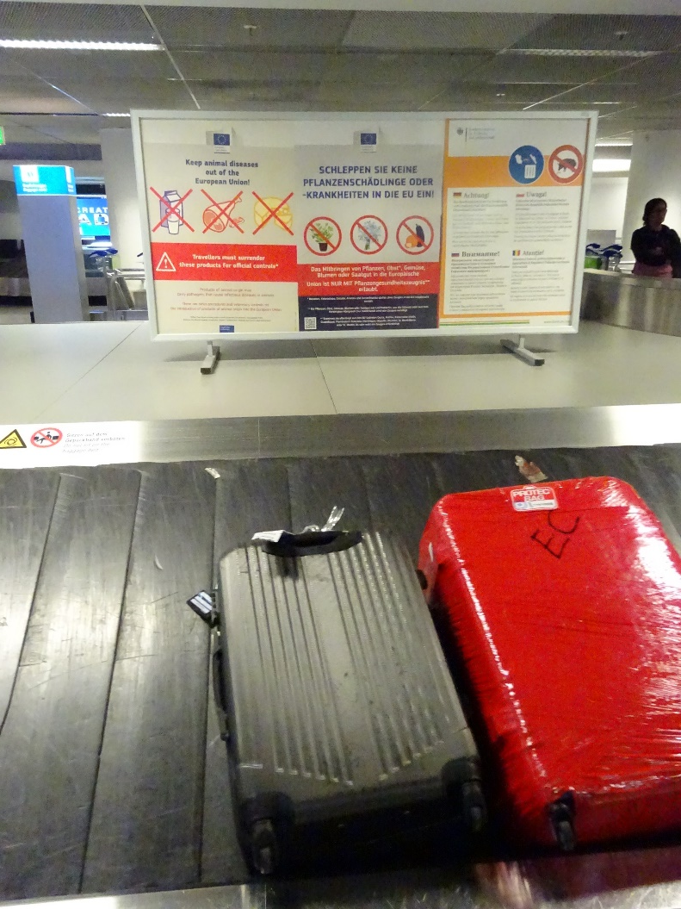
Official controls of passenger luggage at points of entry
Passenger Awareness
Posters at the baggage claim area
at Frankfurt Airport
Action day in the departure area of Frankfurt Airport
Katrin Kaminski | EPPO Workshop for Inspectors | 19.11.2025

Slide 9
Official controls of passenger luggage at points of entry
Responsiblities
Primarily the customs authorities are responsible for passenger luggage checks
NPPO responsible for implementation of phytosanitary regulations
Good cooperation required
Clearly definded responsibilities, also in detail
Clear information flow
Passenger controls
Customs authority
NPPO
Clarifying…
… who is doing
… what and…
… where and…
… when and…
…how
Katrin Kaminski | EPPO Workshop for Inspectors | 19.11.2025

Slide 10
Official controls of passenger luggage at points of entry
Procedures
Higher-level procedures
Planning the checks at national level, including identifying all points of entry
Inspection procedures
Planning the checks
Maintenance of tools and devices
Contact to airport operators
SOPs and guidelines
Training of staff, including customs
Evaluation of the controls
Awareness raising
Sampling and testing, if required
Taking measures and communicating with passengers, invoicing the fines (if any)
Destruction of confiscated material
Documentation and reporting
Inspecting relevant goods
Checking the luggage
Katrin Kaminski | EPPO Workshop for Inspectors | 19.11.2025

Slide 11
Official controls of passenger luggage at points of entry
Risk-based approach and random checks
Risk-profiling as part of the planning process
Collect enough data, including reports from other countries
Based on data and experience from previously conducted passenger checks:
Frequency and quantity of the introduced plants
Likelyhood of the plants being infested
Main plant species and commodities
Additional risk considerations (priority regulated pest present in the departure country)
Specific for each point of entry (depending on the flight connections)
Consider passengers with connecting flights
Time of the year (different risk for spread and establishment)
Risk-profile needs to be updated at regular intervals
Share information with the customs
Katrin Kaminski | EPPO Workshop for Inspectors | 19.11.2025

Slide 12
Official controls of passenger luggage at points of entry
Practical procedure (I)
Search for regulated articles
In the customs area at exits of passenger channels
Categorisation
PC required?
Communication
Phytosanitary inspection
Prohibited article?
Relevant article included?
Explanation of the phytosanitary controls to the passenger
Visual examination of the articles and the luggage (packaging)
Katrin Kaminski | EPPO Workshop for Inspectors | 19.11.2025

Slide 13
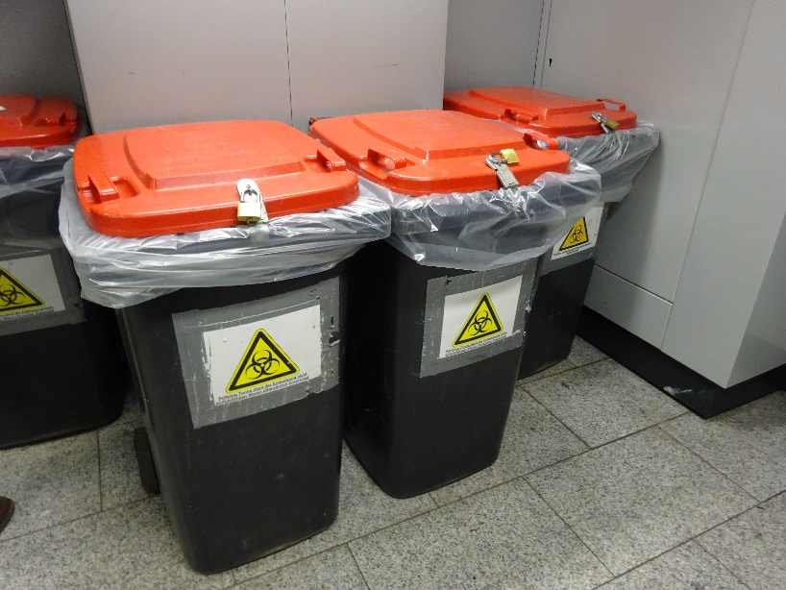
Official controls of passenger luggage at points of entry
Practical procedure (II)
Documentation
Decision on compliance
Disposal
Reporting
Non-compliant articles to be seized
Temporay storage
Imposing a fine?
Notification of non-compliance
Destruction
Container for the disposal of non-compliant goods at Frankfurt Airport
Katrin Kaminski | EPPO Workshop for Inspectors | 19.11.2025

Slide 14
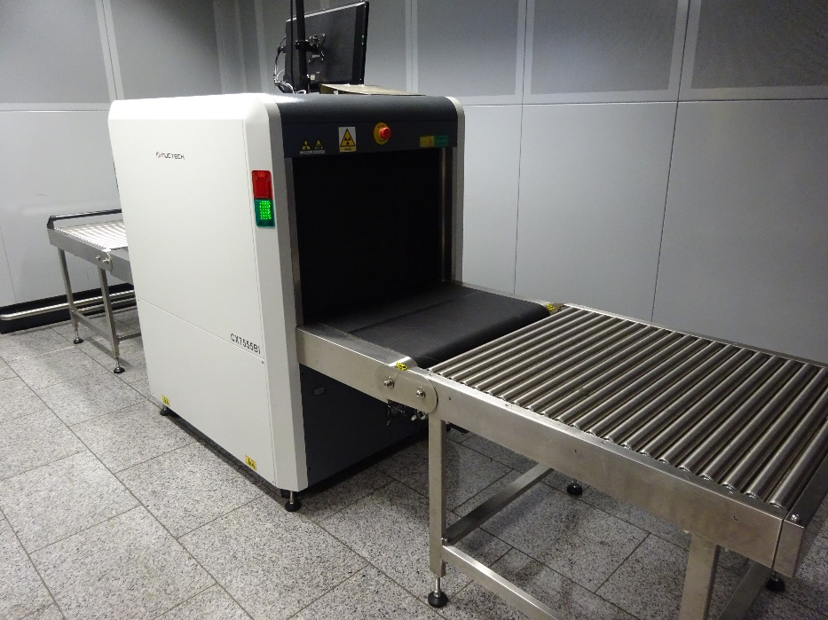
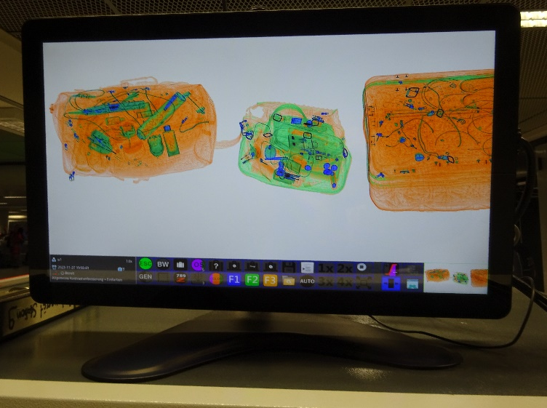
Official controls of passenger luggage at points of entry
Inspection of passenger luggage
Typical elements of international and regional Standards should be observed (although passenger controls are not specified)
Expertise
Appropriate facilities and equipment to check all content of the baggage
Visual inspections by inspectors (torch, magnifying lens, cutting tools)
Undisturbed inspection place
Be prepared for mobile insects!
X-ray scanner in the customs clearance area at Frankfurt Airport
Katrin Kaminski | EPPO Workshop for Inspectors | 19.11.2025

Slide 15
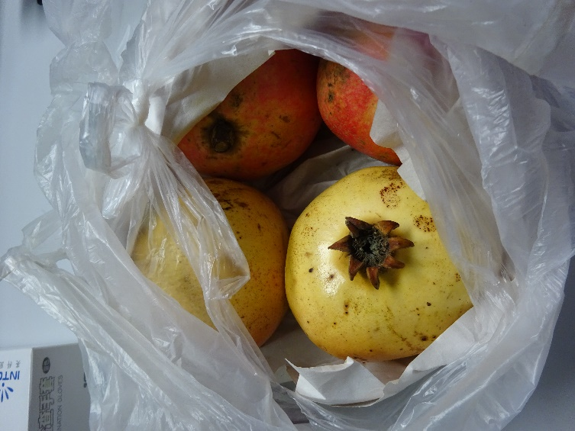
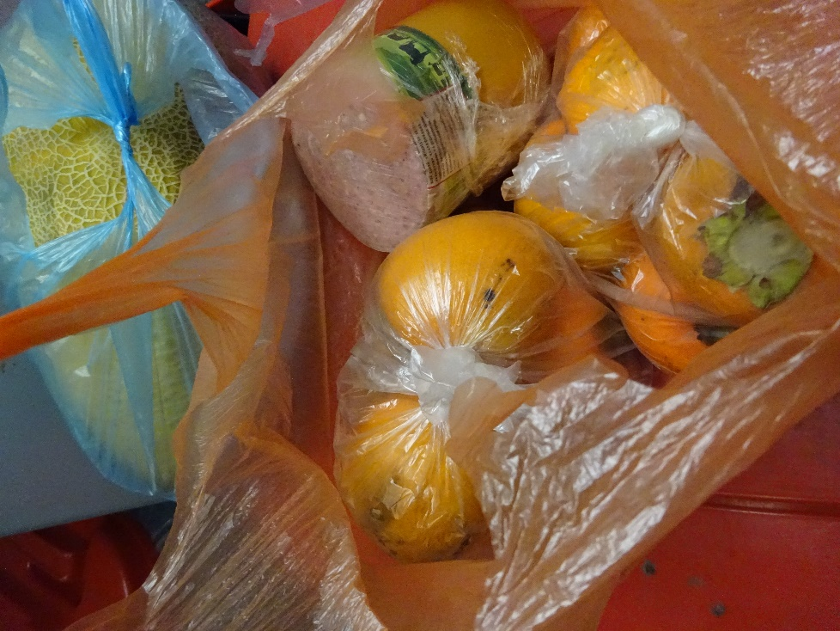
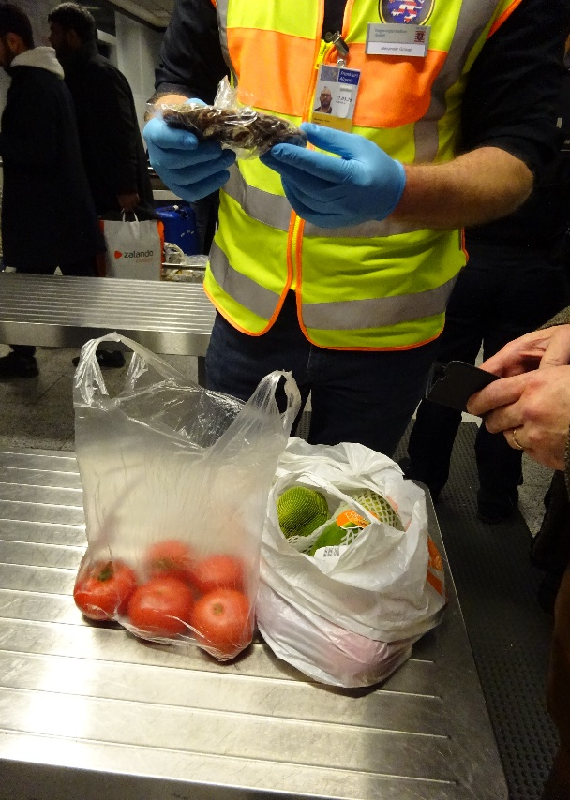
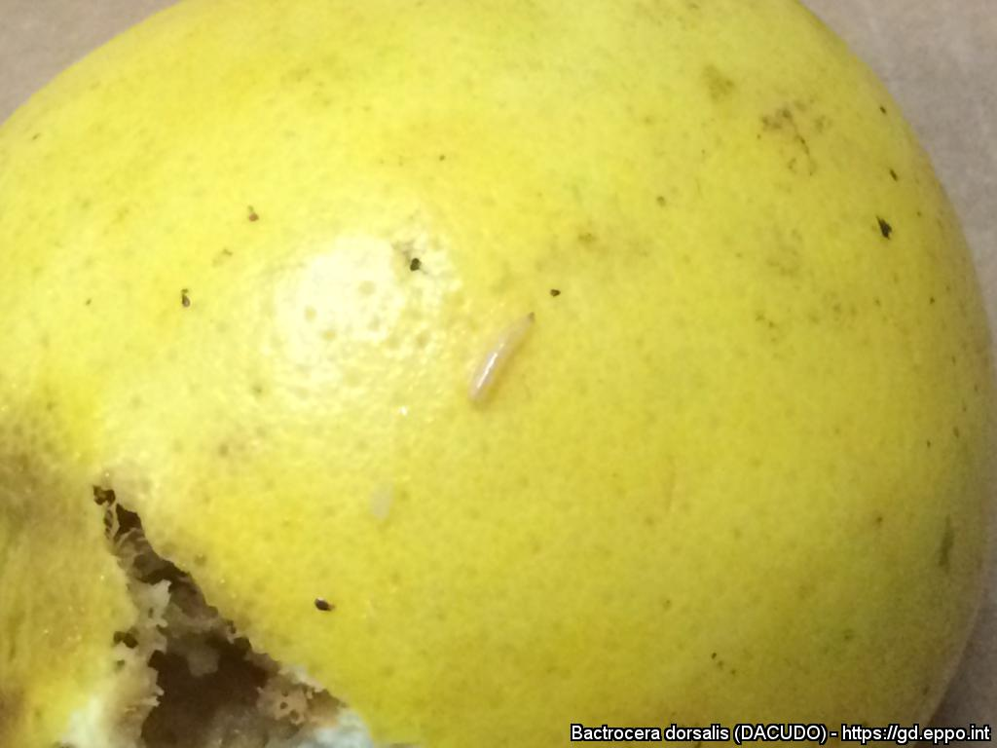
Official controls of passenger luggage at points of entry
Main products of concern and their associated pests
Fruit
Different arthropod species (fruit flies and other insects)
Vegetables
Various pests (thrips, whiteflies, larvae of Lepidoptera, etc.)
Bactrocera dorsalis
(Paride Missio, Swiss Federal Plant protection Service SPPS)
Katrin Kaminski | EPPO Workshop for Inspectors | 19.11.2025

Slide 16
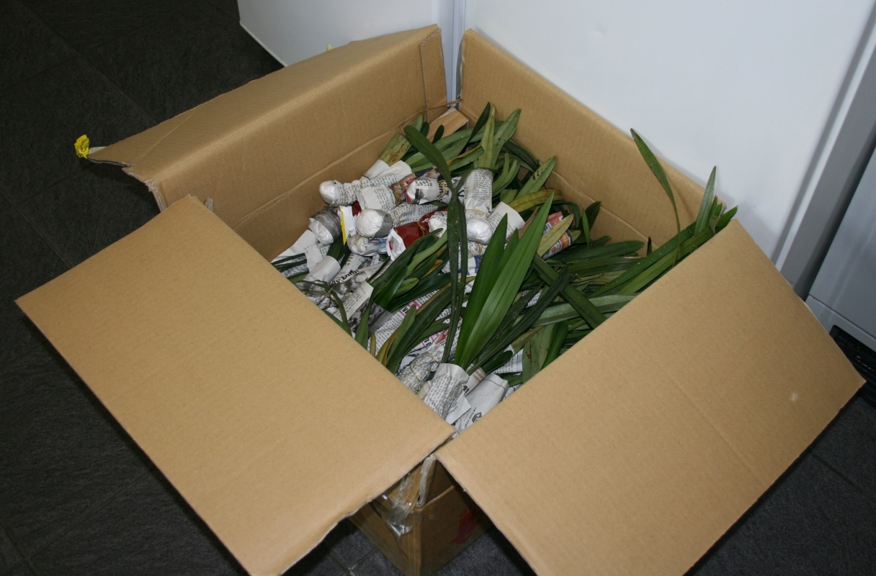
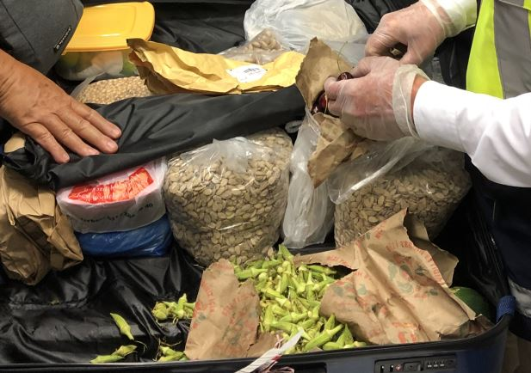
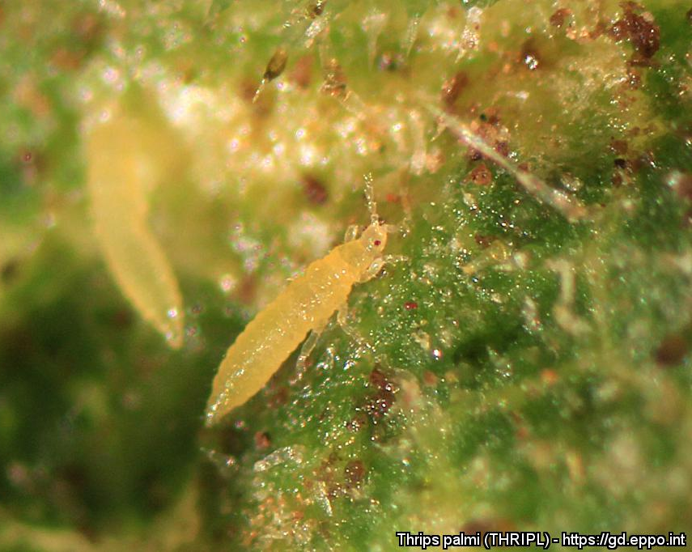
Official controls of passenger luggage at points of entry
Main products of concern and their associated pests
Plants for planting (excluding seed)
Cuttings, tubers, bulbs, roots, whole plants
Sometimes associated with soil
Various pests
Seed and grain
For sowing or consumption
Numerous seed-borne or transmissable pests
© Regierungspräsidium Gießen, Pflanzenschutzdienst Hessen
Larva of Thrips palmi (Philippe Ryckewaert (CIRAD))
© Regierungspräsidium Gießen, Pflanzenschutzdienst Hessen
Katrin Kaminski | EPPO Workshop for Inspectors | 19.11.2025

Slide 17
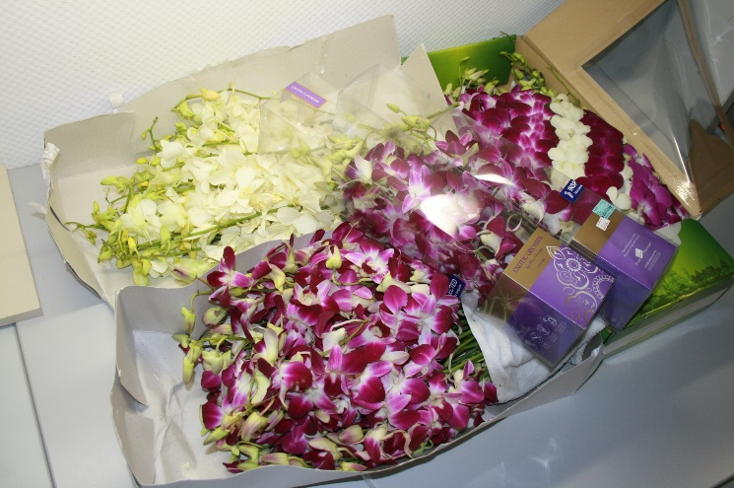
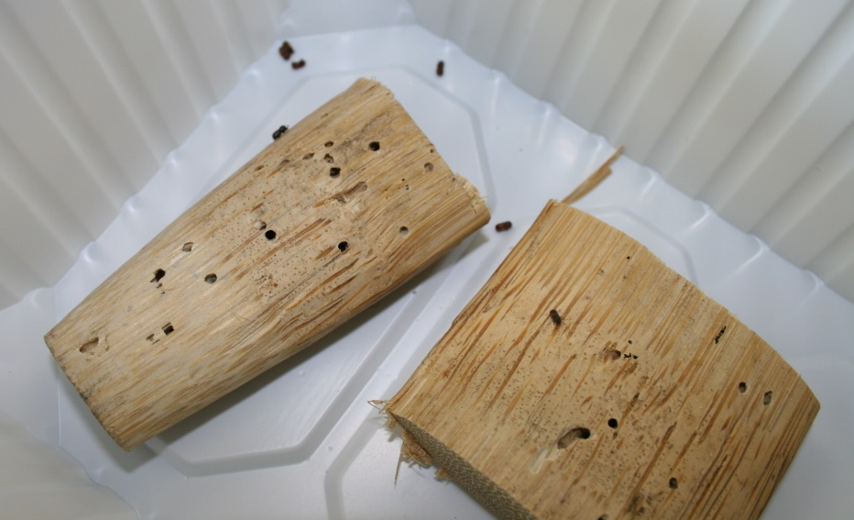
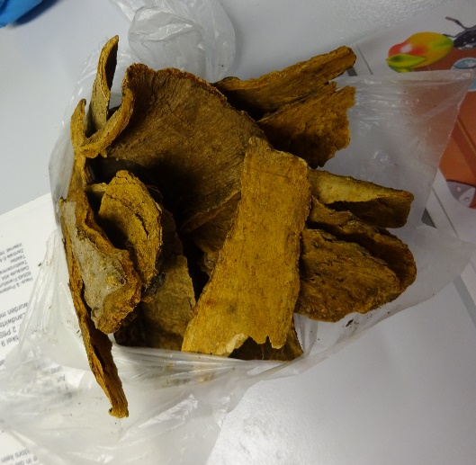
Official controls of passenger luggage at points of entry
Main products of concern and their associated pests
Cut flowers and branches
Numerous pests e.g. thrips, Lepidoptera species
Wood and wood products
Untreated wood and articles
Bark
Various pests e.g. longhorn, bark and ambrosia beetles, nematodes and fungal species
Soil
Attached to plants or as soil itself
Containing organic material
Various pests e.g. nematodes, fungal species, viruses
© Regierungspräsidium Gießen, Pflanzenschutzdienst Hessen
© Regierungspräsidium Gießen, Pflanzenschutzdienst Hessen
© Regierungspräsidium Gießen, Pflanzenschutzdienst Hessen
Katrin Kaminski | EPPO Workshop for Inspectors | 19.11.2025

Slide 18
Implementation of passenger controls in Germany

Slide 19
Official controls of passenger luggage at points of entry
Implementation of passenger controls in Germany
- Responsibilities and agreements with the customs
Since 2022 more formalised agreements with the customs authorities, gradually at all airports with international flights (some of them no border control posts)
Framework agreement at federal level and refined agreements at the airports
Agreement especially on the procedure and delegation of authority in case of findings (confiscation, destruction, documentation, information of affected passengers) and other cooperation issues (training, joint inspections, facilities etc.)
Harmonized formats for seizure and temporary custody of goods and for reporting
Information sheet for customs officer
Katrin Kaminski | EPPO Workshop for Inspectors | 19.11.2025

Slide 20
Official controls of passenger luggage at points of entry
Passenger controls in Germany - Findings in 2023 – 2024
Number of disembarking passengers at German Airports increased (+ 8 % to more than 41.3 Mio.)
Number of German Airports with phytos. passenger control increased (+ 3; 17 of 23 international airports reported interceptions in 2024)
Number of interceptions increased (+ 40 %)
Number of interceptions per Airport and year max. 808 (Dortmund, 16 %)
Number of days with interceptions max. 315 (Munich, 2023)
Own calculations based on data source: Statistisches Bundesamt (Desartis) (2023, 2024): Statistischer Bericht – Luftverkehr auf Hauptverkehrsflügen, Aussteiger nach ausgewählten Streckenherkünften
Katrin Kaminski | EPPO Workshop for Inspectors | 19.11.2025

Slide 21
Official controls of passenger luggage at points of entry
Passenger controls in Germany - Findings in 2023 – 2024
Intercepted passenger luggage from 112 different countries of origin (worldwide)
Katrin Kaminski | EPPO Workshop for Inspectors | 19.11.2025

Slide 22
Official controls of passenger luggage at points of entry
Passenger controls in Germany - Findings in 2023 – 2024
Katrin Kaminski | EPPO Workshop for Inspectors | 19.11.2025

Slide 23
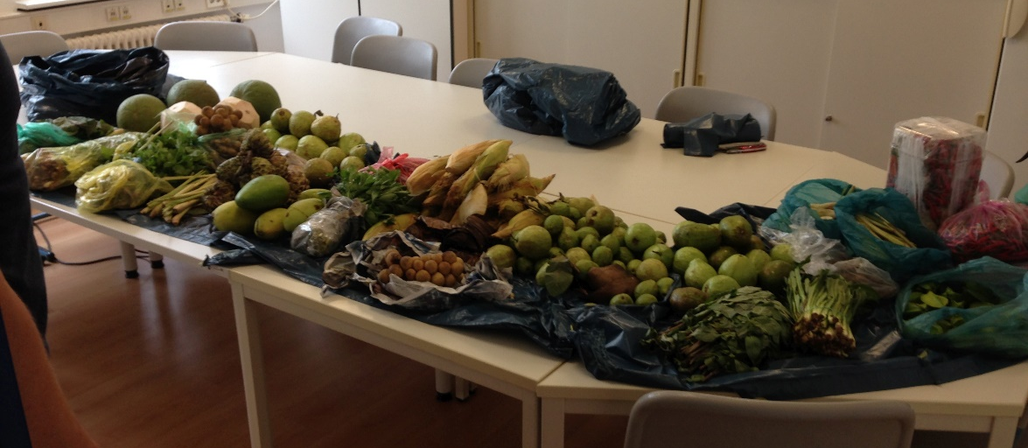
Official controls of passenger luggage at points of entry
Passenger controls in Germany - Findings in 2023 – 2024
© Regierungspräsidium Gießen, Pflanzenschutzdienst Hessen
Confiscated fruits and vegetables at Frankfurt Airport
Katrin Kaminski | EPPO Workshop for Inspectors | 19.11.2025

Slide 24
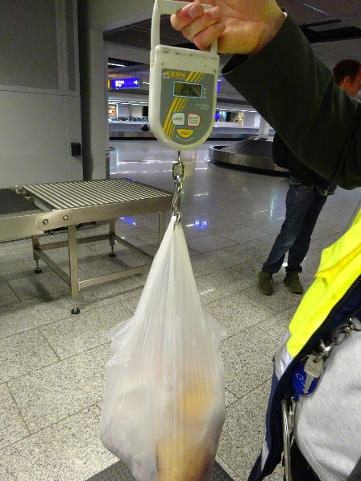
Official controls of passenger luggage at points of entry
Passenger controls in Germany - Findings in 2023 – 2024
Total quantities of intercepted goods in kg increased (+ 2 %)
Additional amounts in piece (weight was not determined)
Average weight per passenger interception at least 6.6 kg in 2024
Weighing the confiscated goods at Frankfurt Airport
Katrin Kaminski | EPPO Workshop for Inspectors | 19.11.2025

Slide 25
Official controls of passenger luggage at points of entry
Conclusions from Passenger Controls in Germany
Passenger controls have been improved since 2022.
Cooperation with the customs is essential and well implemented in Germany.
Phytosanitary risk based checks are difficult to implement because of multiple tasks of the customs (drugs, weapons etc.).
In practice, the possibilities for documentation are limited (e.g. number of inspected pieces of luggage) which also reduces the possibilities for evaluation and risk profiling.
Many non-compliant plants and plant products were/are found in passenger luggage during random checks.
Passenger luggage is considered a pathway for pest introduction.
Non-compliant goods are safely destroyed at airports.
Katrin Kaminski | EPPO Workshop for Inspectors | 19.11.2025

Slide 26
Many thanks to
All colleagues involved in passenger controls at customs and in the plant protections of the Federal Lander and …
Especially the plant protection service Hesse for providing some of the pictures and …
In particular Florian Kunze for compiling the annual reports

Slide 27
Thank you for your attention

