Slide 1

Chinese Unsolicited Seed – UK NPPOs Experience
Paul Bratby – Lead: PHSI e-Commerce Group

Slide 2

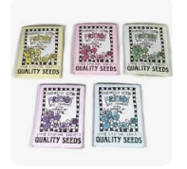
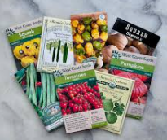
Background
Historically ‘unsolicited seed’ – ie seed that wasn’t ordered or requested by an individual or business has always occurred , though it tends to be quite infrequent with occasional reports being received by members of the public and business’s
Usually flower seeds or vegetable seed

Slide 3
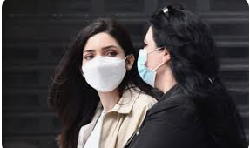



Covid arrived…..
At the end of 2020 reports of people becoming ill with an unknown virus in China and within 6 months the UK and many other countries went into lockdown went into its first lockdown
Empty streets
Masks
Vaccinations

Slide 4
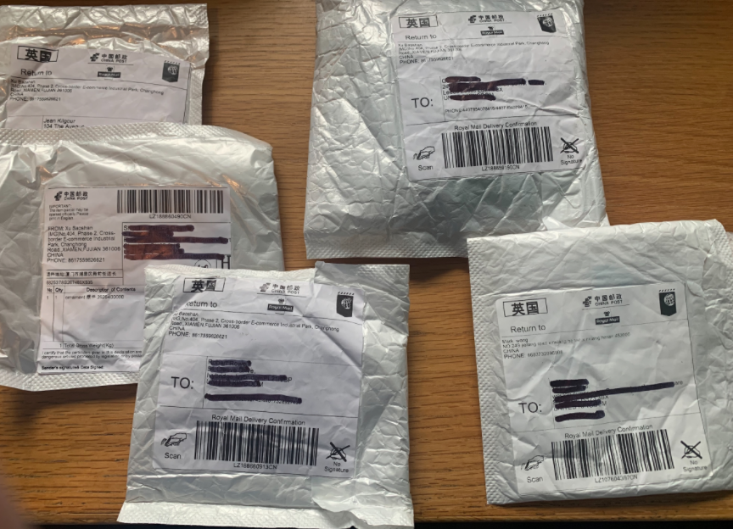
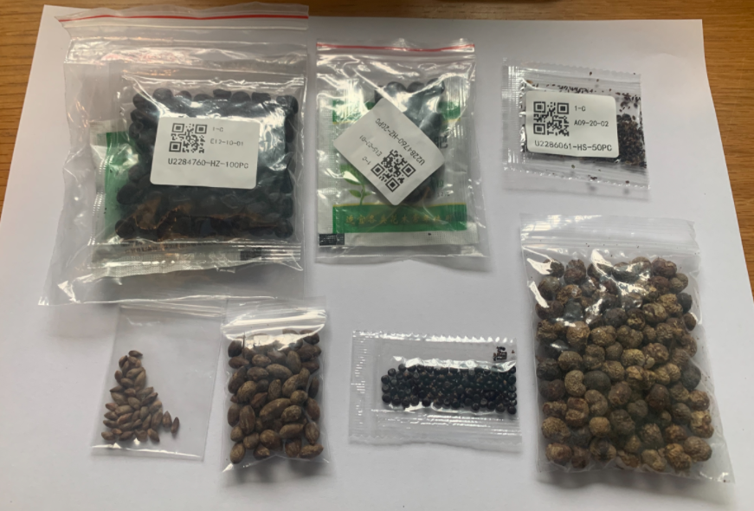
Online shopping
With shops being closed and have restricted hours , online shopping became the norm, but the UK NPPO started receiving queries from memebers of the public who were receiving little grey packets with seed enclosed
Mostly small quantities of seed , and almost exclusively from China , though also received from Taiwan , Singapore Malysia, and Thailand , and the occasional package from Malta.

Slide 5
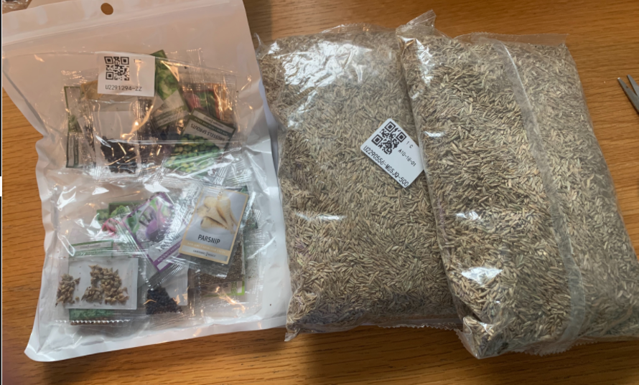
Online shopping
Occasionally larger quantities

Slide 6
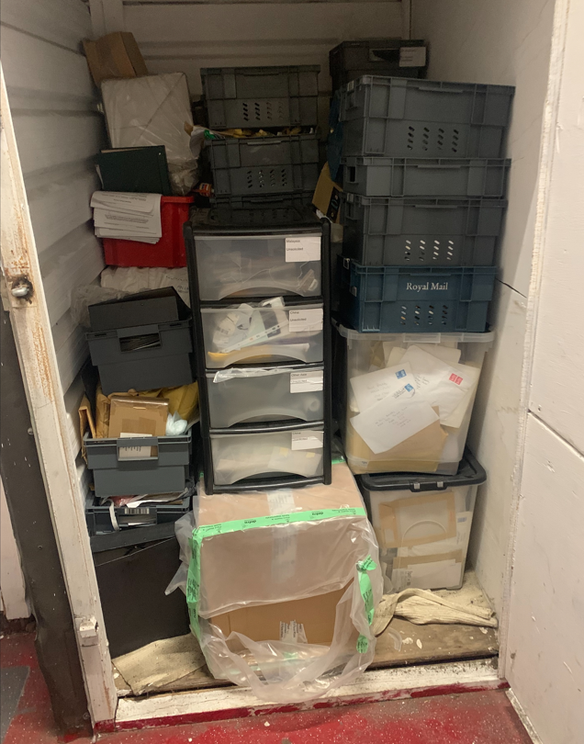
Trickle to flood..
From the a few initial queries, our helpline and Inspectors were receiving queries every day
Through social media and other information outlets , we encouraged members of the public / and business’s to send the packages they received to a central location – my office!
It very quickly became apparent that this was a brushing scam ……

Slide 7
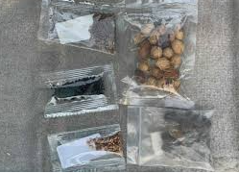
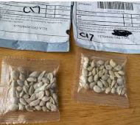
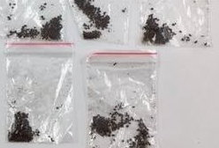
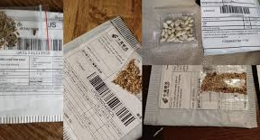
Brushing Scam
https://www.youtube.com/watch?v=5e-vyulWi2o
Brushing Scam..
‘An e-commerce fraud when a seller on an e-commerce platform sends unsolicited packages – often misdescribed’ to avoid interception at the border posts to random individuals tp create positive reviews for their products. Scammers obtain personal accounts on e-commerce sites, order low cost products to be sent to these adrress’s and the post fake revies from those accounts to boost their products ratings and perceived popularity’
Similar scams were happening in other countries such as the USA

Slide 8
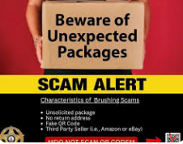
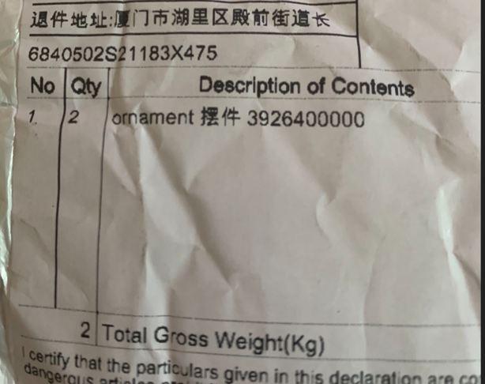
Brushing Scam
Misdescribed goods;
Ornaments
Books
Jewellery
Pens
T-shirts
Scissors
Cards…..

Slide 9

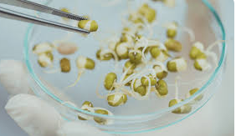
By the end of 2021..
Over Some 5000-7000 packages containing in the region of 20,000- 25,000 individual packets of seeds received from mainly members of the public, If one considers that only a small proportion of seed that arrived in the Uk would have been reported the total number of packages would be very significant
Due to Covid restrictions , not working in teams , etc, it wasn’t possible to catalogue each and every package , but a proportion of the packages were sent to The Food and Environment Agency labs to do seed identification , seed testing, gemination tests .
Overarching analysis of the senders names and address’s , suggested that the consignors were interlinked– its very likely that the seeds were actually distributed from a relatively small number of premises in China

Slide 10
Summary of analysis:
Poor quality seed – very low germination
Extraneous matter – plant parts ‘chaff’/debris, some soil/growing medium
Majority of the seed was ‘low risk’ –flower seed, herb seed, some grasses, some vegetable seeds
There were packages of Solanaceous seed – mainly tomato – no pest or disease detected
Worth noting only small quantities of seed were tested – so confidence levels in detection low.

Slide 11
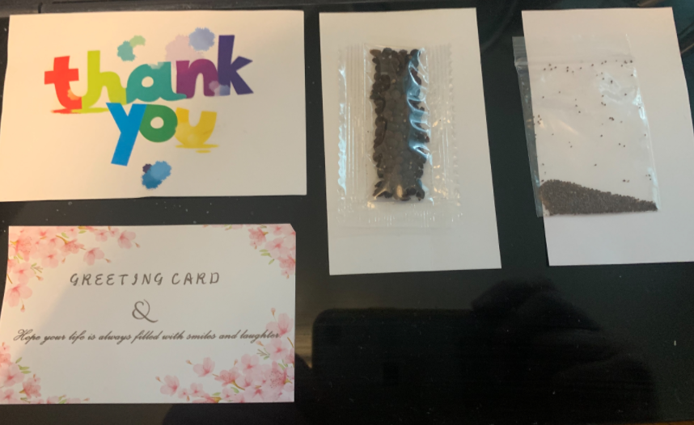
Everything went ‘quiet’ for 3 years…
After the middle of 2022 , the number of packages received started to decline and until the end of 2024, there were relatively low numbers
From the beginning of 2025 the number of reports have started picking up again , and packages are arriving every day.
Will be cataloging all packages and sending a proportion for testing
Intercepting large numbers from the UKs International Postal Depot at Heathrow Airport
There appears to be a trend revolving around greeting cards that accompany the seed – and 2 designs of greeting card in particular:

Slide 12

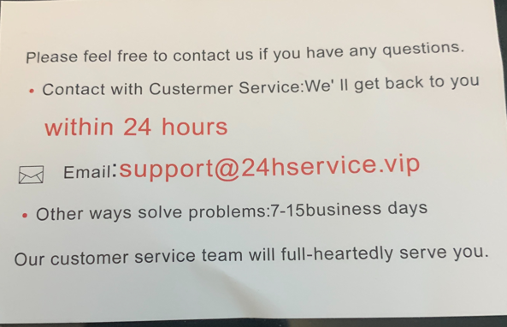
Its not a ‘Thankyou’
There are some details on the back of the card inviting you to contact an e-mail address
There are suggestions if you contact the e-mail address – there is an opportunity for the recipient to gain access to your e-mail and take personal details – scamming.
It has been referred to a ‘slap’ or ‘slash’ scam

Slide 13
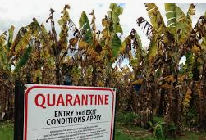


Take away messages
Biosecurity risk – relatively low risk based on small quantities of seed an individual receives and the majority of the seeds are not considered as virus/viroid/disease carriers
IT fraud risk – high risk – if someone has received seeds then a scammer has their details from somewhere – whether the ecommerce platform, bank details – receiving anything unsolicited should raise a red flag!
Bioterrorism risk - ?? Seed treated with biological warfare agents seems the stuff of sci-fi – but is it really sci-fi in todays world?

Slide 14

Thankyou for your time
Stay safe

