Slide 1

EPPO PM 3 Standards - disseminating information to inspectors in the EPPO region
Rob Tanner
Scientific Officer
European and Mediterranean Plant Protection Organization

Slide 2
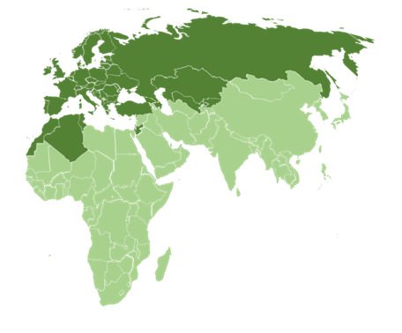
European and Mediterranean Plant Protection Organization
Intergovernmental Organization
Created in 1951: 52 member countries
International cooperation in plant health - plant quarantine - plant protection products
Works for and with National Plant Protection Organizations
2

Slide 3




EPPO’s Aims
to support the Member Governments in their aim of assuring plant health, while preserving human and animal health and the environment.
to pursue and develop, by cooperation between the Member Governments, the protection of plants and plant products against pests and the prevention of their international spread and especially their introduction into endangered areas.
to develop internationally harmonized phytosanitary and other official plant protection measures and, as appropriate, to elaborate standards to that effect.
to present the collective views of the Member Governments, as appropriate, to FAO, World Trade Organization (WTO), other RPPOs and any other bodies with related responsibilities.
3

Slide 4
EPPO Strategic Framework 2026-30
Strategic objectives
1: Enhance Regional Preparedness and Response to Pest Threats for the EPPO region
2: Engage and Promote Sustainable Plant Protection Strategies
3: Strengthen the Scientific Foundation of Phytosanitary Regulations
4: Strengthening Cooperation and Knowledge Sharing Across the EPPO Region and Beyond
5: Strengthening Regional and Global Alignment for Effective Plant Health Management
6: Strengthening the Leadership Role of EPPO and Securing its Future
4

Slide 5
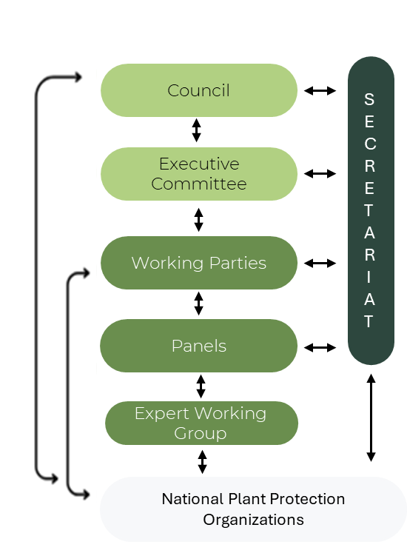
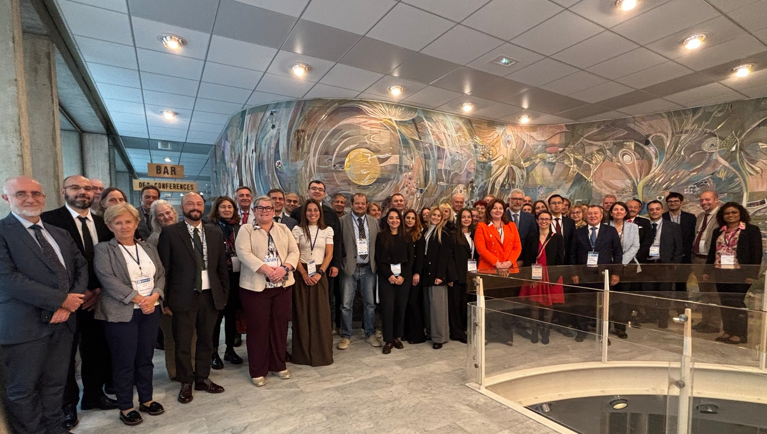
EPPO Structure
75th EPPO Council Session (2025)
5

Slide 6
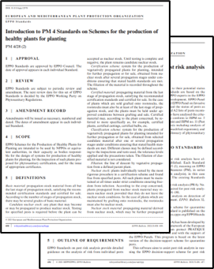
Active Panels
EPPO Standards
EPPO makes recommendations to the National Plant Protection Organizations of its Member Governments. These recommendations are considered as Regional Standards in the sense of the IPPC
EPPO Standards are organized in the following series:
PP1 - Efficacy Evaluation of Plant Protection Products
PP2 – Good Plant Protection Practice
PP3 – Environmental Risk Assessment of Plant Protection Products
PM1 – General Phytosanitary Measures
PM3 - Phytosanitary Procedures
PM4 - Production of healthy plants for planting
PM5 - Pest Risk Analysis (PRA)
PM6 - Safe use of Biological Control
PM7 - Diagnostic protocols for regulated pests
PM8 - Commodity-specific Phytosanitary Measures
PM9 - National Regulatory Control Systems
PM10 - Phytosanitary Treatments
6

Slide 7
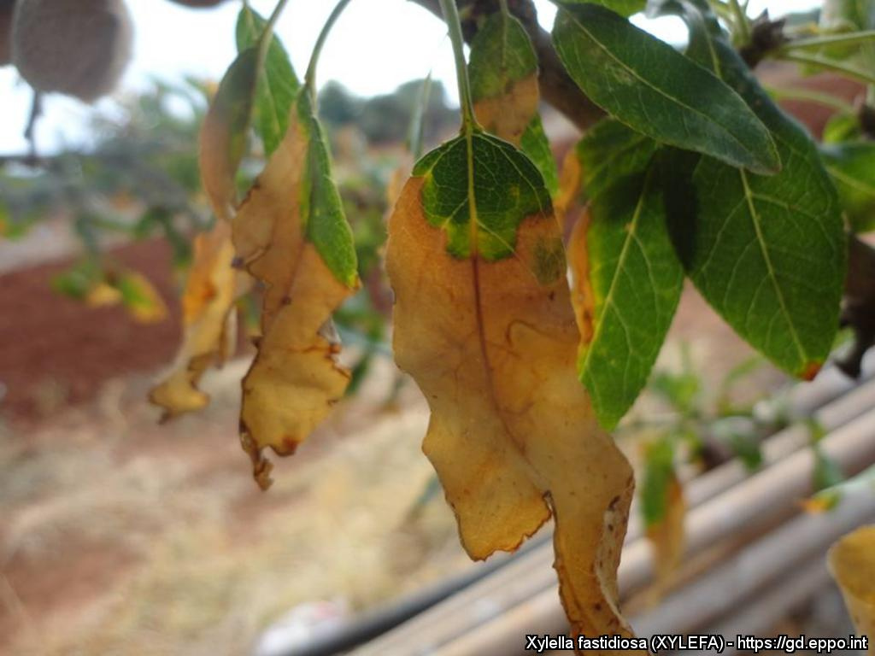
Phytosanitary procedures
PM 3
EPPO Phytosanitary Procedures are intended to be used by NPPOs in their capacity as bodies responsible for the inspection and testing of plants and plant products moving in trade, or for the implementation of surveys against quarantine pests.
7

Slide 8
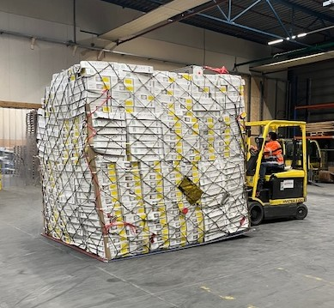
Active Panels
EPPO PM 3 Standards (generic)
PM 3/72 (2): Elements common to inspection of places of production, area-wide surveillance, inspection of consignments and lot identification
PM 3/XX (1) General guidelines for the export certification process for plants, plant products or other regulated articles
8

Slide 9
Active Panels
EPPO PM 3 Standards (specific)
Inspection of place of production
PM 3/76(2) Trees of Malus, Pyrus, Cydonia and Prunus spp. – inspection of places of production
PM 3/82(3) Inspection of places of production for Xylella fastidiosa
PM 3/83(1) Fragaria plants for planting – inspection of places of production
PM 3/95(1) Inspection of places of production – Citrus plants for planting
Inspection of consignment
PM 3/78(2) Consignment inspection of seed and grain of cereals
PM 3/79(1) Consignment inspection for Anoplophora chinensis and Anoplophora glabripennis
PM 3/80(2) Consignment inspection of seed of Solanum lycopersicum and its hybrids
PM 3/81(3) Inspection of consignments for Xylella fastidiosa
PM 3/98(1) Inspection of growing media associated with consignments of plants for planting
9

Slide 10
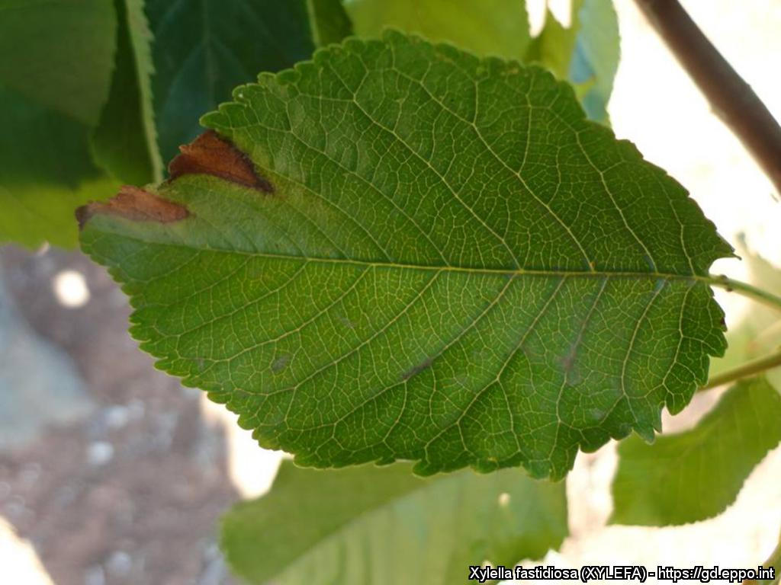
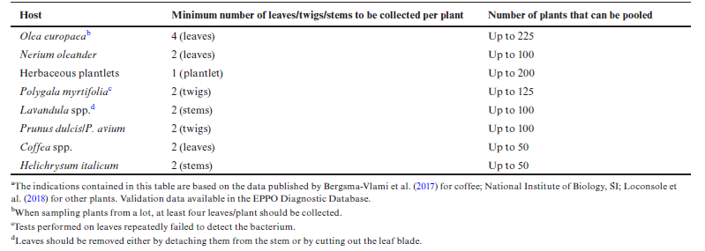
Active Panels
Inspection Standards (contents)
Includes:
Specific scope
Introduction
Phytosanitary inspections
Crop / Commodity concerned
Pests of concern for the EPPO region
Sampling for laboratory testing
Appendix 1: Specific procedures
Appendix 2: Short procedure for inspectors
10

Slide 11
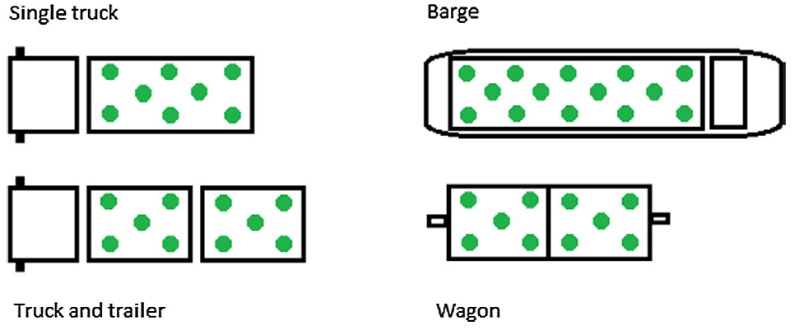
Active Panels
Inspection Standards (contents)
Phytosanitary inspections
What should be selected for inspection? Which parts?
When should inspections take place and under what conditions (e.g. light, weather)?
Where should inspections take place, including any inspections in the vicinity?
What symptoms might be seen?
How can inspections be targeted to maximise the probability of detection?
Guidance on risk-based sampling
Lot identification
Inspection units
Sampling
11

Slide 12
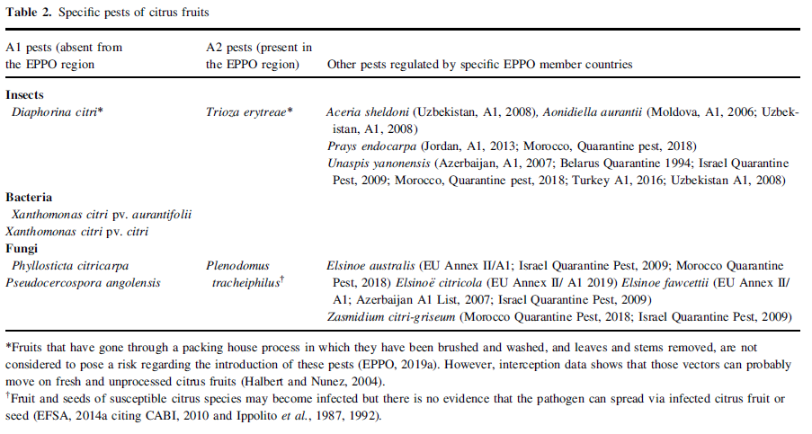
Active Panels
Inspection Standards (contents)
Pests of concern for the EPPO – regulated pests
Symptom description
Sampling
Identification
12

Slide 13
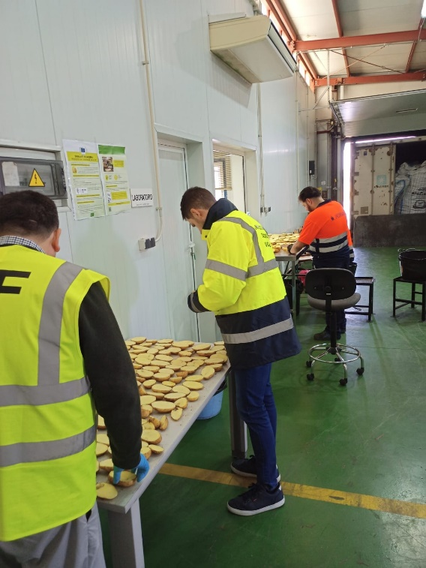
Active Panels
PM 3/70 (2) Compliance procedures for consignments of potato tubers at export and import
Describes compliance procedures for consignments of potato tubers (intended for planting, consumption, or processing) at export and import, in EPPO member countries.
Covers the risk associated with ‘regulated pests’, as defined by ISPM No. 5 Glossary of Phytosanitary terms.
13

Slide 14
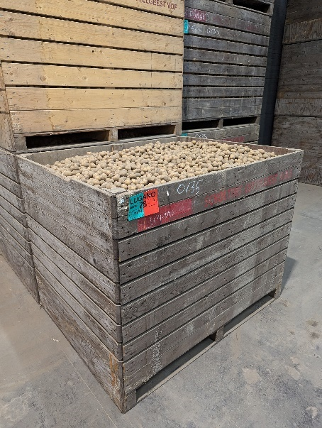
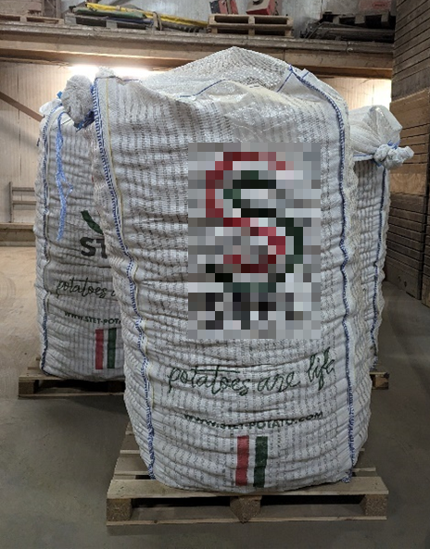
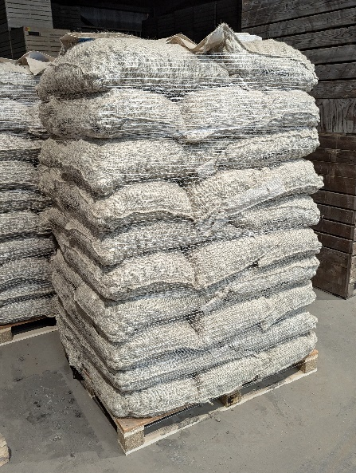
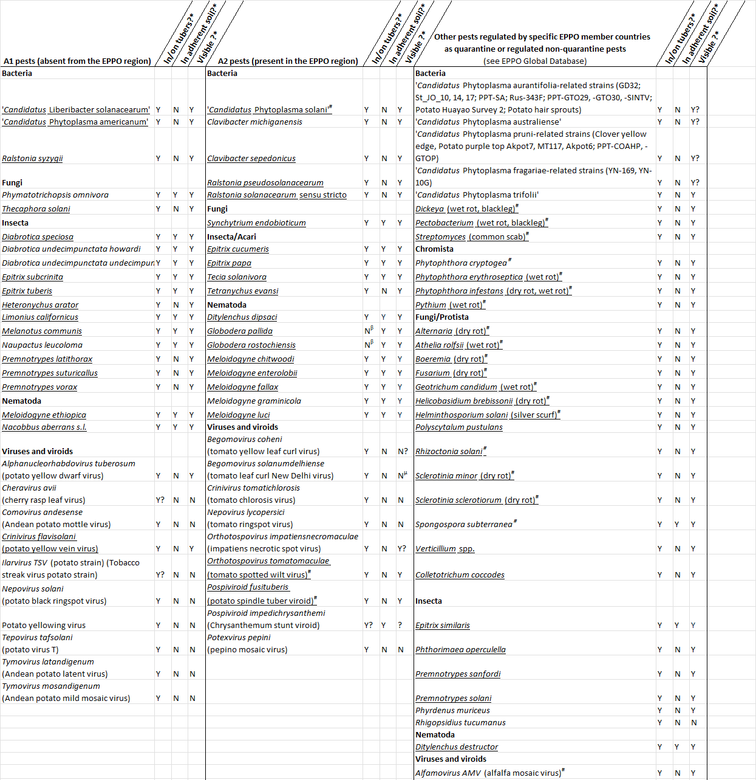
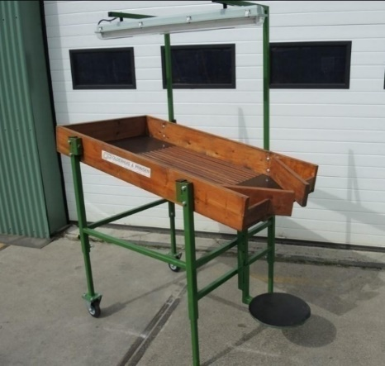
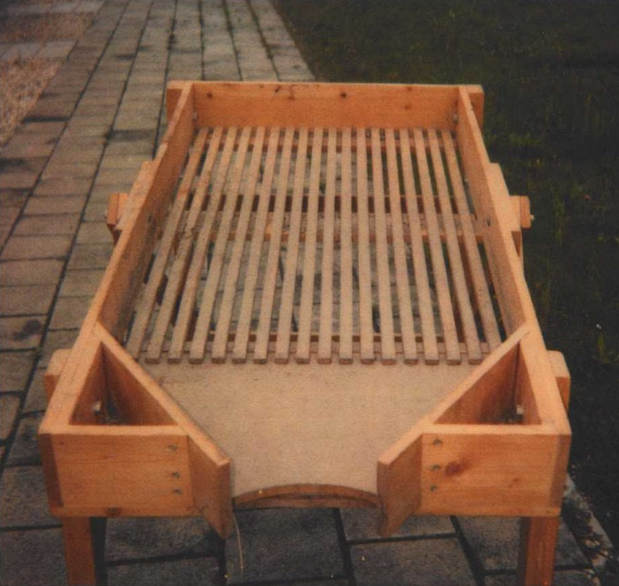
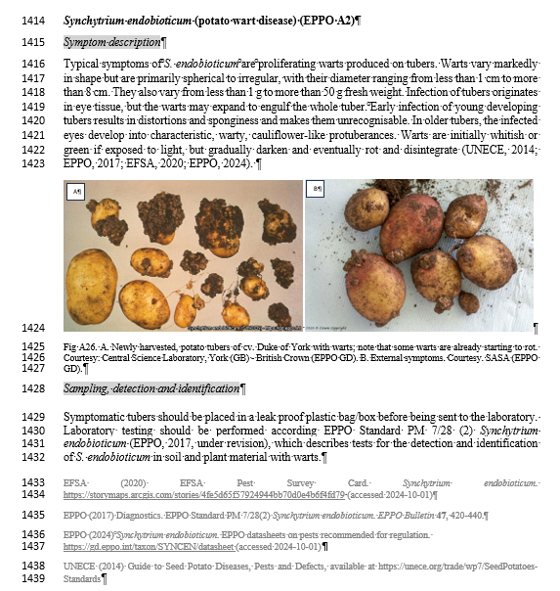
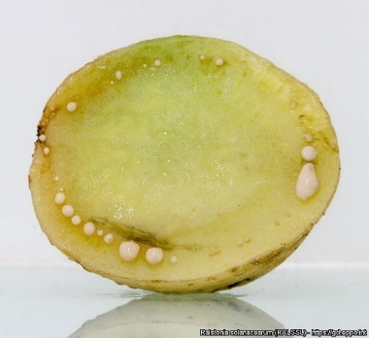
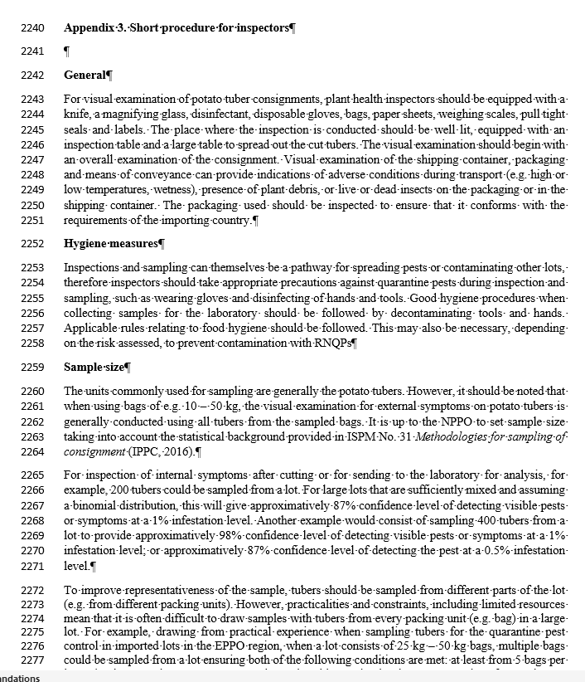
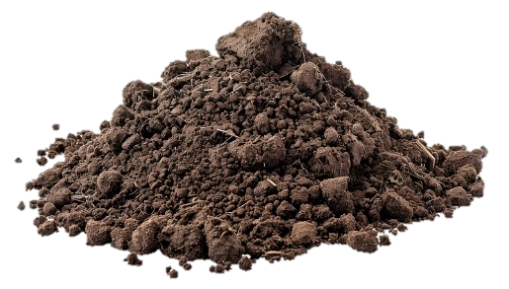
Active Panels
Content
Commodities concerned
Pests of potato tubers
Description of the phytosanitary systems for export/import
Inspection
Conditions incl. equipment, hygiene & other precautionary measures
Lot identification
Seed potatoes: Cultivar x Category x Class x Origin x Tuber size
Ware potatoes: Cultivar x Origin x Packing station
Sampling
Tuber sampling for visual examination
Tuber sampling for laboratory testing
Soil sampling
Inspection results: acceptance/rejection
List of pests relevant for inspection
> 300 pictures added to EPPO GD
Short procedure
for inspectors
> 50 inspection sheets on major potato pests
14

Slide 15
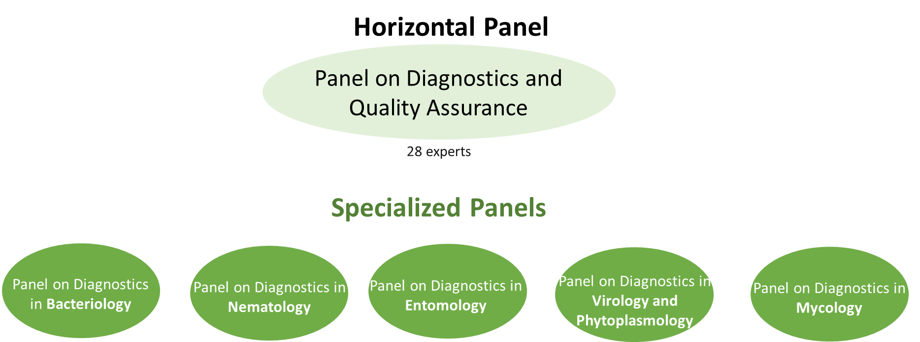
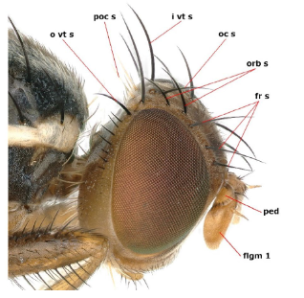
EPPO Diagnostic Protocols are intended to be used by NPPOs in their capacity as bodies responsible for the application of phytosanitary measures to detect and identify regulated pests.
Diagnostics
PM 7
15

Slide 16
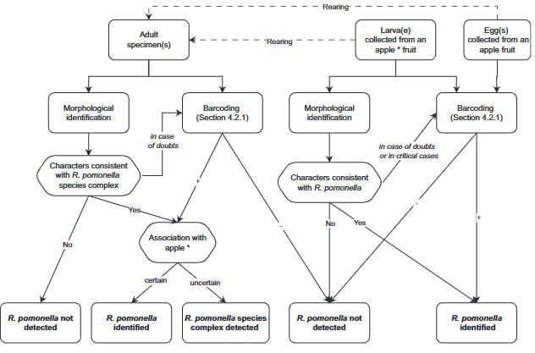
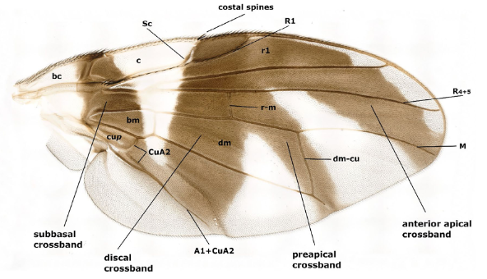
Active Panels
Diagonistic Standards
Pest specific: E.g. PM 7/1160 (1) Rhagoletis pomonella
Includes:
Detection
Trapping
Identification
Morphological – life stages
Molecular
Barcoding
PCR tests
Reference material
Reporting
Performance characteristics
Plus
PM7/129(2) DNA barcoding as an identification tool for a number of regulated pests
PM7/131(2) Guidelines on the main tasks of Reference Laboratories for official plant pest diagnostics
PM7/147(1) Guidelines for the production of biological reference material
PM7/151(1) Considerations for the use of high throughput sequencing in plant health diagnostics + addendum
16

Slide 17
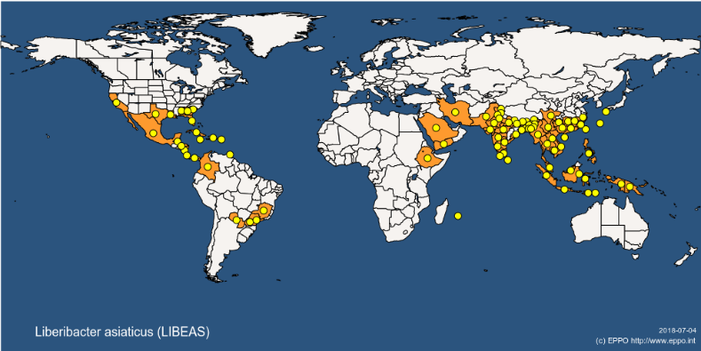
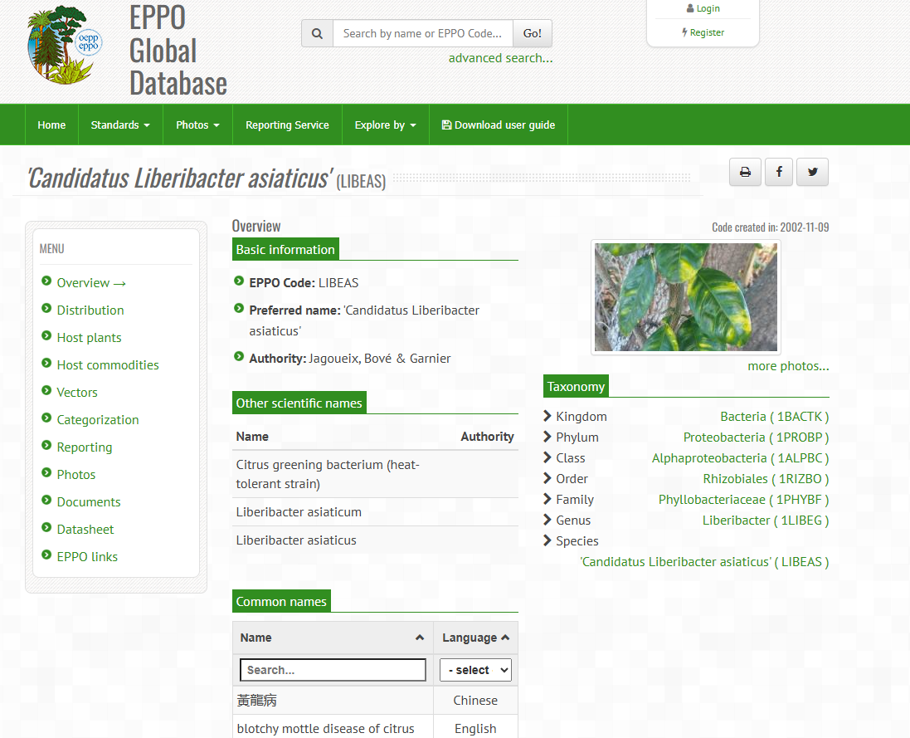
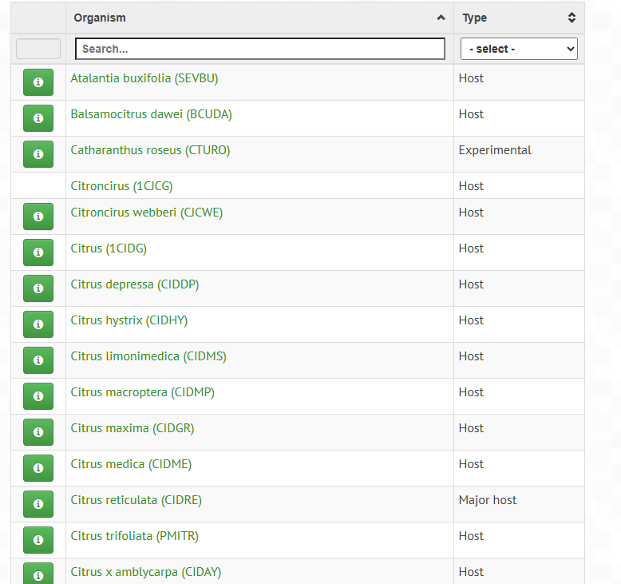
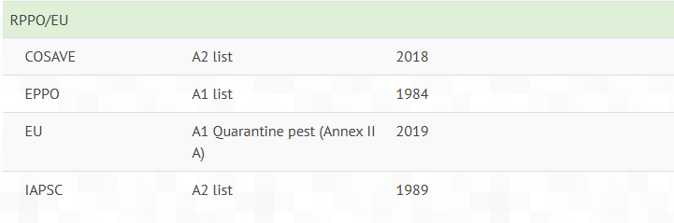
Information Exchange: Global Database
Data on distribution, hosts, categorization, associated documents, vectors and more
www.gd.eppo.int
17

Slide 18
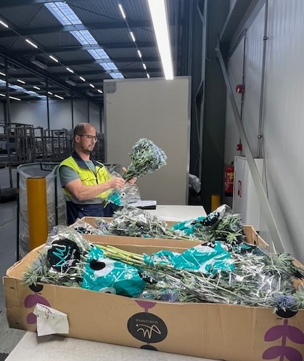
13th meeting of the Panel on Phytosanitary Inspection
Explore the potential use of Artificial intelligence in Plant Health inspections
Update PM 3/72 (2) Elements common to inspection of places of production, area-wide surveillance, inspection of consignments and lot identification
Update PM 3/73(1) Consignment inspection of Fragaria plants for planting
New: Draft inspection Standard: Consignment inspection of cut flowers
New: Consignment inspection of woody plants for planting
18

Slide 19

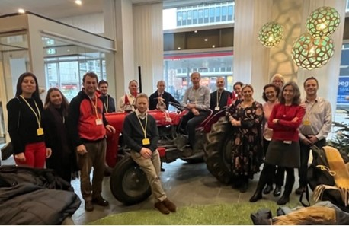




Thank you
linkedin.com/company/eppo-oepp/
bsky.app/profile/epponews.bsky.social
www.facebook.com/EPPOsecretariat/
t.me/eppo_news
tinyurl.com/eppo-whatsapp
19

