Slide 1

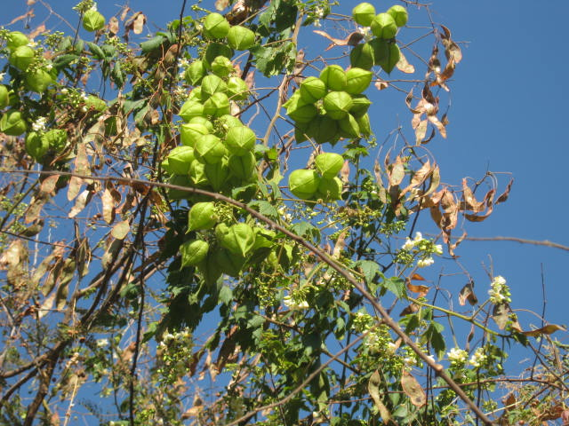
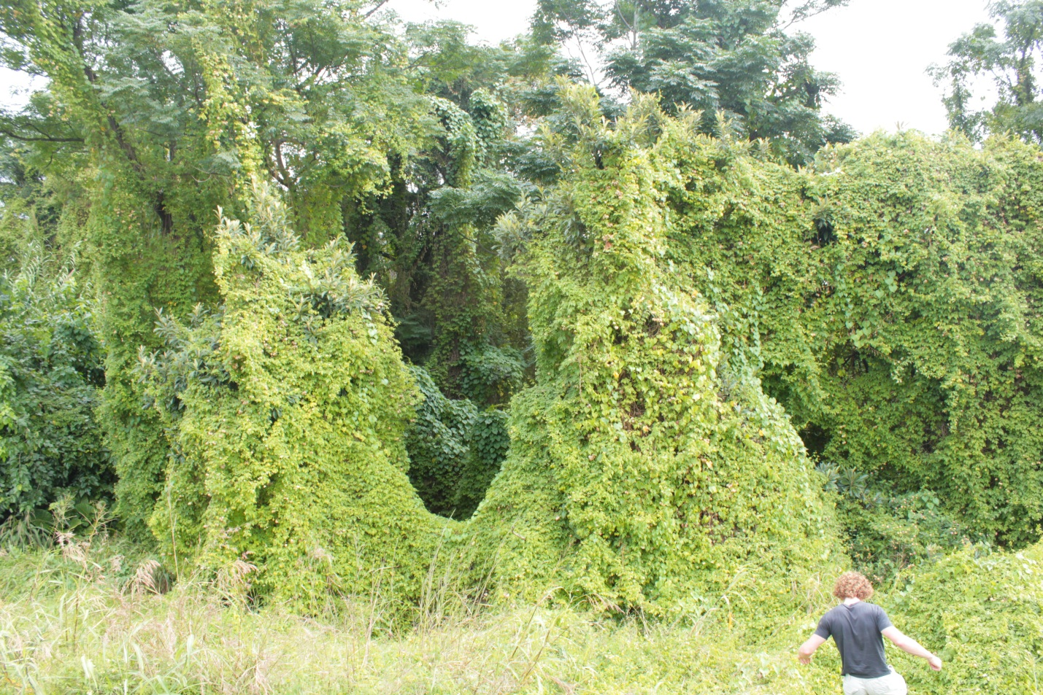
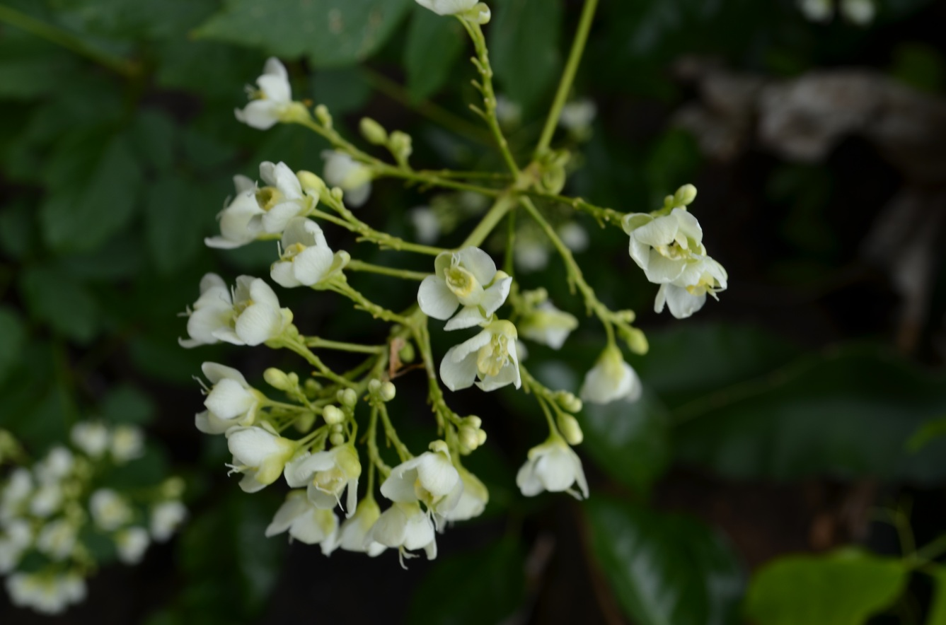



^{BE AWARE!}
^{Cardiospermum grandiflorum}
^{A threat to the EPPO region}
Image: J Le Roux (Department of Botany and Zoology, Stellenbosh University) EPPO Global database, https:\\gd.eppo.int
What is it?
Cardiospermum grandiflorum is a annual or perennial vine-like climber native to the Americas and is an EPPO A2 pest, recommended for regulation as a quarantine pest. In the EPPO region, C. grandiflorum is recorded from France (only in Landes and Alpes-Maritimes departments), Italy (mainland and the Island of Sicily), Malta, Portugal (only in Madeira Island), Spain (only in Canary Islands: Gran Canaria, Tenerife, La Gomera, La Palma). C. grandiflorum prefers open habitats though it may grow well in forest edges and thrives in well-drained soil types.
Plants for planting is considered the main pathway for entry into the EPPO region. In its invasive range,
C. grandiflorum typically forms dense draping carpets/mats, smothering large areas of underlying vegetation. In Malta, there is evidence of impacts on biodiversity as the species has formed extensive invasive populations. The invaded area in Malta may present unique micro-climatic conditions for the species due to it being a steep-sided dry valley.
What's the problem?
C. grandiflorum smothering native vegetation in South Africa
C. grandiflorum
flowers
Image: J Le Roux (Department of Botany and Zoology, Stellenbosh University) EPPO Global database, https:\\gd.eppo.int
Image: J Le Roux (Department of Botany and Zoology, Stellenbosh University) EPPO Global database, https:\\gd.eppo.int
Contact us!
Your contact details, logos, links, QR codes …
Learn more about Cardiospermum grandiflorum: https://gd.eppo.int
This poster has been prepared within the LIFE funded project LIFE15 PRE FR 001

